Slide 1

CPS HR Board of Directors
Board Meeting Agenda
Friday, June 7, 2024
9:30 AM PDT – Closed Session 10:45 AM PDT – Open Session
CPS HR Consulting
2450 Del Paso Road, Suite 220
Sacramento, CA 95834
t: 916.263.3600 f: 916.263.3613
www.cpshr.us

Slide 2
By request, alternate agenda and agenda document formats are available to persons with a
disability as required by Section 202 of the 1990 Americans with Disabilities Act.
To arrange an alternative agenda format or to arrange aid or services to accommodate persons with a disability to participate in a public meeting, contact the Executive Office at (916) 263-3600 extension 3379.
Any person not on this Agenda who wishes to address the Board of Directors must sign in with
the Board’s Executive Assistant. Any person requesting a disability-related modification or accommodation, including auxiliary aids, or services who require these aids or services in order to participate in the public meeting should contact Dana Henderson, Executive Assistant, CPS HR Consulting, 2450 Del Paso Road, Suite 220, Sacramento, CA, 95834, (916) 263-3600. Requests must be made at least 3 business days before the scheduled meeting.
CPS HR Consulting Board Meeting Teleconference Locations June 7, 2024
Closed Session 9:30AM PDT (12:30 PM EST) Open Session 10:45AM PDT (1:45 PM EST)
Click on the “Join Microsoft Teams Meeting” link in your meeting invitation or phone in to the toll-free number.
Locations:
CPS HR Consulting, 2450 Del Paso Road, Suite 220, Sacramento, CA 95834 Hayward Unified School District, HR Dept., 24411 Amador Street, Hayward, CA 94544 Mecklenburg County, 700 E. 4th Street, Charlotte, NC 28202
City of Plano, 1520 Avenue K, Plano, TX 75074
City of Anaheim, 201 S. Anaheim Blvd., Suite 501, Anaheim, CA 92805 City of Las Vegas, 495 S. Main Street, Las Vegas, NV 89101 Sacramento County, 700 H Street, Sacramento, CA 95814
Pinellas County, HR Dept., 400 S. Fort Harrison, Clearwater, FL 33756

Slide 3

The CPS Board Year
Revised June 2023
The following calendar outlines “routine” agenda items that are addressed throughout the year. Other items are added as required based on business/governance requirements.
Every Meeting
Minutes from previous meeting – for approval
Budget and Cash Flow Update – for information
Performance Dashboard – for information (variances only)
Investment Update – for information (as required by law)
Approve Class/Pay Plan (to meet CalPERS requirements)
Return to Board Funds Update – for information
Employee Recognition – for information (recognize the individual, and highlight the accomplishment)
Board Development/Emerging Trends (30-60 minutes)
  Organizational Showcase
  Current trends or client success stories
November
Review CPS HR cash minimum every two years. (Next review Nov. 2024) –For information
Annual Financial Audit Report – discussion/approval
Salary market survey results/class and pay plan implementation – discussion/approval
Meeting dates/locations for following year’s Board Meetings – for approval
Disclosure of reimbursement for special districts – for information (no report out)
Board Member Meeting Attendance Cost Summary – annual report – for information (no report out)
Board Development Activity (new in 2011)
March
Board Offsite Meeting for Strategic Planning and Board Integration Activities
Review By-Laws & Ground Rules annually (eff. 3/2012)
Review Board Orientation (Eff. 2016)
Review Return to Board Funds availability and amount for next FY (Friday agenda)
Senior Leader/Board Dialogue
Board report out of CEO-level interviews on business trends (eff. 3/2014)
June
Next Fiscal Year Budget and Strategic Plan – for approval
Election of Board Officers (every 2 years) – upcoming in 2024, 2026, etc. or as needed – for approval
Annual appointment of Board Development Committee, Executive Committee and Financial Audit Committee members – for approval
Investment Policy for Next FY – for approval
Delegation of Authority/Authority to Contract (approval) if needed
FY Strategic Plan and Accomplishments – for info and discussion (variances only)
Annual Diversity Report – for information (year to year performance)
Client Satisfaction Survey Data (for information)
Emergency Succession Plan – Review and update for approval by the Board every two years starting in 2018.
Executive Performance Plan Accomplishments – discussion/closed session
Executive Performance Plan for Next FY – discussion/acceptance/closed session
As Needed
Information on policy changes, internal operations, investments, special projects and Board subcommittee reports.
CEO Report – info and discussion on an as-needed basis.
Insurance/Benefits-for information at the beginning of each calendar year; sent out as separate report

Slide 4

CPS HR Board Committee Appointments
Board Executive Subcommittee (standing committee) July 1, 2022 – June 30, 2024
Fernando Yañez, Board Chair, Hayward USD
LaShon Ross, Board Vice Chair/Secretary, City of Plano
Joseph Hsieh, Member-At-Large, Sacramento County
Board Development Subcommittee (standing committee) July 1, 2022 – June 30, 2024
Vince Zamora, City of Las Vegas
Linda Andal, City of Anaheim
LaShon Ross, City of Plano
Board Financial Audit Subcommittee (ad-hoc committee) 2023 members:
Vince Zamora, City of Las Vegas
Vacant
Updated 2/2024

Slide 5
CPS HR Consulting – Agenda
Board of Directors Meeting
Friday, June 7, 2024 – 9:30 a.m. PDT (Closed Session)
10:45 a.m. PDT (Open Session)
CPS HR Consulting
2450 Del Paso Road, Suite 220
Sacramento, CA 95834
Action may be taken on any item on the Agenda
Board of Directors - Closed Session - 9:30 AM PDT
1. PUBLIC EMPLOYEE PERFORMANCE EVALUATION
Title: Chief Executive Officer
CONFERENCE WITH LABOR NEGOTIATOR (Government Code §54957.6)
Agency designated representative: Board Chair Unrepresented employee: Chief Executive Officer
Board of Directors Business Meeting – Open Session - 10:45 AM PDT Introduction of Board Members and Senior Staff
Report out from Closed Session
Oath of Office – Wade Childress, County of Pinellas, FL
I. Action Items
Approval of Minutes – March 8, 2024, Board meeting
Election of Board Officers and appointment of Board Committee Members
Approval of FY25 Budget & Strategic Plan (under separate cover)
Approval of Investment Policy for FY25
Approval of Class/Pay Plan (to meet CalPERS requirements)
Adoption of DBA
Action to modify Chief Executive Officer compensation and benefits
Attachment 1
Attachment 2
Attachment 3
Attachment 4
Attachment 5
Attachment 6
II. Information Only
FY24 Budget/Cash Flow Update
CPS HR FY24 Performance Dashboard
CPS HR FY24 Investment Update
Review FY24 Strategic Plan & Business Unit Accomplishments
Attachment 7
Attachment 8
Attachment 9
Attachment 10

Slide 6
CPS HR Consulting – Agenda
Board of Directors Meeting
Friday, June 7, 2024 – 9:30 a.m. PDT (Closed Session)
10:45 a.m. PDT (Open Session)
CPS HR Consulting
2450 Del Paso Road, Suite 220
Sacramento, CA 95834
Board of Directors Meeting Continued –
Informational Items Only (Con’t)
Annual Diversity Report
Review of Client Satisfaction Survey Data
Return to Board Funds Update
Employee Recognition
Attachment 11
Attachment 12
Attachment 13
Attachment 14
Public Comment on Matters Not on the Agenda

Slide 7

Attachment 1
Minutes of Board of Directors Meeting
March 8, 2024
The Board of Directors of CPS HR Consulting met on Friday, March 8, 2024, at the CPS HR Consulting office located at 2450 Del Paso Rd, Suite 220, Sacramento, CA, 95834 in the Grand Canyon Conference Room.
Board members attending:
LaShon Ross, City of Plano (Vice Chair) Vince Zamora, City of Las Vegas Joseph Hsieh, County of Sacramento Linda Andal, City of Anaheim
Maria Ciro, County of Pinellas
Joanne Freeman, County of Mecklenburg Carla Romine, City of Plano, Alternate
Staff attending: Jerry Greenwell, CEO | Dana Henderson | Melissa Asher
Jeff Hoye | Greg Roberson | Sandy MacDonald-Hopp
Jaclyn Padilla Vicki Quintero Brashear | Geralyn Gorshing | Kevin Nicholson
Staff attending online: Kaelyn Gasper | Stacey Heckler | Jan Nishikawa
Abby Ackers | David Prieto | Dimple Patel
Kristin Holden | Michelle Long | Kinsey Mitchell
Karina Mendez | Manpreet Kaur | Kimberly Sumagit
Tiffany Bose | Karen Evans | Pranita Chand
Dave Rechs | Edward Sisson | Kale Brinley
Jennifer Houston | Fatima Nukic | Eliza De La Cruz
Christina Peacock | Roxana Durbin | Cerri Mansfield
Lynne Harris | Ome Enebeli | Michelle Garbato
Heather Moore | Lisa Conner | Ana Costa
Ashley Jacobs | Ellen Fishel | Megan Misasi-Randles
Alan Tomassetti | Ashley Poritz | Suzanne Ansari
Walter Johnson | Amy Bigone | Deanna Heyn
Holly Hatada | Chelle Ramon | Chase Sivret
Board Members not attending:
Fernando Yañez, Hayward Unified School District (Chair) Peggy Rowe, County of Pinellas
Sue Brown, City of Las Vegas
Attachment 1– Page 1

Slide 8
Attachment 1
Open Session for Board Meeting
LaShon Ross, Vice Chair, called the meeting to order at 9:30AM PST and welcomed all attendees. All board members and staff in attendance in-person introduced themselves.
Action Items
Attachment #1 – Approval of Board of Directors Meeting Minutes
The minutes from the November 3, 2023, Board Meeting were presented for approval. There were no comments or changes to the minutes.
The Board of Directors of CPS HR Consulting approved the November 3, 2023, Board Meeting Minutes.
Motion: | Zamora, City of Las Vegas
Second: | Andal, City of Anaheim
Vote:
 | Pinellas County | Aye
 | City of Las Vegas | Aye
 | City of Anaheim | Aye
 | City of Plano | Aye
 | Sacramento County | Aye
 | Mecklenburg County | Aye
 | Hayward USD | Absent
Attachment #2 – Approval of Board Development Committee Minutes
The minutes from the January 29, 2024, Board Development Committee Meeting were presented for approval. There were no comments or changes to the minutes.
The Board of Directors of CPS HR Consulting approved the January 29, 2024, Board Development Committee Meeting Minutes.
Motion: | Zamora, City of Las Vegas
Second: | Andal, City of Anaheim
Vote:
 | Pinellas County | Aye
 | City of Las Vegas | Aye
 | City of Anaheim | Aye
 | City of Plano | Aye
 | Sacramento County | Aye
 | Mecklenburg County | Aye
 | Hayward USD | Absent
Attachment #3 - Approval of the Class/Pay Plan
The Class and Pay Plan was presented for approval. There were no changes to the class and pay plan since the board approved it last in November 2023.

Slide 9
Attachment 1
The Board of Directors of CPS HR Consulting approved the Class and Pay Plan as presented in the March 8, 2024, board agenda.
Motion: Second: Vote:
Zamora, City of Las Vegas Andal, City of Anaheim
Pinellas County City of Las Vegas City of Anaheim City of Plano Sacramento County
Mecklenburg County Hayward USD
Aye Aye Aye Aye Aye Aye Absent
Resolution # 24-01
For Information only
Attachment #4 - FY24 Budget/Cash Flow Update
Sandy MacDonald-Hopp presented the FY24 Budget and Cash Flow update to the board. The total CPS revenue of $18.1 million for the fiscal year-to-date as of January 31, 2024, is $592k or 3.4% better than budget. This revenue represents a 6% decrease from year-to-date January 2023 in which CPS HR had $1.2 million more in revenue. The year-over-year revenue change reflects a mix of growth in class & comp, DEI, and talent marketing increased revenue offset by other service lines contracting. Year-to-date, Training, State, and Emerging Markets are all exceeding revenue budget.
Fiscal year-to-date through January 2024, direct expenses are underrunning budget by $342k and the mix generated gross profit margin of 40.5% versus budgeted 36.6% as a percent of revenue. Operating expenses are $16k or 0.2% under budget due to staffing vacancies. OMS indirect expense, a component of total operating expense, is $271k under budget. Average monthly operating expense is running $969k per month versus FY23’s $815k monthly average.
Year-to-date CPS has a net operating income of $567k, which is $950k better than the budgeted operating loss thru January 2024. The positive net income figure of $1.1 million equates to 37% of revenue and better than budgeted $87k net loss. Minimum cash reserve balance of $4M was established in November 2018 and as of January 31, 2024, the cash balance is $16.1M. Based on a seven-month Operating Expense average of $969k the $4M reserve would cover 123 days of operations.
LaShon asked if there is anything that differentiates CPS HR from other competition in the Test Rental market, and if we start working with an organization do they tend to stick with us or do they switch providers. Vicki Quintero-Brashear responded that she believes we have more of a variety of exams than our competitors, and there is a lot of competition in the area of police and fire exams. Jerry added it is hard to get agencies to switch providers unless something has gone wrong.
Melissa brought up the recruiting work that is starting for a state client in healthcare, and the analytics behind it. Melissa explained we are also doing a data comparison across job boards that we can share in the future once that data is collected. LaShon shared she is working on a class

Slide 10
Attachment 1
for the Texas City Managers Association next month, and she would like to get talking points around this to help spread the word about CPS HR.
Attachment #5 – Performance Dashboard
Geralyn Gorshing gave an update on the Performance Dashboard. Geralyn said we are on target to meet our goal of qualified leads with 511. Our overall Win Rate is at 66.6%, which is a little below our target of 70%. Geralyn explained Limited Comp are proposals that only go out to a few agencies, and we are at a 60% Win Rate for our Limited Comp. Our Sole Source Win Rate is at 97.4%. The Full & Open Win Rate is 24.1%. Geralyn explained we are being more selective about the Full and Open proposals we are going after. There are currently 278 proposals in play: 230 for FY24, 42 in FY23 and 6 in FY22.
Attachment #6 – Investment Update
Sandy reviewed the investment update. Our portfolio value as of January 31, 2024, is $8,418,784 (includes accrued interest of $96.8k) and an average maturity of 2.4 years. We have 38% of our investment dollars in CDs that are FDIC insured.
Attachment #7 – FY24/25 Return to Board Funding Update
This fund is provided to promote Human Resources within Board member organizations. Funds go toward improvement of management, culture, or HR function of the organization. Ideally, these funds support initiatives or training that might not otherwise be budgeted for.
Each Board member agency will have $5,000 to use in Return to Board Funds by March 1, 2025.
Having no other topics on the agenda to discuss, the board meeting was adjourned at 10:29AM PST.
Minutes prepared by: Dana Henderson
Minutes reviewed by: Jerry Greenwell
Respectfully Submitted:
Dated: 3/20/2024
Signed: LaShon Ross LaShon Ross, CPS HR Vice Chair City of Plano

Slide 11
Attachment 2
DATE: June 7, 2024
TO: CPS HR Consulting Board of Directors
FROM: Jerry Greenwell, CEO
PREPARED BY: Dana Henderson, Executive Assistant
SUBJECT:
Election of Board Officers and appointment of Board Committee Members
ACTION REQUESTED:
Information Item
_X_ Approval and/or Authorization
Policy Change or Adoption
Closed Session Item
RELATIONSHIP TO BUSINESS PLAN:
Board Governance is an important element to the overall success of CPS HR Consulting. Roles and responsibilities within the Board ensure the governance role is effectively carried out.
DISCUSSION:
Every two years, as part of the Annual Board Meeting in June, the Board makes decisions about who will serve as Board officers. The election of Board Officers is for a term serving from July 1, 2024, through June 30, 2026.
According to the CPS HR By-Laws, “Board officers shall be elected at the annual June Board meeting of the year in which the term of the prior officer ends. Election of officers requires that a quorum of the Board be present, and a majority of that quorum must vote for the new officer.” The By-Laws also state “The officers of the Board shall be a Chair and Vice Chair/Secretary.”
Another part of the Annual Board Meeting in June is the CPS HR Board makes decisions about who will serve on Board committees for the next fiscal year.
See the duties of the Chair, Vice Chair/Secretary and Board Committee responsibilities on page 3.
Committee Assignments
Two standing committees were formed in 2008: The Executive Committee and the Board Development Committee. The Finance Audit Subcommittee was formed as an Ad-Hoc Committee.
The Board Executive Committee is made up of the Board Chair, Board Vice-Chair and one Board Member-At-Large. Current members are Fernando Yañez, LaShon Ross, and Joseph Hsieh.
Attachment 2– Page 1

Slide 12
Attachment 2
Current Board Development Committee Members are Linda Andal, LaShon Ross and Vince Zamora and their term expires on June 30, 2024.
The Finance Audit Subcommittee is formed as an ad-hoc committee responsible each year for the CPS HR financial audit process and reporting of audit results. Vince Zamora was on the committee in 2023. Two Board members are needed to serve as the 2024 Finance Audit Committee.
RECOMMENDED ACTION:
Nominate and elect Board Officers for the following positions to serve:
Board Chair
Vice Chair/Secretary
Appoint Board Members to the following committees:
One Member-at-Large to serve on the Board Executive Committee
Three Board Members to serve on the Board Development Committee.
Two Board Members to serve as the Finance Audit Subcommittee for 2024. (This committee disbands after the 2024 audit is completed.)
FISCAL IMPACT:
None
Attachment 2– Page 2

Slide 13
Attachment 2
The duties of both the Chair and Vice Chair/Secretary as defined in the By-Laws are listed below:
6.02 Duties of the Chair. Subject to the direction and control of the Board, the Chair shall:
Preside at all meetings and assure the integrity of the Board’s procedures.
Create and maintain a spirit of unified purpose among the members of the Board.
Ensure that deliberation will be fair and open, but also efficient, timely and orderly.
Ensure that the Board works appropriately with the Chief Executive Officer and staff in exercising power effectively and ethically.
Represent the Board to outside parties.
Be a member of all standing and ad hoc committees, except the nominating committee.
Appoint all committees, except when such appointment is reserved to the Board of Directors.
Set the Board Agenda in collaboration with the Chief Executive Officer.
Authorize expenditures of $250,000-$500,000.
Provide a summary report to the full Board of any actions he/she has taken since the last Board meeting and any reports he/she has received from the Chief Executive Officer concerning the general overview of the affairs of the business of the agency.
6.03. Duties of the Vice Chair/Secretary. The Vice Chair/Secretary shall ensure that accurate minutes of the meetings of the Board of Directors are kept and distributed to the Directors in a timely and appropriate fashion. The Vice Chair/Secretary shall act in place of the Chair in the latter’s absence and shall also perform such other duties as assigned by the Chair.
Board Executive Committee Responsibilities
The Executive Committee is tasked with managing the Emergency CEO Succession Plan.
Board Development Committee Responsibilities
Develop a recruitment plan, when needed, that takes into account the expertise, perspective, judgment, and resources needed in new board agencies and members.
Review potential board member agencies and candidates, and present nominees for the
Board’s approval.
Review the talents and interests of current and new members and recommend to the Chair committee assignments most appropriate for their involvement.
Recommend to the Board policies about expectations for members, reaching out to
those whose commitment does not match expectations.
Nominate members for officer positions.
Encourage participation in special occasions, which bond trustees to each other and to the organization.
Attachment 2– Page 3

Slide 14
Attachment 2
Report to the Board of Directors at regular meetings of the Board in a manner determined by the Board.
Assist in planning a one-day session of the 2-day annual March Board Meeting.
Revised 6.9.17
Finance Audit Committee Responsibilities
The Finance Audit Subcommittee is formed as an ad-hoc committee responsible each year for the CPS financial audit process and reporting of audit results.
Attachment 2– Page 4

Slide 15
Attachment 3
DATE: June 7, 2024
TO: CPS HR Consulting Board of Directors
FROM: Jerry Greenwell, CEO
PREPARED BY: Jerry Greenwell, CEO and Sandy MacDonald-Hopp, CFO
SUBJECT:
Fiscal Year 2024-2025 Strategic Plan & FY25 Budget (under separate cover)
ACTION REQUESTED:
Information Item
X Approval and/or Authorization
Policy Change or Adoption
Closed Session Item
RELATIONSHIP TO BUSINESS PLAN:
The proposed FY2024-2025 Strategic Plan and FY25 Budget documents outline the direction for our organization in the coming year. As in previous years the information is now presented in a one-page document that outlines the upcoming efforts to support our guiding values and our strategic objectives for FY2025.
DISCUSSION:
The budget process was an iterative process led by the Chief Financial Officer and occurring in the same time frame as our strategic planning process led by the Chief Executive Officer. Both processes engaged the entire Senior Leadership team along with unit/team leadership and staff as appropriate. The strategic plan and budget provide business units, and the organization, specific parameters to work toward and to be held accountable for in the next year. The strategic plan and budget assumptions are outlined in the document under separate cover.
FY25 Initiatives
The strategic plan for the upcoming year will continue to build upon our guiding values: Care for our Customers, Care for the Organization, and Care for Each Other. We have seen a surge in project work and have expectations that it will continue into the upcoming fiscal year.
The initiatives for FY2025 that emerged from our strategic planning process continue to be aligned under the following:
Care for the Customer
Develop and deliver quality products and services.
Care for the Organization
Achieve key financial and operational metrics.
Care for Each Other
Create an organization with a high level of employee engagement.

Slide 16
Attachment 3
There are seven distinct goals outlined with the associated tactics to achieve success. As we develop the key strategic initiatives for the next fiscal year, building better together to be nationally recognized for our expertise in public sector HR consulting.
FY2025 Budget
The budget as presented recognizes the challenge of aligning expenditures with revenues from short-term contracts and clients whose budgets are limited. Steady business with some growth means FY2025 revenue will be 3% more than the FY2024 actual revenue and are reluctant to budget 100% of the anticipated revenue from a variety of sources in the coming year and believe the conservative approach has served us well. We are confident in our projections based on focused and disciplined sales and business development efforts, and an understanding of current economic trends and market analysis. Our stretch goals are reflected in our aggressive business development efforts. We budgeted for increased expenses to incorporate some technological enhancements to current product offerings, and reinvestment funds for increasing staff capacity and capability through development opportunities. Given these factors, we believe we can achieve better than a break-even budget for FY2025 considering our reinvestment funding. We believe this is a realistic budget projection based on historical trends and an analysis of market potential.
In the FY24-25 Strategic Plan and Budget document, the documents are organized to present:
Overall organizational context
FY24-25 Strategic Direction and FY25 Initiatives
FY2025 Budget
RECOMMENDATIONS:
The CPS HR Board of Directors approves the Strategic Plan Initiatives for FY2025 as presented in the FY 2024-25 Strategic Plan and Budget packet under separate cover.
The CPS HR Board of Directors approves the Budget for FY2025 as presented in the FY 2024-25 Strategic Plan and Budget packet under separate cover.

Slide 17
Attachment 4
DATE:
June 7, 2024
TO:
CPS HR Consulting Board of Directors
FROM:
Jerry Greenwell, CEO
PREPARED BY:
Sandy MacDonald-Hopp, CFO
SUBJECT:
Investment Policy for Fiscal Year 2025
ACTION REQUESTED:
Information Item
X Approval and/or Authorization
Policy Change or Adoption
Closed Session Item
RELATIONSHIP TO BUSINESS PLAN:
The Investment Policy maximizes interest income while minimizing risk, thereby helping to ensure the financial success of CPS HR.
DISCUSSION:
The board approves this policy annually, often with no changes. For FY2025, there are no changes.
The current policy allows us sufficient discretion to shorten the portfolio’s maturity as required by liquidity needs.
RECOMMENDED ACTION: Approval of the investment policy for Fiscal Year 2025.
FISCAL IMPACT: None

Slide 18
Attachment 4
CPS HR Consulting Investment Policy June 30, 2013
I.
SCOPE: It is intended that this policy cover all funds and investment activities under the direct authority of Cooperative Personnel Services (CPS).
II.
OBJECTIVES:
A.
Safety: It is the primary responsibility of the Treasurer of CPS to protect, preserve, and maintain all cash and investments placed in his/her trust on behalf of CPS.
B.
Liquidity: An adequate amount of the investment portfolio is to be maintained in liquid, short-term securities that may be easily converted to cash, if necessary, to meet disbursement requirements.
C.
Yield: Yield should become a consideration only after the basic requirements of safety and liquidity have been met.
D.
Market Average Rate of Return: The investment portfolio shall be designed to attain a market-average rate of return throughout budgetary and economic cycles, taking into account the agency's risk constraints and other influencing factors.
E.
Diversification: The investment portfolio will be diversified to avoid incurring unreasonable and avoidable risks regarding specific security types or individual financial institutions.
F.
Prudence: CPS adheres to the guidance provided by the "prudent man rule," which obligates a fiduciary to ensure that:
"investment shall be made with the exercise of that degree of judgment and care, under circumstances then prevailing, which persons of prudence, discretion, and intelligence exercise in the management of their own affairs, not for speculation but for investment considering the probable safety of their capital as well as the probable income to be derived."
G.
Public Trust: All participants in the investment process shall act as custodians of the public trust. The investment portfolio is subject to public review and evaluation and shall be designed and managed with a degree of professionalism worthy of the public trust. While occasional losses are inevitable, they are to be considered within the context of the overall portfolio's rate of return providing the requirement of adequate diversification has been met.
III.
DELEGATION OF AUTHORITY: The CPS Joint Powers Agreement designates the Chief Financial Officer as the Treasurer/Auditor of CPS. It further states that the Treasurer/Auditor shall be responsible for prudent investment of funds and be responsible for the safekeeping of all CPS money. All investments under this investment policy shall be made in accordance with the Joint Powers Agreement and provisions of Article 1 (commencing with Section 6500), Chapter 5, Division 7, Title 1 of the Government Code.

Slide 19
Attachment 4
IV. REPORTING:
A.
Annually: covered.
Annual reports shall be submitted summarizing activity for the period
B.
Every Board Meeting: The Treasurer shall submit an investment report to the Board of Directors, encompassing all required elements of the report as prescribed by Government Code Section 53646:
Type of investment
Institution
Date of maturity
Deposit amount/cost
Current market value of long-term (12+ months) securities
Interest rate
Statement relating the report to the Investment Policy
Statement that there are sufficient funds to meet the next 30 days' obligations
Accrued interest
Earnings to date.
V.
INVESTMENT INSTRUMENTS: Authorized investment instruments may include:
Securities of the U.S. Government
Debt issued by U.S. Government Agencies or U.S. Government Sponsored Enterprises
Certificates of Deposit
Negotiable Certificates of Deposit
Banker's Acceptances
Commercial Paper
Sacramento County Pooled Investment Fund
LAIF
Cal/TRUST
Passbook Deposits
Mutual Funds
Corporate Bonds
Municipal Bonds
VI.
INTERNAL CONTROL: A system of internal control shall be established and designed to prevent losses of public funds arising from fraud, employee error, unanticipated changes in financial markets, or imprudent actions by employees and officers of the agency.
MATURITIES: Except for investments listed in section V.(a) and V.(b) above, the limitation on the term or remaining maturity at the time of investment for any debt security should be five years. Further, no investment stated in V.(a) and V.(b) should have a remaining maturity at the time of investment of greater than ten years. The total of investments with greater than five years remaining to maturity should be limited to not more than 50 percent of the portfolio."
VII.
VIII
BANKS AND SECURITIES DEALERS: The Treasurer shall consider the credit worthiness of financial institutions being selected for deposit or investment of funds and shall continue to monitor the credit and financial history of said institutions throughout the

Slide 20
Attachment 4
investment/deposit period. All bank deposits shall be secured with pledged securities in accordance with California Government Code Section 53651.
IX.
RISK/TOLERANCE: No individual investment transaction shall be undertaken which
jeopardizes the total capital position of the overall portfolio. The Treasurer shall periodically establish guidelines and strategies to control risks of default, market price changes, and illiquidity. Prudence in selection of securities and portfolio diversification is employed to minimize risk. Short-term securities selected for investment shall have credit ratings at or above A-1 by Standard & Poor’s, P-1 by Moody’s, and, if available, F1 by Fitch, with the exception of short-term municipal obligations, which shall be at or above a short-term rating of SP-1 by Standard & Poor’s, MIG1 by Moody’s, and, if available, F1 by Fitch. All long- term securities selected for investment shall have credit ratings at or above A- by Standard & Poor’s, A3 by Moody’s, and if available, A- by Fitch. Security selection shall be in compliance with California Government Code Section 53600, et seq.
X.
SAFEKEEPING AND CUSTODY: All securities owned by the agency should be held by a third party except time-deposits in banks and savings and loans.
XI.
STATEMENT OF INVESTMENT POLICY: The Statement of Investment Policy shall be reviewed and submitted annually to the Board of Directors.
AMENDED JUNE 2003, DECEMBER 2003, JUNE 2007, JUNE 2008, JUNE 2009, JUNE 2012, AND JUNE 2013

Slide 21
Attachment 5
DATE: June 7, 2024
TO: CPS HR Consulting Board of Directors
FROM: Jerry Greenwell, CEO PREPARED BY: Kale Brinley, Sr. HR Consultant SUBJECT: Approval of Class/Pay Plan ACTION REQUESTED:
Information Item
_X_ Approval and/or Authorization
Policy Change or Adoption
Closed Session Item
RELATIONSHIP TO BUSINESS PLAN:
Maintenance of competitive pay is critical to attracting and retaining a workforce that can deliver our products and services to meet the wide variety of our clients’ needs.
DISCUSSION:
The equity study was approved by the Board in March 2024. However, one classification change has been initiated. The Program Coordinator salary range was changed to align with the HR Consultant position which is the appropriate benchmark.
Effective January 1, 2024, California legislation raised the minimum salary for exempt positions to $66,560 annually. In response to this change, CPS HR has adjusted the minimum salary range of five impacted classifications, including:
Accounting Coordinator | Associate HR Consultant
Contracts Coordinator | Associate Bid and Proposal Coordinator
Associate Training Coordinator
In compliance with this change, CPS HR has outlined the following actions:
Minimum Salary Adjustment - Effective immediately, we have revised the minimum salary for the five impacted exempt positions to comply with the new California law. We have moved the minimum salary range to $66,560 and adjusted the midrange appropriate to the minimum and the maximum, and the maximum remains unchanged. Please see the attached Pay Scales. We have also updated our salary equity tool, to ensure compliance with this requirement and will apply uniformly across all relevant positions within the organization.
Communication Plan - Transparent communication is vital throughout this process. We have communicated with the impacted employees and confirmed salary adjustments to ensure compliance with state regulations and our dedication to fair and competitive compensation practices.

Slide 22
Attachment 5
Classification review – In the next fiscal year, as part of our strategic initiative, we plan to conduct a comprehensive review of all CPS HR’s classification concepts for alignment with industry standards and our organizational objectives. Followed by a market salary study completed by December 2025. This review will encompass benchmarking against comparable roles in the market to ensure our compensation remains competitive and equitable.
Ongoing Compliance Monitoring - Compliance with statutory requirements is an ongoing responsibility. We have established mechanisms for regular monitoring and review to ensure continued alignment with California labor laws and any subsequent legislative updates.
Implementation Timeline - The implementation of changes posed in action 1, and 2 above have been executed. While actions of item 3 will complete by December 2025, and implementation and monitoring will be ongoing. Upon Board approval, the revised salary structure will be in place allowing for seamless transition and minimal disruption to our operations.
By addressing these changes, we demonstrate our commitment to upholding legal standards while prioritizing the well-being and satisfaction of our employees.
RECOMMENDED ACTION:
Approve the Class and Pay Plan as shown in the CPS HR Board Agenda for June 7, 2024
FISCAL IMPACT:
Sufficient revenue exists to support this action.

Slide 23
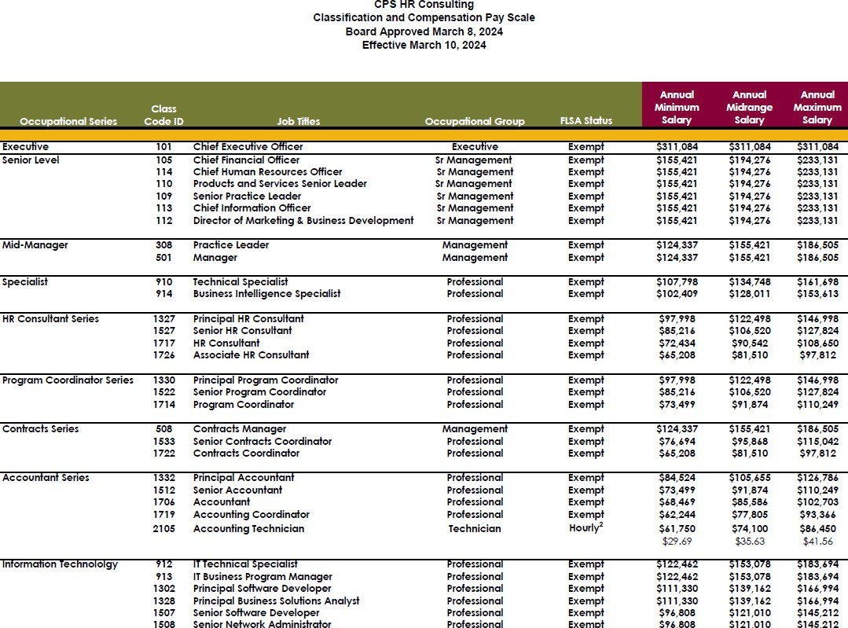
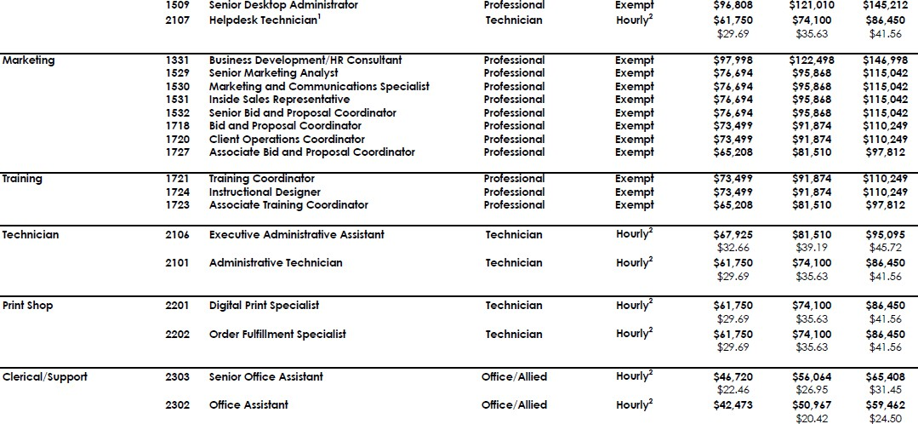
Attachment 5

Slide 24

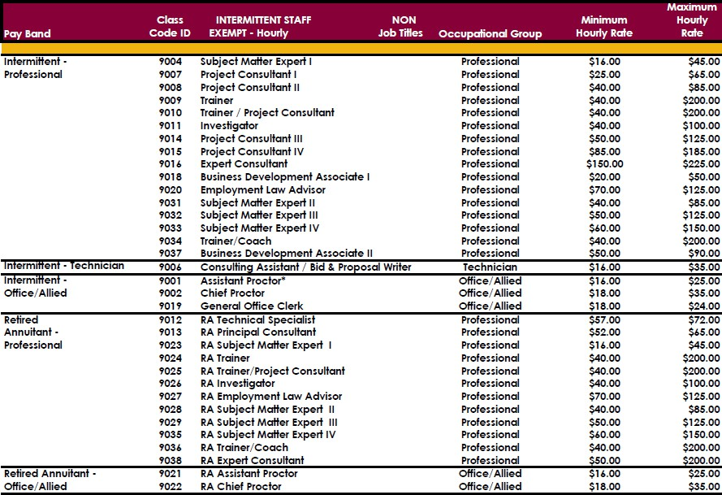
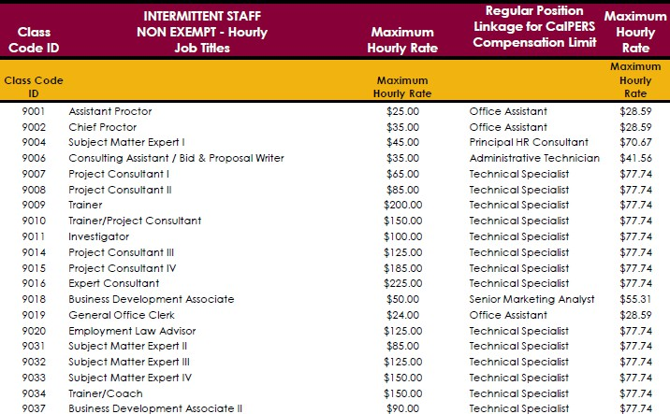
Attachment 5

Slide 25
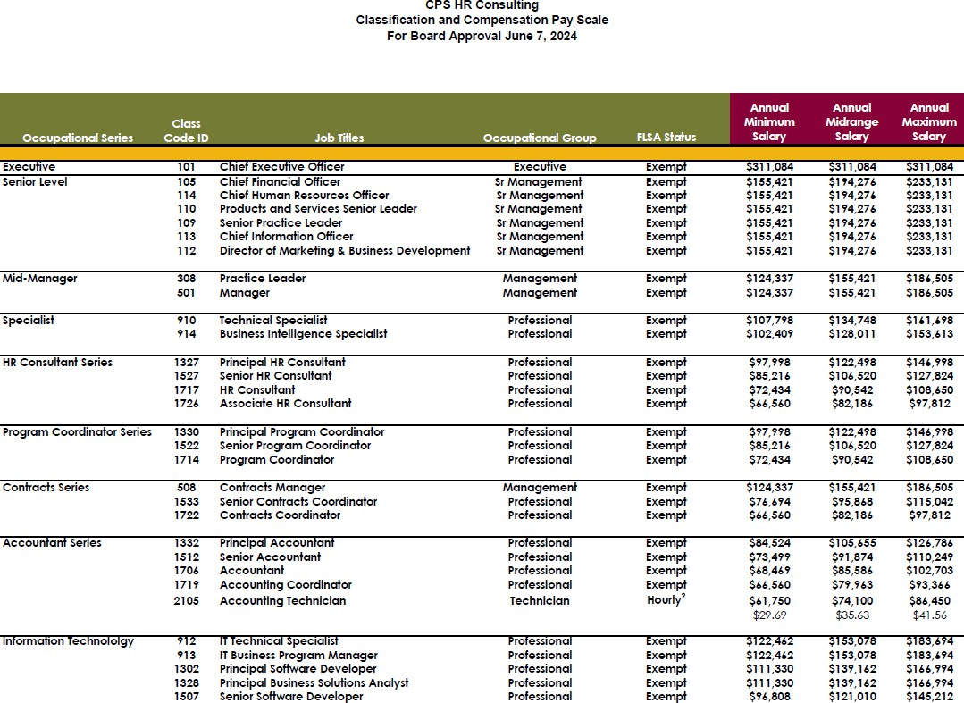
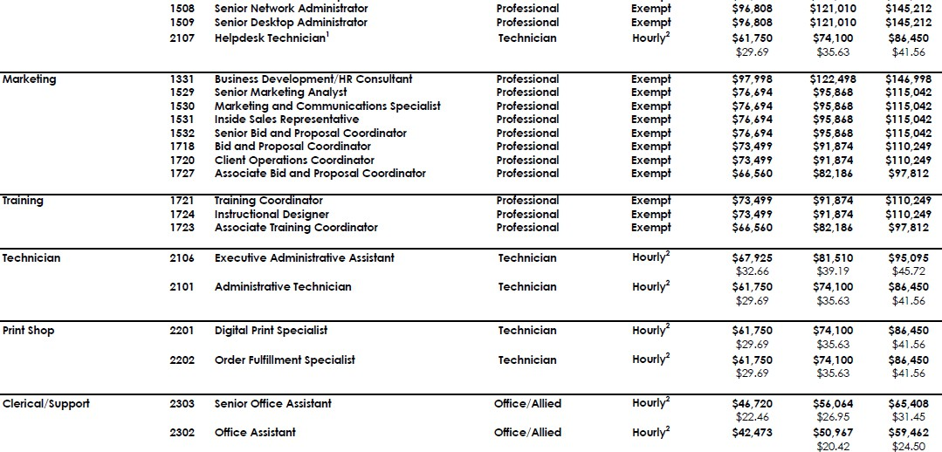
Attachment 5

Slide 26


Attachment 5

Slide 27
Attachment 6
DATE: June 7, 2024
TO: CPS HR Consulting Board of Directors
FROM: Jerry Greenwell, CEO PREPARED BY: Sandy MacDonald-Hopp, CFO SUBJECT: Adoption of DBA
ACTION REQUESTED:
Information Item
X Approval and/or Authorization
Policy Change or Adoption
Closed Session Item
DISCUSSION
Since 2011, Cooperative Personnel Services has been using “CPS HR Consulting” as a DBA and as part of its logo without any formal authorization by the Board of Directors. The staff has determined that there is no official process for Cooperative Personnel Services, a JPA, to apply for and register a DBA. The California Secretary of State does not accept DBA applications. The counties in which Cooperative Personnel Services operate do not have a process for DBA applications by JPAs. Notwithstanding the foregoing, given the long-standing usage and Cooperative Personnel Services’ plan to continue using “CPS HR Consulting” as a DBA, the Board of Directors should formally authorize the use of “CPS HR Consulting” as a DBA.
RECOMMENDATION:
It is recommended that the Board of Directors adopt this resolution “authorizing the use of “CPS HR Consulting” as a DBA of Cooperative Personnel Services.”
FISCAL IMPACT: None. The authorization simply affirms a long-standing practice of Cooperative Personnel Services.

Slide 28
Attachment 6
A RESOLUTION OF THE BOARD OF DIRECTORS OF COOPERATIVE PERSONNEL SERVICES AUTHORIZING THE USE OF “CPS HR CONSULTING” AS A DBA OF COOPERATIVE PERSONNEL SERVICES.
WHEREAS, Cooperative Personnel Services has used “CPS HR Consulting” as a DBA and part of its logo since 2011;
WHEREAS, the Board of Directors has determined that it is in the best interests of Cooperative Personnel Services to continue using “CPS HR Consulting” as a DBA and part of its logo;
NOW, THEREFORE, BE IT RESOLVED, that the Board of Directors of Cooperative Personnel Services hereby APPROVES the use of “CPS HR Consulting” as a DBA and as a logo.
Resolution #
Resolved by the Board of Directors of
CPS HR Consulting
At The June 7, 2024, Board Meeting
Motion: Second: Vote:
City of Anaheim Hayward USD City of Las Vegas
Mecklenburg County Pinellas County
City of Plano Sacramento County
Aye Aye Aye Aye Aye Aye Aye
Certified:
Dated: LaShon Ross, Vice Chair/Secretary
CPS HR Consulting Board of Directors

Slide 29
Attachment 7
DATE: June 7, 2024
TO: CPS HR Consulting Board of Directors
FROM: Jerry Greenwell, CEO PREPARED BY: Sandy MacDonald-Hopp, CFO
SUBJECT: FY2024 Budget and Cash Flow Update ACTION REQUESTED:
X Information Item
Approval and/or Authorization
Policy Change or Adoption
Closed Session Item
RELATIONSHIP TO BUSINESS PLAN:
The attached schedules depict unaudited financial performance for the month-ending April 30, 2024, in comparison to the budget. These schedules depict the organization in its’ component groups of State, Local, Emerging Markets, Client Services, and Operation Management Services.
DISCUSSION:
Revenue
The total CPS revenue of $26.1 million for the fiscal year-to-date as of April 30, 2024, is $103k or 0.4% better than budget. This revenue represents a 7% decrease from year-to-date April 2023 in which CPS HR had $1.8 million more in revenue. The year-over-year revenue change reflects mix of growth in class & comp, DEI, and talent marketing increased revenue offset by other service lines contracting. Year-to-date, Training, State, and Emerging Markets are all exceeding revenue budget.
Expense
Fiscal year-to-date through April 2024, direct expenses are underrunning budget by $464k and the mix generated gross profit margin of 38.9% versus budgeted 36.9% as a percent of revenue. Operating expenses are $213k or 2% over budget due to print shop and facilities allocation. OMS indirect expense, a component of total operating expense, is $214k under budget. Average monthly operating expense is running $1M per month versus FY23’s $815k monthly average. We anticipate spending a full $12.2 million FY24 op ex.
Net Operating Income/Loss and Cash Flow
Year-to-date CPS has net operating loss of $131k, which is $355k better than the budgeted operating loss thru April 2024. The positive net income figure of $541k equates to 2% of revenue and better than budgeted $62k net loss. The cash flow forecast for the next 12 months indicates some ups and downs in cash reserves with capital expenditures, ongoing disbursements, and timing of collections. Monthly variations in cashflow reflect changes in the timing of receipt of invoice payments and payments to vendors. Minimum cash reserve balance of $4M was established in November 2018 and as of April 30, 2024, cash balance is $14.4M. Based on a ten-month Operating Expense average of $1M the $4M reserve would cover 117 days of operations.
RECOMMENDATIONS: None, information only
FISCAL IMPACT: None, information only

Slide 30
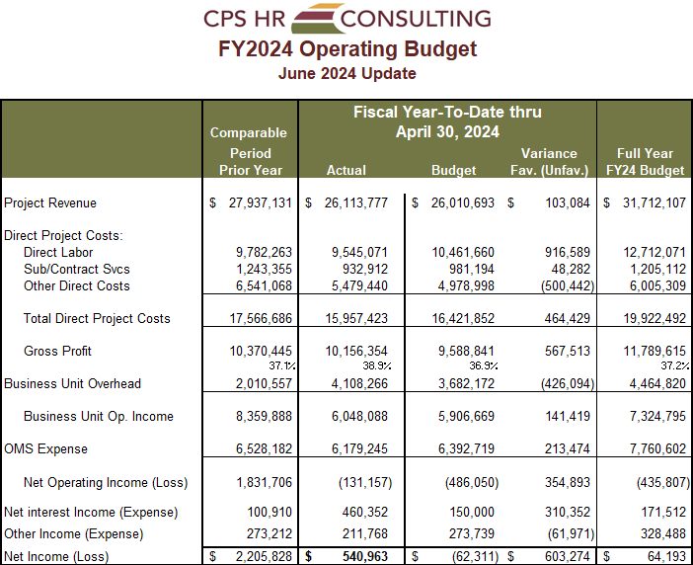
Attachment 7

Slide 31
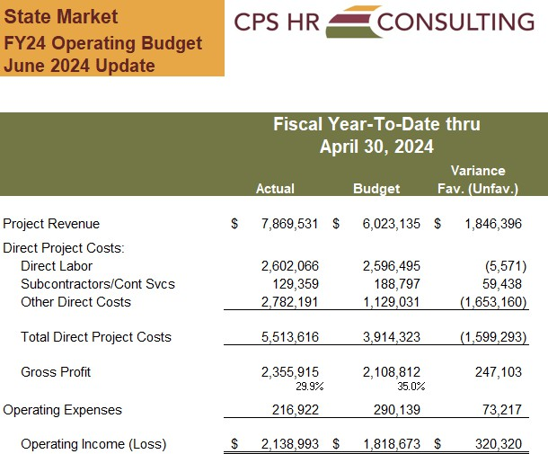
Attachment 7

Slide 32
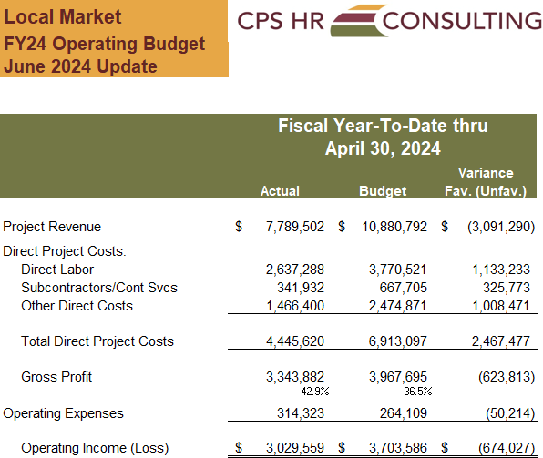
Attachment 7

Slide 33
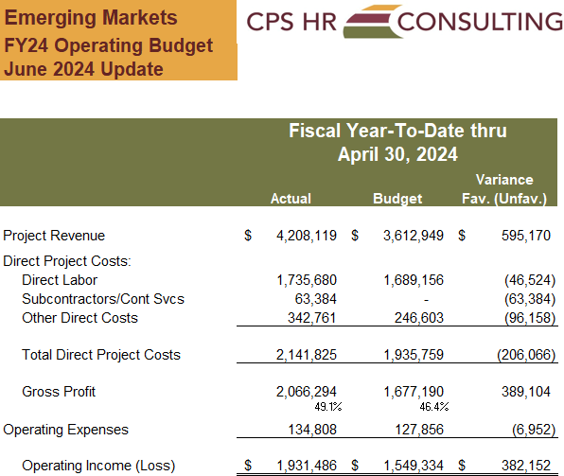
Attachment 7

Slide 34
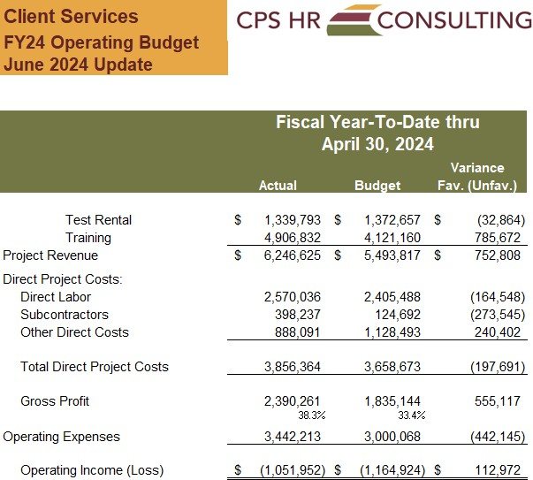
Attachment 7

Slide 35
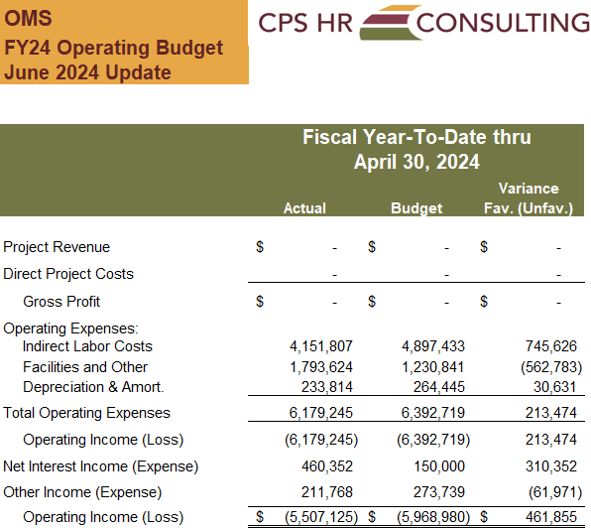
Attachment 7

Slide 36
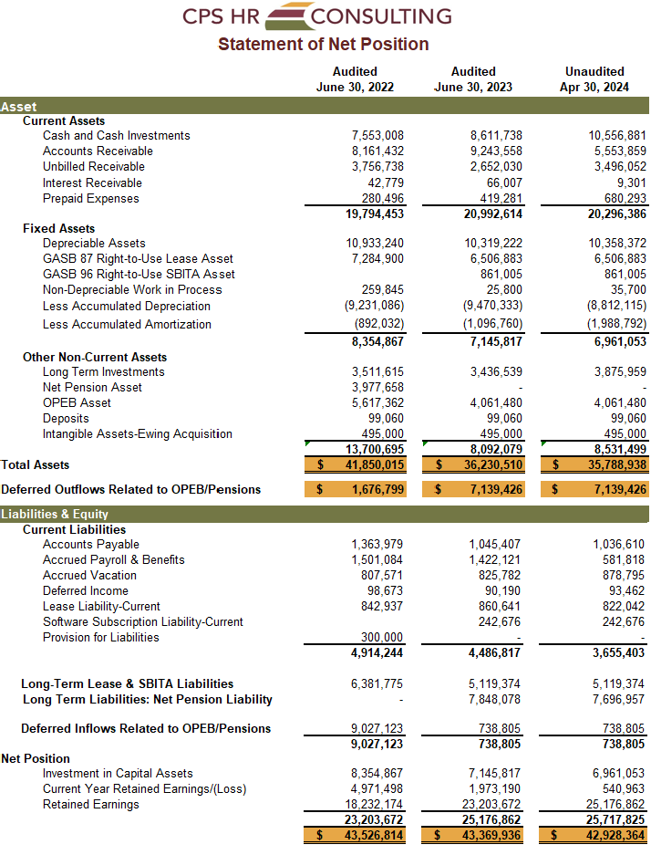
Attachment 7

Slide 37

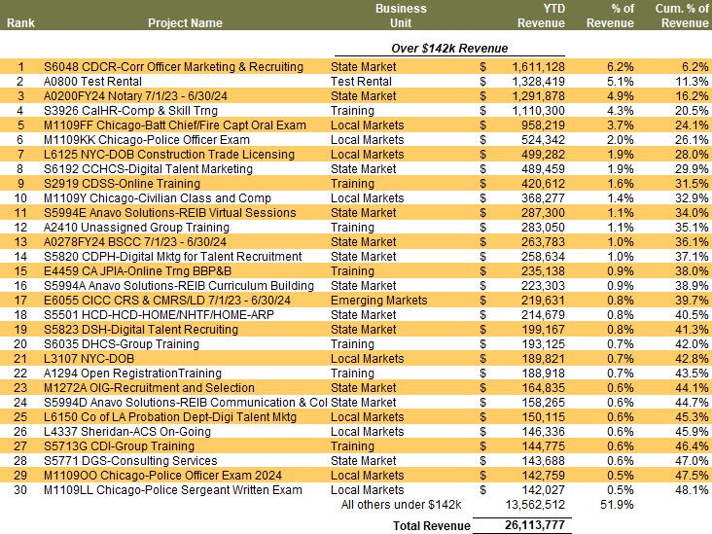
Attachment 7

Slide 38
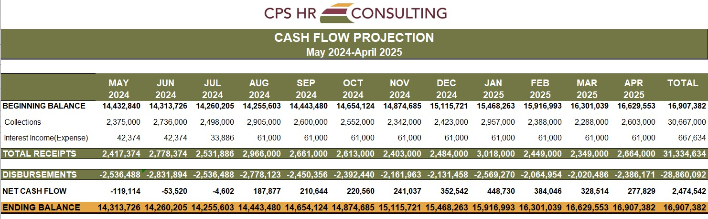
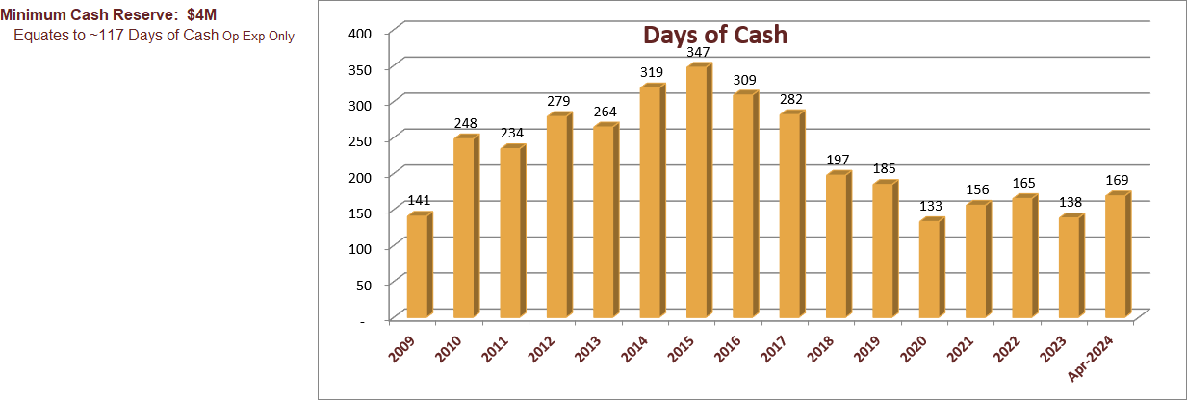
Attachment 7
Attachment 7– Page 10

Slide 39
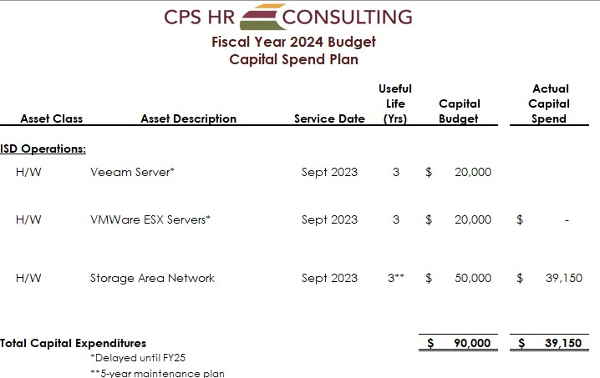
Attachment 7

Slide 40
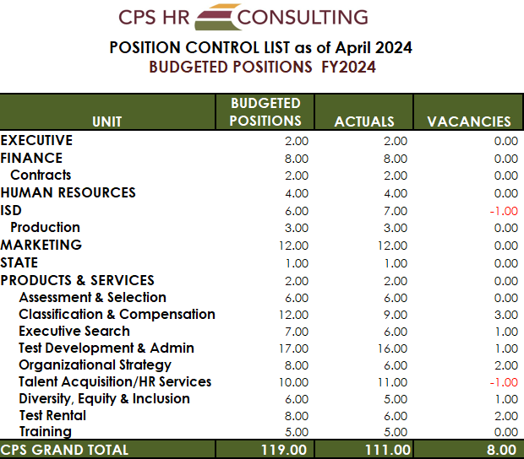
Attachment 7

Slide 41
Attachment 8
DATE: June 7, 2024
TO: CPS HR Consulting Board of Directors
FROM: Jerry Greenwell, CEO
PREPARED BY: Dana Henderson, Executive Assistant SUBJECT: CPS HR Performance Dashboard ACTION REQUESTED:
X_ Information Item
Approval and/or Authorization
Policy Change or Adoption
Closed Session Item
RELATIONSHIP TO BUSINESS PLAN:
At the request of the Board, the purpose of the Performance Dashboard is to provide the Board with a high-level overview of the performance of the organization at a glance. The Senior Team and staff monitor these indicators in order to assess organizational performance as tracked to goals.
DISCUSSION:
The performance indicators on the Performance Dashboard reflect the key elements that are monitored to assess organizational success at a high level.
RECOMMENDATIONS: None, for information only
FISCAL IMPACT: None
*Note - this is a dynamic file and reflects current data as of May 17, 2024

Slide 42
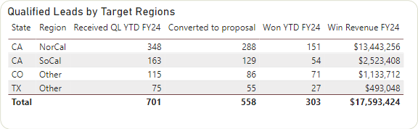
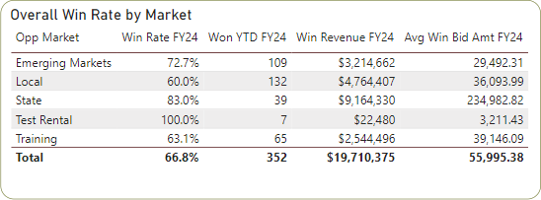
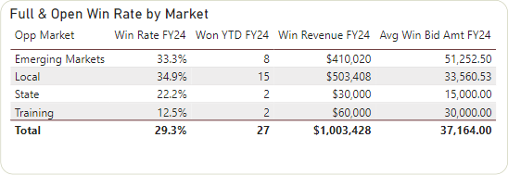
Attachment 8
CPS HR Performance Dashboard

Slide 43
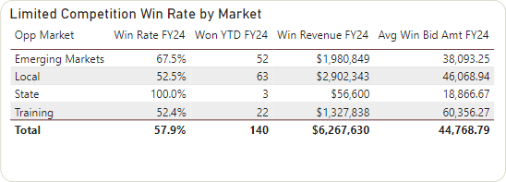
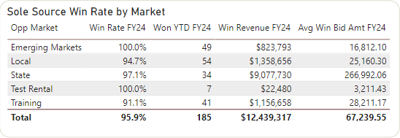
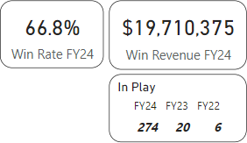
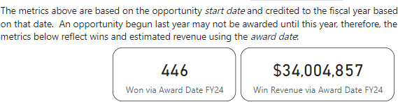
Attachment 8

Slide 44
Attachment 8
This page intentionally left blank.

Slide 45
Attachment 9
DATE:
June 7, 2024
TO:
CPS HR Consulting Board of Directors
FROM:
Jerry Greenwell, CEO
PREPARED BY:
Sandy MacDonald-Hopp, CFO
SUBJECT: Investment Update
ACTION REQUESTED:
X_ Information Item
Approval and/or Authorization
Policy Change or Adoption
Closed Session Item
RELATIONSHIP TO BUSINESS PLAN:
The CPS schedule of investments is presented for Board information and to comply with the reporting section of CPS’s Investment Policy. It is the intent of CPS to maximize investment earnings through longer-term investments while maintaining a balance of short-term investments to meet current obligations. All investments must conform to CPS’s investment policy. Current reserves are sufficient to meet the next 30 day’s obligations.
DISCUSSION:
As part of the Board’s role in providing financial oversight at each meeting, an updated investment portfolio is provided for informational purposes. At the request of the board, portfolio summary statistics are provided below, including the annualized investment total return on the long-term portfolio.
Portfolio Value as of April 30, 2024: $7,418,963 (includes accrued interest of $62.7k)
Average Maturity | 2.7 years
Average S&P Rating | A+; 32% investment dollars are CDs that are FDIC insured
Performance | 1 month | YTD | Since Inception
Period Total Return | -0.31% | 4.33% | 0.51%
Annualized Total Return | -3.39% | 7.85% | 0.66%
RECOMMENDATIONS: None, for information only.
FISCAL IMPACT: None, no expense will be incurred.

Slide 46
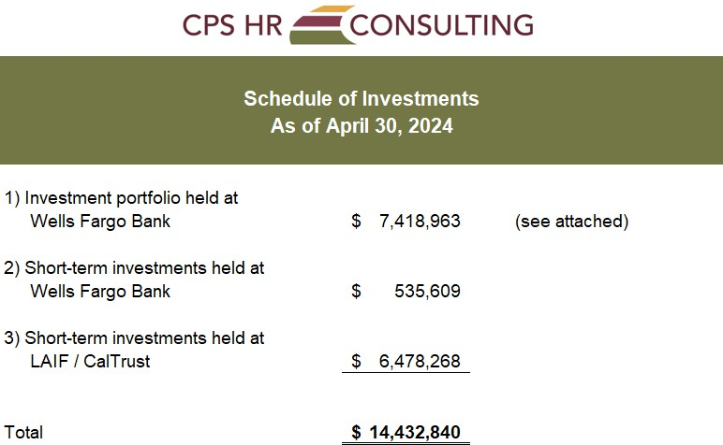
Attachment 9

Slide 47

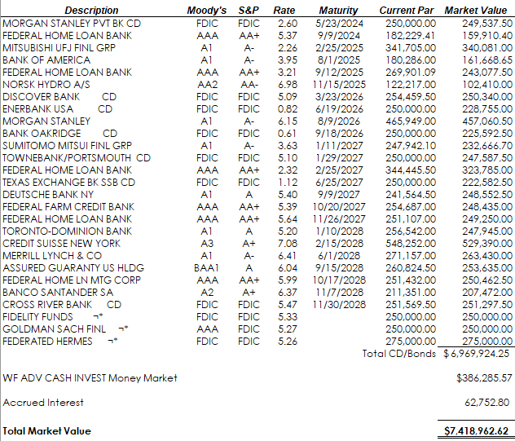
Attachment 9

Slide 48
Attachment 9
This page intentionally left blank

Slide 49
Attachment 10
DATE: June 7, 2024
TO: CPS HR Consulting Board of Directors
FROM: Jerry Greenwell, CEO
PREPARED BY: Jerry Greenwell, CEO and Dana Henderson, Executive Assistant SUBJECT: FY24 Strategic Plan Progress Update and FY24 Accomplishments
ACTION REQUESTED:
X Information Item
RELATIONSHIP TO BUSINESS PLAN:
Our FY24 strategic goals are aligned with the FY 2024 Strategic Direction as approved by the board in June 2023. The goals were designed to address our staffing capacity and infrastructure needs to continue the momentum from FY23. The plan has been built to ensure we achieve our mission and vision while adhering to our core organizational principles.
DISCUSSION:
We are closing out FY 2024 with this 4th quarter report. We have made sustained progress on our major initiatives. With project numbers exceeding 300 per month, we have begun adding billable resources and expanding our project/intermittent consultant workforce. We continue to balance the addition of new staff with prudent management of the finances. Internal work on our systems and processes continues, and in the HR area we have made significant progress. The 10-month financial reports reflect additional business but are accompanied by slight increases in expenses for many reasons. (labor cost, travel, inflation, etc.) Our focus on sole source and limited competition opportunities is paying dividends as our reliance on full and open RFPs has continued to decline. We are still optimistic about our business development (sales) pipeline and understand that going forward the need to staff up in key areas to meet the needs of our customers is essential. Our challenges with capacity to take on additional work will continue to be a balancing act into the new FY, but we are evaluating internal efforts to enable us to effectively manage the flow of projects to meet client expectations and to address efficiently onboarding additional resources.
The identified service areas we focused on in the planning process are all at or near budgeted revenue levels, and in some cases exceeding expectations. Recruitment efforts for clients at all levels have fluctuated, unbudgeted work for the City of Chicago, and a strong CA State market continue to bolster our finances and new client growth. We have sustained our momentum throughout the year but anticipate a modest end to the current year.
The FY24 Accomplishments outline the significant work done on behalf of clients and internal services groups. It clearly shows the positive impact we have as an organization and the comprehensive nature of our offerings.
RECOMMENDATIONS: None, for information only

Slide 50
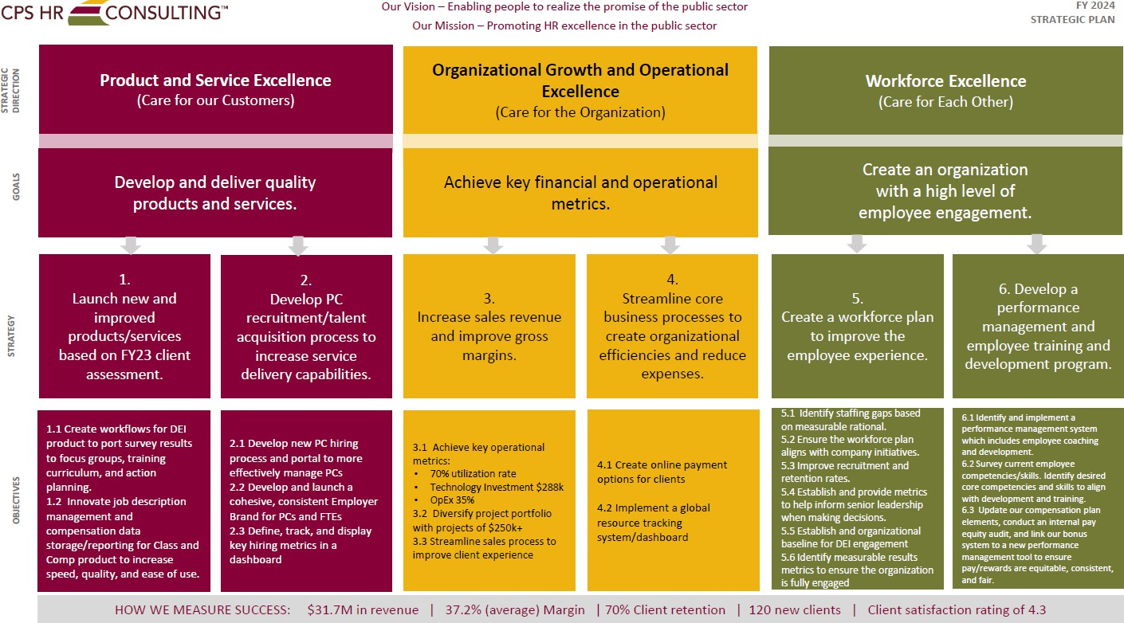
Attachment 10
Attachment 10- Page 2

Slide 51
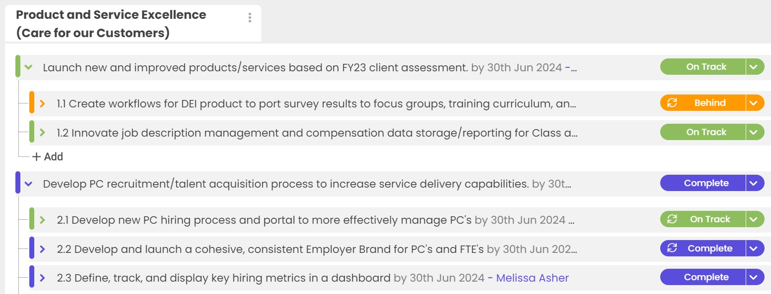
Attachment 10
Attachment 10- Page 3

Slide 52
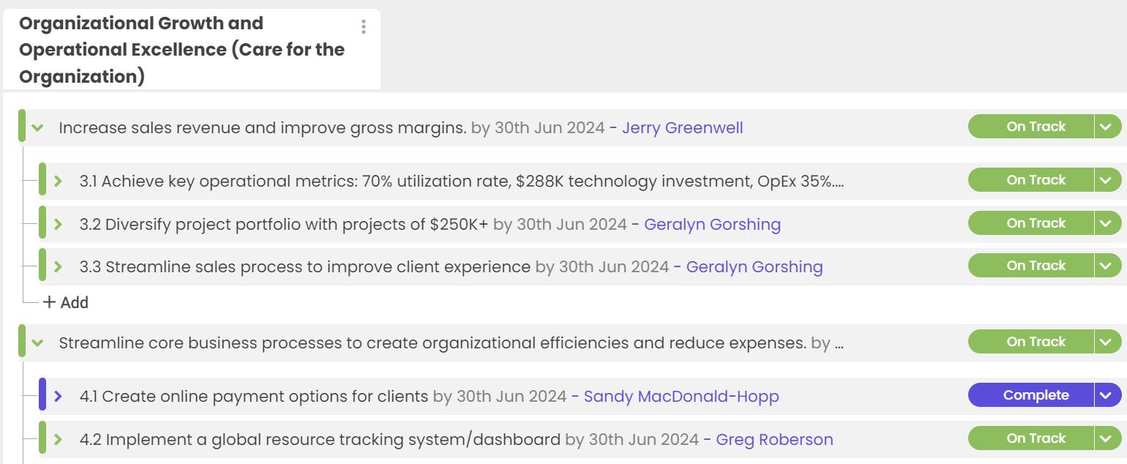
Attachment 10
Attachment 10- Page 4

Slide 53
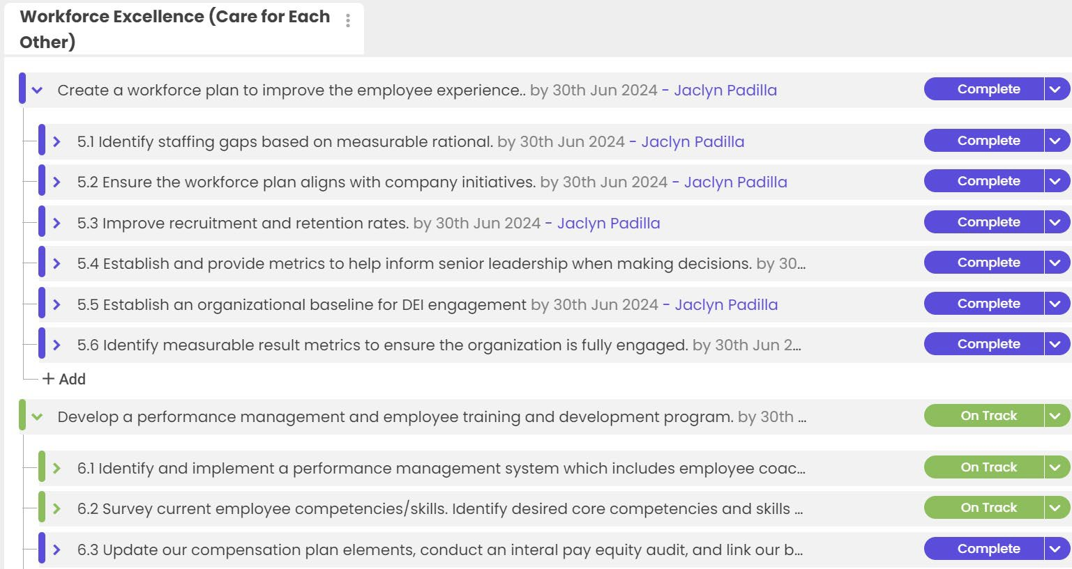
Attachment 10
Attachment 10- Page 5

Slide 54
Attachment 10
FY2024
Business Unit Accomplishments

Slide 55
Attachment 10
Talent Acquisition and HR Services (TAHRS)
Talent Acquisition and HR Services (TAHRS) remained strong in Fiscal Year 2024 providing a variety of HR Services including recruitment and selection, policy development, review and updates of employee handbooks or personnel rules, on-demand and interim HR consulting, small classification studies/base salary studies, and workplace investigations.
We have seen a change in the make-up of our projects. In FY23, we had a high number of recruitment and selection efforts (flat rate), whereas in FY24, we have seen an increase in ongoing HR consultation projects (time and materials) which has impacted our ability to meet our revenue goal to date. However, the amount of projects and scope of work has not decreased. In order to keep up with the demand, we continued to maintain a strong, diverse group of Project Consultants (approximately 12).
Key Client Projects:
FEDERAL – Recruitment and Selection, Compliance, Assessment of HR Function
U.S. House of Representatives, Office of Legislative Council (4th Renewal)
Our project team was retained for a 4th consecutive year by HOLC to assist with continued efforts to streamline their annual recruitment and selection process for Attorneys and Summer Associates. However, this year’s contract included a separate scope to create a job description for a designated HR person for their office which resulted in the development of the Principal Recruitment and Retention Specialist. Our team then ran the recruitment in an expedited time frame resulting in a selected candidate accepting the offer. The candidate is slated to start the new role on 5/13/24 and CPS HR will train up and collaborate with the candidate on HOLC’s annual recruitment for Attorneys and Summer Associates.
COUNTY – Multiple Recruitment and Selection Efforts
County of Solano, CA
CPS HR entered into an initial contract agreement with the County’s IT Department to handle five (5) consecutive IT recruitments some of which fell under the County’s civil service rules and required our team to use the County’s applicant tracking system. Our project team successfully collaborated with County HR and the IT hiring managers to understand the civil service rules, recruitment process, and client applicant tracking system. The County was pleased with the outcome and has since entered into two additional contracts of 5 recruitments each for a total of 15 recruitments to date.
COUNTY – Multiple Small Classification and Base Pay Studies
County of Sonoma, CA
The project team continues to work on various small classification and/or base pay compensation studies for the County of Sonoma. The outcome of this work ensures positions are appropriately classified/allocated, built upon a sound classification structure, and align with the County’s compensation philosophy in consideration of internal equity. The County made the decision to outsource this scope of work resulting in a $1.5 million contract split up into $500,000 for the next 3 fiscal years.
SPECIAL DISTRICT – Ongoing HR Consultation
Fort Bend Water Control and Improvement District No. 2, TX
  CPS HR contracted with Fort Bend Water Control and Improvement District No. 2 in Texas to provide ongoing human resource consultation for up to 12 hours per week.

Slide 56
Attachment 10
Since March of 2024, CPS HR has provided the District with the following deliverables:
Created a standard operating procedure and frequently asked questions document
for the District’s FMLA policy/process.
Reviewed the District’s current Employee Manual and provided comments on items that need to be updated, removed, or added based on best practice recommendations and compliance with local and federal employment laws.
Created a standard operation procedure for the District’s performance management
process.
Created a personnel requisition template for the District.
Revised the District’s Employment Application.
Created a Conditional Offer template for the District.
CITY – Performance Management Review & Update
City of Vacaville, CA
CPS HR was tasked with reviewing and evaluation of the City’s current performance management process and making recommendations for improvement. Our team created and executed a citywide survey to all employees as well as managers to obtain feedback on the performance management process. After analyzing the results of the survey, our project team identified the main themes and created a set of questions to be addressed and answered in focus groups comprised of employees at large. Our project team compiled the survey results and focus group data into a report for the City which provided recommendations of ideal performance management models the City should consider based on the feedback. The City requested that our project team create a Continuous Feedback performance management model. Our project team created this model, relevant templates, and executed training for both managers and employees.
Training & Development
The Training and Development unit had an excellent year, delivering 1,591 classes and generating $5.8 million in revenue, well above the $5.3 million goal. The addition of a new team member, Mai Vang, Training Support Specialist, enabled the team to better support our client’s needs and fully implement the new Learning Management System, ExpertusOne.
Notable accomplishments include:
Operational Enhancements
  Focus on learning and leveraging the new Learning Management System
    Implemented training coordinators access to the LMS enabling agencies to directly enroll participants and receive notifications.
    Deployed and tracked mandated Workplace Harassment training for all CPS staff.
    Leveraged the LMS within CPS HR for our own training by setting up employee profiles.
    Initiated a separate instance of ExpertusOne LMS for CPS HR only that will enable
integration with other HR systems in the new fiscal year.
New and Expanded Business
FY24 saw the Training Center expand our local municipality client base as well as expand programs with key State of California agencies.

Slide 57
Attachment 10
Contract Renewal: CA Department of Human Resources (CalHR); 3-years; Value:
$4.5M
Department of Industrial Relations (DIR) – Mentoring; Mediation; Aspiring Leaders program Skills for Success program; Writing series; Creating Accessible Documents; Master Trainer series; Training Needs Assessment; Value: $370,000
Caltrans – Advanced technology training; Value: $96,500
Caltrans – Implicit Bias eLearning – licensed for distribution to all Caltrans employees;
Value: $192,510
NEW CA Privacy Protection Agency (CPPA) – Coaching and 360 Assessment; Value:
$132,000
NEW CA Department of Corrections and Rehabilitation (CDCR) – Board of Parole Hearings – 360 Assessment
NEW CA Department of Consumer Affairs, BPELSG License Renewal (3) –– eLearning; Value: $49,500
NEW Secretary of State – Elections and Voter Information, County Compliance Training eLearning; Value: $57,000
NEW County of Nevada – Leadership Coaching; Value: $25,000
Inland Empire Utilities Agency (IEUA) – Leadership Coaching; Value: $32,500
NEW Mendocino County – DEI training and leadership development; Value: $18,000
City of Sheridan (CO) – SHP; Value: $32,400
Pinellas County (FL) - Writing; Value: $8,280
Santa Clara County Housing Authority; Value: $50,000
County of El Dorado Health and Human Services Agency: Value: $70,000
Northern California Power Agency; Value: $17,200
New Products and Services
Data to Diamonds – Created and launched a 5-course advanced data analytics program
Expanded technology offerings (beyond Excel) to include Smartsheet, OneNote, Adobe Captivate, Articulate, MS operating systems, accessible document creation, Power BI, and other advanced technology courses.
Writing Coaching
Talent Marketing
The Talent Marketing group focused efforts this year mostly on continuing client projects and added a notable new client project with the Los Angeles County Probation Department. Our portfolio of projects this year include:
Agency | Position/Branding
Los Angeles County Probation Department | Detention Services Officer; Group Supervisor (Nights)
California Department of Corrections and Rehabilitation | Correctional Officer
City of El Cerrito, CA | Police Officer
City of Richmond, CA | Police Officer and Dispatcher

Slide 58
Attachment 10
California Department of State Hospitals | Registered Nurse, Psychiatric Technician, Psychologist, Psychiatrist, Custodian, Food Service Technician
California Department of Public Health | A wide range of positions such as Research Scientist, Health Facility Evaluator Nurse, Health Equity Specialist, Emergency Services Coordinator
California Correctional Health Care Services | Clinical Social Worker, Medical Assistant, Psychologist, Psychiatrist, Registered Dietician, Recreation Therapist
We continue to grow our experience applying digital marketing strategies and techniques to a growing number of high volume or specialized positions. Notable accomplishments include:
California Department of State Hospitals – Through our social media lead generation campaign and virtual career fairs held in conjunction with onsite job fairs we were able to reduce the vacancy rate for Custodian and Food Service Technician around 20% to less than 10% across all State Hospitals.
California Department of Public Health – Over the course of our work with CDPH augmenting their job postings through Facebook advertising, Indeed and LinkedIn we have increased their overall number of applications by 337%, greatly increasing awareness and visibility for their job opportunities. Additionally, we collaborated with their recruitment team to create an ongoing employment branding series called Career Connect in which we use paid social media advertising to drive registrations to a regularly occurring virtual educational event to promote available opening and walk participants through the application process.
California Department of Corrections and Rehabilitation – In our third fiscal year working with CDCR, we have been able to produce an impressive average 3,977 Correctional Officer applications per month which is almost 900 more per month that the previous year. Additionally, through a change in our geographic targeting we shifted the majority of the applicants to Northern California where the greatest need is.
Los Angeles County Probation Department – We began working with LACP in the fall of 2023, launching their campaign at the end of December. We saw immediate results and three months into the campaign for Detention Services Officer (DSO) and Group Supervisor Nights (GSN) we are seeing incredible increases in the number of applications received and equally important, the number of applications being accepted/meeting minimum qualifications.
Position | Increase in Apps | Increase in Accepted
DSO | 171% | 131%
GSN | 270% | 261%
Executive Search
The demand for Executive Search services has remained strong with the team initiating more than 110 recruitments this fiscal year for executive positions in every facet of local government, state government and special districts.

Slide 59
Attachment 10
Several complex and high-profile recruitments were completed, including:
Fire Chief, City of Cincinnati, OH
Executive Director, San Diego Association of Governments, CA
City Auditor, City of Phoenix, AZ
County Administrative Officer, County of San Luis Obispo, CA
Executive Director, State of California Building Standards Commission
Our work in Texas has continued to grow and necessitated hiring another recruiter in the DFW Metroplex. This has strengthened our ability to easily cover recruitments throughout the State. In addition, we continue to be strong in Arizona, Oklahoma, and Colorado where we completed several department head recruitments for the cities of Tucson, Phoenix, Oklahoma City, and Aurora, CO.
Through the efforts of our Business Development Team and their focus on Community Choice Aggregators in California, we have developed a relationship with the Orange County Power Authority placing their Chief Executive Officer and currently recruiting their Director of Power Resources. In addition, while not a CCA, we placed the Executive Director for the Southern California Power Authority.
Another focus this year has been professional development and cross training for team members in order to ensure the staff has ongoing opportunities for professional growth and robust succession planning. We have considerably bolstered our outreach and sourcing abilities by dedicating a team to these efforts rather than relying on each recruiter to conduct those services on their own. The team has expanded our online and social media presence and is currently researching different uses of AI that could streamline processes. While these are all exciting opportunities, Executive Search continues to provide a white glove, high touch relationship- focused service.
We have also been concentrating on winning Master Agreements. Our current agreements include: City of Richmond, CA; State of Utah; City and County of San Francisco, CA; City of Oklahoma City, OK; City of Carlsbad, CA; City of San Diego, CA; City of Phoenix, AZ; California Public Employees’ Retirement System (CalPERS); City of San Jose, CA; Frederick County, MD; City of Tucson, AZ; Alameda-Contra Costa Transit District; and the San Diego Association of Governments (SANDAG), to name a few.
We have continued our efforts to provide services nationally and conducted recruitments in 14 states this year:
Arizona California Colorado Florida Kansas Maryland Montana | New Mexico Nevada Ohio Oklahoma Oregon Texas Utah
Some of our more noteworthy current recruitments include:
Chief Administrative Officer, County of San Diego, CA

Slide 60
Attachment 10
Executive Director, Citizen Complaint Authority, City of Cincinnati, OH
City Attorney, City of Aurora, CO
Executive Director, Fresno Council of Governments
Executive Director, California Student Aid Commission
Organizational Strategy
The Organizational Strategy group focused efforts this year on continuing to maintain a broad suite of project types and a diverse range of clients. A notable new client this year is the State of California Department of Industrial Relations, who is engaging with Organizational Strategy on a workload study. Our portfolio of projects this year include:
Agency | Project Type
Department of Industrial Relations | Workload Study
Department of General Services: Facilities Management Division | Workload Study
City of Hayward | Workload Study and Strategic Facilitation
Office of Planning and Research | Strategic Planning
California State Lottery | Employee Engagement
California State Assembly | Organizational Assessment and Employee Engagement
Secretary of State | Process Improvement
Contractor’s State Liscense Board | Process Improvement
Eastern Municipal Water District | Succession Management
California Department of Corrections and Rehabilitation | Succession Management
Port Authority, City of Oakland | Succession Planning
Bay Area Air Quality Management District | Performance System Evaluation
Rancho Water District | Performance System Evaluation
Mountain View Fire Protection District | HR Department Assessment
We continue to grow our experience applying organizational design and development practices to a variety of unique client needs. Notable accomplishments include:
Eastern Municipal Water District – We partnered with EMWD to develop a Planning and Workforce Development Program to address immediate and long-term workforce needs. As part of this project, we developed a new customized process for developing Key Job Profiles for
32 Incumbent Leader (IL) positions that contain competencies critical for success and suggested development opportunities for their Aspiring Leaders. We also developed a new process to create 60 key job profiles for the Aspiring Leaders (AL) which are designed to assess their knowledge and proficiency in relation to their respective IL and identify any competency gaps. A database was created to house all of the information gained from the IL and AL profiles and from the database several analyses were performed that gave EMWD insight into the highest priority training and development opportunities for the organization.

Slide 61
Attachment 10
As part of this effort, we developed a revised Succession Planning and Workforce Development Program toolkit that gave EMWD detailed guidance and templates to assist EMWD with conducting the remaining steps in the CPS process.
Department of Industrial Relations – In 2020 we completed a workload study for the Department of Industrial Relations covering Industrial Hygienist and Safety Engineer classifications in the Division of Occupational Safety and Health. In 2023, as a direct result of our previous work, the Department of Industrial Relations asked us to refresh the study with new data and has since invited us to submit proposals for seven additional workload and fee studies covering other areas.
California State Lottery – We have now been working with the Lottery for over ten years and we are currently wrapping up our fifth administration of their employee engagement assessment. With this administration, we are able to provide the Lottery with a robust longitudinal view of their employee engagement levels over time. Additionally, we have complimented this wealth of survey data with employee focus groups designed to elicit themes and trends underlying the survey results in order to give a richer perspective on the employee experience and opportunities for improvement.
California Department of Corrections and Rehabilitation – Initially hired to conduct a succession management analysis, the study recognized a need to establish a supportive foundation and more robust methodology, building in feedback on current processes to address existing gaps. Results included the creation of recommended actions with corresponding step-by-step guidelines to create a governance structure, define roles and responsibilities, and implement a new four-step methodology for assessing and tracking succession management in addition to providing a review of current development resources and gaps. The results provided the tools and a four-year action plan prioritizing the recommendations to create a structure to support the implementation of a long-term succession management program.
Test Development and Assessment
Test Rental
Discovered and registered for a FedEx Insight account. This allows Test Rental to see all incoming packages into the organization, assists in planning for office coverage as needed, and allows us to be proactive on delayed/exception on packages.
Updated Test Rental Scoring log by creating workflows and automations. Changes have
improved the process / time of prep for scanning answer sheets and improved the emails that are sent to the client with status of scanning
Updated entry fire candidate prep manual with new content including more emphasis on
online formats; streamlined content to be generalized to all administration types, including remote proctoring.
Updated ProctorU candidate communications template to adjust to most relevant
information for candidates (new video, removed covid 19 statement, etc.).
Expanded eSkill test options for client use.
Created the candidate remote proctor reschedule request table to provide clients for tracking remote proctor reschedule requests to expedite reschedule process and streamline client communications.

Slide 62
Attachment 10
Completed update of LP1325C-CA and LP1325C Law Enforcement Lieutenant to new form to update content of the test to current California law and other sourcing updates.
Completed update of FP202 Fire Engineer new form to reflect updates in content and
bring sourcing up to date.
Completed refresh & review of California Peace Officer Legal Sourcebook items in item bank to provide fresh and up-to-date content for law enforcement clients.
Test Rental obtained 16 new clients in FY 2023/24
  City of Red Bluff
  Placentia Police Department
  Richmond Fire Dept, TX
  City of Hinton
  City of Orting
  South Sioux City Police Department
  Clark County Fire District 10
  City of La Porte Fire Department
  Prepared for Duty Recruitment Service Inc.
  Itasca County Sheriff's Office
  East Providence Police Department
  Tucson Airport Authority
  City of Sylvania
  Windsor-Severance Fire Protection District
  Marysville Fire Department
  City of Kennewick
Assessment Centers
The assessment team worked on 72 different assessment center projects in FY 2023/24, 41 customized written exams, and developed three customized oral interviews. The assessment center team has a gross margin of 42.5%.
New assessment center clients include:
  Broward County Sheriff’s Office Department of Law Enforcement
  Sunrise Fire Department
  Fremont Fire Department
  South Metro Fire Department
  Mountain View Fire Department
  Greeley Fire Department
  Golden Fire Department
  Grand Island Fire Department
  Fremont, Nebraska Fire Department
Job Analysis/Selection Tool Development
Continued work with the CA Department of Parks and Recreation, with 120 job analyses conducted over their multi-year contract, of which eleven job analyses have been conducted in the FY 23/24 year.
Continued to provide psychometric services for the Board of State and Community
Services (BSCC)’s Adult Corrections Officer, Juvenile Corrections Officer, and Probations Officer for BSCC.
  Additional service amendments were conducted in the current FY, inclusive of
Angoff passpoint setting activities for all three classifications and assistance with the development of their new combined exam version.

Slide 63
Attachment 10
Continued to provide services on a multi-year contract with options to renew with Roswell Park Cancer Institute (RPCI) to conduct various job analytic and examination development activities for the Institute’s 400+ class titles.
  Fourteen S.O.W.s awarded under this contract to date, with three S.O.W.s completed this FY and one currently underway.
Continued work with CalPERS and CalSTRS with six job analyses for each of their
Investment Officer classification titles.
  Additional work utilizing the job analytic results to develop a consolidated new classification series across both departments and MQ development activities.
Awarded and begun work with the California Department of Corrections and
Rehabilitation (CDCR) to conduct Correctional Officer exam development and validation activities, as well as develop exam resource guides for candidates.
Multiple contracts completed during the past FY, some of which include:
  Completed work with the City of Dallas for three new, City-wide job-analyses (911 Call Taker Trainee, Permit Clerk, Water Operator Technician).
  Completed CalPERS’ Chief Investment Officer and Chief Operating Investment
Officer job analyses.
  Completed work with the Metropolitan Water District of Southern California (MWD) to conduct a job analysis for their Pre-Apprentice job classification title.
    Completed validation evidence activities for the Pre-Apprentice to support
the continued use of their multiple-choice examination.
Test Development and Administration (TDA)
Throughout the year, TDA has maintained its reputation as a trusted partner for testing solutions, with a focus on enhancing client experiences. Our commitment to excellence is evident in the long-standing relationships we've cultivated with our clients, many of whom return year after year for our comprehensive testing services. From initial job analysis to exam development and administration, TDA continues to offer a full spectrum of services tailored to meet the unique needs of each client. Most notably, our transition to electronic testing models has streamlined processes and improved accessibility for candidates, with most clients embracing this advancement. By facilitating transitions to electronic testing and offering flexible modalities, such as computer-based testing (CBT) at testing centers throughout the United States, online with remote proctors, and paper options, we've empowered our clients to adapt to evolving testing landscapes while maintaining rigorous standards. In FY23-24, over 3,000 exams were delivered to our CBT clients (APA, CEPI, CICC, DOB, and QME) at Pearson VUE testing centers throughout the United States and Canada.
This year, we've prioritized continuous improvement and efficiency enhancements with our clients. In our Notary program, we are actively working towards implementing future technological enhancements, including an electronic application process, and eventually, computer-based testing. Despite a reduction in exam processing due to the four-year commission renewal cycle being down for 2024, we anticipate processing approximately 45,000 Notary exams by year-end.
Many of our long-standing clients, including the California Department of Public Health, Probate Referee, and City University of New York, have successfully transitioned to remote proctoring, showcasing our commitment to providing flexible and accessible testing solutions. Our collaboration with the Lead Abatement program has been particularly fruitful, with a focus on improving candidate performance through psychometric analysis and subsequent updates to

Slide 64
Attachment 10
exam items. These efforts have been successful, building upon previous initiatives aimed at encouraging the department to prioritize exam updates and driving positive outcomes for candidates.
The Board of State and Community Corrections, serving over 70 correctional agencies in California, has embraced our diverse testing modalities, with exams being administered remotely, in computer labs, and through traditional paper and pencil settings, giving their agencies the most flexible solutions. The use of remotely proctored exams for this client continues to grow, with the number of remote administrations doubling over last year.
Celebrating our fifteenth year as the City of Chicago's preferred provider for exam administration services in public safety, we've successfully administered 21 exams across seven ranks, including the administration of seven makeup exams. Our ability to offer multiple modalities, including paper and pencil written exams and computer-based oral exams, has further solidified our position as a trusted partner in ensuring the integrity and efficacy of public safety assessments.
Our team was successfully awarded a multi-year, $5 million dollar contract with the City of New York Department of Buildings (NYC DOB). We look forward to continuing our decade-long partnership with the NYC DOB as we effectively support DOB in managing and supervising its 14 licensure programs over the next 5-11 years (5-year contract, with two 3-year option years). Under this contract, we will conduct job analyses for its 14 licensure programs, update all written and practical exams to the new exam plans as well as to the updated NYC DOB codes and standards that were released in 2023, handle all candidate complaints and appeals, support DOB with litigation cases, and effectively contribute to the overall quality and integrity of the licensure programs managed by NYC DOB.
FY23/24 was particularly busy for our Carpenters International Certification Council (CICC) client and their three accredited programs [Certified Rigger and Signaler (CRS); Certified Master Rigger and Signaler/ Lift Director (CMRS/LD); Overhead Crane Certified Operator (OCCO)]. In addition to supporting the CICC with managing their three certification programs, we conducted extensive test development activities and psychometric services, facilitated week-long/in-person subject matter expert panels at the client site, oversaw the administration of their written exams with Pearson VUE, prepared documents and facilitated their bi-annual board meetings, and we created and submitted all of the validation documentation for the NCCA 113-step reaccreditation application for both the CRS and the CMRS/LD programs. The CMRS/LD application was submitted on 8/31/23 and was approved on 1/22/24, so the CMRS/LD program is now successfully reaccredited for another 5 years until 2029. The CRS application was submitted on 4/30/23, so it is currently under review, but we are eagerly awaiting approval for another 5-year accreditation period for the CRS program.
As a result of our incredibly strong and collaborative relationships with our clients, this fiscal year brought about continued and fruitful work with several of our long-standing clients. For all these clients, we provided the full spectrum of test development and delivery services, including job analysis, item writing/review, test development, CBT testing with Pearson VUE, linear equating for pass point setting, score reports to candidates:
Certified Equity Professional Institute (CEPI) – Client for 20+ years
  4 exams: Level 1/2/3 (CEP), Advanced Equity Compensation Accounting (AECA)
California Department of Public Health – Client for 20+ years
  1 exam: Registered Environmental Health Specialist (REHS)

Slide 65
Attachment 10
Texas Dept of Insurance (Division of Worker’s Compensation) – Client for 14+ years
  11 exams
    Medical Doctor/Doctor of Osteopathy (4 forms)
    Doctor of Chiropractic (4 forms)
    Doctor of Podiatry Medicine (1 form)
    Doctor of Optometry (1 form)
    Doctor of Dental Surgery (1 form)
Department of Industrial Relations (DIR) – Client for 20+ years
  4 exams
    Qualified Medical Examiner (QME)
    Qualified Medical Examiner/Acupuncturist (QMEA)
    Farm Labor Contractor (2 language versions: English and Spanish)
    Garment Manufacturer (3 language versions: English, Spanish, Korean)
For our newer clients that we onboarded within the past fiscal year, we are now developing 200+ items for their exams (CDFA), as well as successfully delivering their exams at computer-based testing centers and remoted proctored online exams via OnVUE (APA). The goal, of course, is to develop high quality content that is helpful to these clients, so they, too, become long-standing clients that appreciate the guidance and support they receive from us in meeting the needs of their licensure and certification programs.
California Department of Food and Agricultural (CDFA) – Client for 1+ years
  2 exams:
    County Agricultural Commissioner/County Sealer of Weights & Measures
    Deputy County Agricultural Commissioner/Deputy County Sealer of Weights and Measures
Accessibility Professionals Association (APA) – Client for 1+ years
  1 exam: The National Accessibility Professional Certification (NAPC) exam
Lastly, in addition to exceling in their roles, several of our team members attended professional webinars, workshops, and conferences (ATP, SIOP, AI workshops), presented their research at industry-relevant professional conferences (SIOP), participated in organizational committees (EEXCel committee), and spearheaded organizational initiatives (Utilization Rate Project).
Classification and Compensation
Throughout the year, the Classification and Compensation Division has achieved significant outcomes in delivering exceptional services to our clients.
Developed and implemented comprehensive job classification frameworks, resulting in
streamlined organizational structures and increased clarity in job roles and responsibilities. This year, we conducted ten (10) classification studies totaling
$277,457.50.
Conducted extensive market research and analysis to provide tailored compensation recommendations, leading to improved competitiveness in the labor market and enhanced employee retention. This year, we conducted eighteen (18) compensation studies totaling $731,322.50.
In addition to the stand-alone classification or compensation projects, we conducted twenty (20) combination classification and compensation projects totaling $1,444,982.50.

Slide 66
Attachment 10
Various other classification and compensation projects which carried over from FY 23 were completed in FY 24.
Designed and delivered client-facing training programs, webinars, and internal training on classification and compensation best practices, empowering HR professionals (and our own staff) to make informed decisions and improve internal capabilities.
Started working with an outside vendor to streamline all Classification & Compensation processes including PDQ distribution and review, interview scheduling and completion, classification specification creation and updates, job matching, and final reporting. Work is expected to continue through December 2024.
Conducted standalone compensation work to create compensation policy for organizations and specific position, completed FLSA analysis of positions and incumbents, internal pay equity analysis at the position and incumbent level, and created wage progression tools for clients. This work totaled four (4) projects and $65,587.
Continued our practice of incremental process improvement to ensure we are increasing quality and efficiency.
Filled one long-standing vacancy [Principal HR Consultant] with highly qualified, experienced individual (David Prieto), increasing our capacity, capability, and providing key leadership to the division.
Diversity Equity Inclusion Belonging
The DEIB unit experienced significant growth and interest this year. From 2023 to 2024, the DEIB team successfully secured five new contracts and renewed all standing contracts.
Notable Achievements:
Major Win:
Secured the California statewide REIB (Racial, Equity, and Implicit Bias) contract from the California Department of Social Services. Led the design of 8 REIB curricula for State vendors, including hosting the highest-attended webinar within the State’s REIB initiative, focusing on Trauma-Informed Practices for Public Agencies.
Major Achievement:
Completed our first Comprehensive DEIB Enterprise Engagement with the City of Loveland, CO, and successfully renewed the contract. Transitioned the City of Northglenn, City of Claremont, City of Durango, and City of Martinez to DEI Enterprise Engagements.
Speaking Engagement:
Presented at the National Forum for Black Public Administrators (NFBPA) and the Moreno Valley College Annual Diversity Summit for the second consecutive year.
Product and Service Enhancement:
Recognizing the need for a more comprehensive approach to equity and inclusion engagement, the DEIB team introduced the “Enterprise Model.” This model focuses on addressing the diverse needs and experiences of leadership, staff, and departments within client organizations. It empowers each level to effectively implement and understand DEIB principles in alignment with their roles, driving actionable initiatives and measurable outcomes. The workflow of the enterprise

Slide 67
Attachment 10
model involves collaboratively defining DEIB goals for each level, establishing success metrics, and guiding clients toward actionable responses to promptly address any challenges that may arise as they continue their DEIB journey.
Institute for Public Sector Employee Engagement (IPSEE)
Products / Services Offered: Employee Surveys, Action Planning, Focus Groups, Leadership Coaching
Surveyed 29,000 government employees, received 12,000 responses, for an overall response rate of 41%.
Completed 14 survey projects, 5 for repeat clients, and 9 for new clients.
Conducted our biennial national poll, which is used to create benchmarks (private sector and government sector, including federal, state, and local government). Janelle Callahan, co-founder of IPSEE and Principal Consultant, shared major findings in a webinar in February.
Planning for a recognition program to honor clients with outstanding survey results, as well as a high-performance client benchmark to reveal survey results needed to be among the top 10%. A client suggested that we do an awards program because there are currently no good options for state and local government organizations.
Advanced our survey language translation offering through the expertise of Senior Consultant Jose Gonzalez, and our professional service provider, which offers translations in 200 languages. A new client will have a survey translated into Spanish and Haitian Creole.
Developed a new analytical offering to reveal stay/leave differentiators – the survey questions showing the largest differences between those who plan to stay compared with those who plan to leave. Understanding and acting on these questions may help clients improve employee retention.
Client Spotlight
Conducted the employee engagement survey for the City of Houston, the 4th largest city in the U.S.
Participated in the City’s Learn and Plan Summit, designed to help department leaders understand their results and develop action plans.
Discussed results in 1-hour meetings with leaders of each of the City’s 25 departments.
Briefed the new mayor’s team and received positive feedback on our reports.
The City ordered over 100 additional reports for work units, and key driver analyses for 17 departments.
State Practice
The State Practice continues to beat revenue projections this fiscal year and will do a bit better than last year’s revenue numbers. This despite a $27 billion dollar state budget deficit that is having a negative impact on our state clients. The Department of Industrial Relations (DIR) is driving a lot the State Practice revenue with multiple class studies, workload/fee studies and customized training and has surpassed the Housing and Community Development as our biggest state client. We continue to see demand for supplemental staffing at executive levels as well as executive search requests. The State Practice is well positioned for a variety of future

Slide 68
Attachment 10
projects with a healthy bench of project consultants. (See accomplishments in other Product and Services areas within the State of CA market)
ISD and Production
Implementation of Electronic Timesheets and Expenses for all Employees – Nearly half of our intermittent workforce did not convert to electronic timesheets and expenses when we reached that step in our digital transformation. These exam proctors and subject matter experts were submitting paper timesheets and expense reports that would require additional manual processing by CPS HR staff. This important part of our workforce has been re-onboarded, assigned licenses and compliance training, and are now submitting weekly electronic timesheets and expense reports.
New Technology Deployments for Business Development and Talent Marketing – Our web domain – https://www.cpshr.us – content management and hosting has migrated from Webflow to WordPress, enabling cost savings and a more user-friendly interface for creating and managing content for our business units. Our Talent Marketing business unit has also moved off Webflow to Unbounce for easier management of their client domains and landing pages. The Business Development team has deployed Responsive RFP for proposal management and speed up the proposal generation process.
Technology Solutions for Chicago Police and Fire Exams and Assessments - Providing a myriad of technology solutions for small scale and large-scale engagements including 200+ Chromebook stations for oral examinations, check-in and scanning stations for written examinations, and deployment of Chromebooks to accept entry level exam applications.
Implementation of NeoGov for HR Management - Our new Chief HR Officer and her team reviewed Integrity HRP and its capabilities for onboarding and performance management. They found the product insufficient to meet our needs and initiated discussions with NeoGov for an implementation project. We are actively working to implement various modules of this HRIS, including Recruitment, Onboarding, Benefits Management, and Performance Management.
Artificial Intelligence (AI) Exploration – We have deployed Microsoft CoPilot licensing to select employees for their use and exploration and an AI Users Teams Channel has launched to provide a common area to discuss ideas and share experiences. We are tracking the usage and following best practices for keeping CPS HR information assets safe while comparing the viability of various other tools like ChatGPT and ClaudeAI. The next step is to identify potential use cases internally that will assist in streamlining processes and adding efficiencies that will be critical to meeting our CPS HR vision for 2030.
Human Resources
Human Resources dedicated efforts this year have focused on enhancing employee benefits, refining compensation structures, fostering diversity and inclusion, and improving overall employee engagement and performance management.

Slide 69
Attachment 10
Benefits
Created the Intermittent Employee Guide to assist in the recruitment and onboarding of intermittent employees. This guide includes an introduction to CPS HR, outlines the organization's mission and values, and details the benefits available to intermittent staff.
Successfully conducted the annual benefits enrollment process.
Completed a comprehensive study and review of total employee compensation package and presented recommendations to the Sr. Leaders.
Increased the number of paid holidays by adding 3 additional days.
Long-term sick days per year increased from 6 to 12.
Introduced a stipend to support remote work setups.
Introduced a 529 college savings plan benefit for employees.
Enhanced the 457 retirement plan options to include Roth contributions.
Coordinated 16 virtual presentations covering various benefits offered to employees.
Classification & Compensation
Created detailed organizational charts for all departments.
Gathered and analyzed compensation data from our comparable agencies and included private sector to ensure our pay is competitive with the market.
Received approval from the board on the new pay scale because of the compensation study.
Standardized the process for justifying position changes (reclass, promo in place, etc.).
Developed and trained managers and supervisors on the Promotion in Place Operating Procedure to ensure adequate justification and management of the positions.
Created a template to standardize role profiles across the organization.
Diversity, Equity, Inclusion and Belonging (DEIB)
Developed a detailed DEIB Action Plan to operationalize and enhance diversity, equity, inclusion, and belonging within the organization.
Conducted and implemented the Salary Equity Audit to ensure salary equity across the
organization. This process involved evaluating the experience and education of all our full- time employees to ensure proper placement within the salary range.
Updated the compensation and pay administration policy based on the outcome of the
Salary Equity Audit.
Established regular meetings and check-ins with the CPS HR DEIB team to assist in building the partnership and relationship.
Employee Engagement
Carried out the annual Engagement and DEIB Survey to assess and enhance employee engagement, the last survey was conducted in 2019.
Established the EEXcel committee, comprised of volunteer employees dedicated to leading initiatives that enhance engagement and communication, and drive improvements based on the results of the Employee Engagement Survey.
Improved internal communication strategies by sending messages to PCs via personal email and establishing new Microsoft Teams channels.
Introduced a wellness initiative encouraging employees to walk together on Wednesdays called Walking Wednesdays with Jaclyn.
Launched a monthly HR newsletter called In the Loop to keep employees informed and engaged.
Revamped and created the Onboarding/Stay/Exit Surveys.

Slide 70
Attachment 10
Hosted monthly trivia.
Coordinated the monthly Breaks with the Live Well Squad summer series.
Assisted with the employee free Rivercats ticket event.
Coordinated 4 virtual presentations covering various wellness topics.
Performance Management
Completed a comprehensive review and assessment of our existing performance management program and successfully developed an enhanced version that integrates more robust feedback and coaching elements. This new program is designed to better align with our organizational strategic goals and employee development needs.
Adjusted the schedule for performance appraisals to coincide with each employee's anniversary date.
Eliminated the use of employee introductory periods.
Created a template to standardize performance improvement plans and increased supervisor and manager support.
Created a detailed Employee Expectations Memo for supervisors and managers to use during the onboarding of new hires or to clarify and reset expectations for all roles.
Talent Acquisition
Took the vacancy rate from 12% in July 2023 to as low as 5% in December 2023. Currently the vacancy rate is 11%. This is due to a retirement, termination and a couple folks leaving CPS HR.
Hired and onboarded 19 full-time employees and 135 intermittent employees.
Processed 10 promotions in place and/or position reclassifications.
Processed 12 full-time and 108 intermittent employee separations.
Completed 5 reorganizations (Class and Comp, DEI, IPSEE, TAHRS and Org Strat).
Created a standardized full-time and intermittent Hiring Process and trained supervisors and managers.
Developed the Peer Partner Guide and Checklist for supervisors and managers to use during new employee onboarding.
Implemented the weekly Position Control/Vacancy/Recruitment Report.
Overhauled the Conditional and Final Offer Letters.
Updated the PC Agreement and Expectations Letter.
Drafted and implemented the Supervisor + Managers Onboarding Guide, Checklists, and Resources.
Implemented the Onboarding and Orientation Revamp/Standardized Processes for all full- time and intermittent employees.
Enhanced strategies for sourcing talent and building recruitment pipelines.
Created a Microsoft Teams channel for Internal job postings.
Technology
Lead the evaluation, selection, and purchase of NEOGOV, a cloud-based software that specializes in streamlining HR processes for the public sector. It provides a suite of applications designed to automate and simplify various HR functions, including recruitment, onboarding, performance management and engagement.
Created the intermittent Onboarding + Offboarding Request Forms in SharePoint.
Implemented the SkillSurvey tool to digitize reference checks for full-time and intermittent hires.
Transitioned all HR documentation to SharePoint to improve accessibility and security.
Attachment 10- Page 22

Slide 71
Attachment 10
Training and Development
Created a comprehensive annual training plan for all full-time employees. The plan includes the following courses: CPS HR Core courses (culture based), compliance courses, employee, and supervisor/manager development courses.
Conducted mandatory Sexual Harassment Prevention Training for all employees.
In partnership with training developed the Employee Ethics training, scheduled to be released in July 2024 for all full-time employees.
Created the Ethics Policy and Agreement for all intermittent employees.
Compliance & Processes
Refreshed Employment Posters and ensured that all employment posters are current and prominently displayed at essential sites.
Conducted a thorough I-9 Audit and introduced a new policy to ensure compliance with regulations. We addressed over 1200 I-9 forms that were previously not audited, logged, or disposed of according to retention rules. This was our first I-9 audit since 2009, marking a significant step in enhancing our compliance practices.
Implemented E-Verify.
Developed the Operating Procedures Template and established a library on SharePoint to store them.
HR’s achievements in FY24 have significantly advanced the development and expansion of our workforce, positioning us closer to becoming the employer of choice. We are excited to not only continue these successful initiatives but also to introduce innovative strategies that will further enhance our workplace environment and attract top talent.
Finance Department
FY2024 Finance team activities supporting the mix of business with decreased revenue actually involved more new vendors, similar number of contracts, invoices, subcontractor and vendor agreements and purchasing/payments than prior fiscal year.
  Contract volume remains steady with 900 contracts executed this fiscal year similar to FY2023.
  Accounts Receivable Invoiced 922 different clients on 6,700 invoices versus
7,400 in FY2023.
  Accounts Payable issued 2,488 checks/EFT/online payments in addition to high volume of credit card processing. The decrease in the number of live vendor checks is a positive change in avoiding stale checks and manual handling.
Launched online credit card/ACH invoice payment option in collaboration with ISD and
$441k paid from 115 different clients since November 2023 go-live. Prior manual credit card payment processing is now more efficient so that staff can spend more time on collections. Unfortunately, client turnover appears to have made it harder to get paid for services delivered requiring more collection follow-up activities.
Efficiency improvements this year included retiring proctor paper timesheets and expense reports. Good collaborative effort with ISD, Test Development Admin and HR staff for training and troubleshooting and successfully going electronic. This has been long term goal and technology challenges did involve a small number of proctors deciding not to adapt so they opted to end CPS service.

Slide 72
Attachment 10
Payroll activity included processing weekly timesheets and paying 471 employees this fiscal year. Annual W-2 processing for 472 employees, up from 400 2022 W-2s. Remote work and new staff hires involves multi-state tax activity in 28 different states.
Document retention activities in process with ISD for electronic tagging and deletion in compliance with policies.
Collaborated with Marketing and Business Units to create a database for Master Agreements to better track and assist our clients in contracting work.
Finance staff participated in various client work, committees, and strategic initiatives.
Annual Audit activities for workers comp and annual financial audit by outside CPA and responding to various client requests.
Marketing and Business Development
Business Development
As of 5/13/24, CPS HR has acquired 129 new clients for FY24 versus a goal of 120.
CA Market (Tiffany/Kevin)
Business Development revenue (direct BD involvement) is $4,321,514M as of May 2, 2024, versus a goal of $3,150,000M.
Acquired 23 new clients through May 2, 2024, versus a goal of 10 for FY24.
Goal to diversify project portfolios with projects of $250k+
  Master contract with Southern California Association of Governments for $400,000 over 3 years
  Contract with County of Los Angeles for Digital Talent Marketing for Probation for
$587,500
  Contract with County of Los Angeles for DEI Initiative for $250,000
  Contract with Saddleback Valley Unified School District for a Class and Comp Study for $613,200
  Contract with Bay Area Air Quality Management District for $200,000 for Performance Management and also $50,000 for Training and Development =
$250,000
  Contract with Riverside Community College District for $200,000 in FY 23/24, and additional funding to continue into FY 24/25
Goal of cross selling to introduce multiple engagements across service lines
  4 engagements for City of Long Beach, 3 engagements for Inland Empire Utilities District and the Orange County Power Authority, and 2 engagements for eight (8) other agencies
Colorado Market (Deanna/Eliza)
Business Development revenue (direct BD involvement) is $1,082,812 through April 2024 versus a goal of $1,205,000 for the year. Total actual revenue for CO is currently
$1,111,138 through March 2024.
Acquired 20 new clients through April 2024 versus a goal of 17 for FY24.

Slide 73
Attachment 10
Goal of establishing strong relationships with existing customers through proactive communication and regular check-ins, becoming a trusted adviser.
  City of Aurora is a target agency in our market and a long-time client delivering
Executive Search services (which will exceed $100,000 this fiscal year). Through more proactive communication and connection, we diversified our portfolio of
services into Employee Engagement, where we helped to design and administer the City’s customized survey.
  One of the in-demand services, and high revenue drivers for Colorado, is for HR outsourcing services. We have built an excellent reputation, and partnerships with a
number of agencies, to include:
    City of Sheridan (long-term partnership) – estimated $175,000 annual revenue
    Town of Eaton (long-term partnership) – estimated $114,400 annual revenue
    Town of Mead (new client) – estimated $50,000
    County of Morgan (newer client) - $40,000
Goal of cross selling to introduce multiple engagements across service lines
  A new client this fiscal year is Mountain View Fire Protection District. And we have delivered services across three P&S lines for revenue potential this fiscal year of
$136,710, to include:
    Exec Recruitment for a total contract value of $27,000
    Fire Captain Development, Battalion Chief Development (Written Exam and Promo Assessment) and Fire Fighter Oral Exam for a total contract value of $72,750
    HR Assessment for a total contract value of $36,960
  Another newer client is County of Morgan. In this fiscal year, we started with a
compensation/salary study, added to that HR outsourcing/on-demand services, and we are also now delivering a compensation, pay philosophy and wage progression project. We expect revenue overall to exceed $150,000 with this client.
Texas Market (Stacey)
Business Development revenue (direct BD involvement) as of 3/31/2024 is $117,930 versus a goal of $615K for the year. Total revenue for TX is as of 3/31/2024 and is currently $550K.
Acquired 5 new clients through May 2024 versus a goal of 8 new clients for FY24.
Goal of cross selling to introduce multiple engagements across service lines
  City of Burleson, we have delivered services across three P&S lines for revenue potential this fiscal year of $112,630 to include:
    Exec Recruitment for HR Director - $25,000 (10/2023)
    Exec Recruitment Deputy Parks and Rec Director - $25,000 (05/2024)
    Org Strat PW Assessment - $24,480
    DEI Training - $37,750
Goal of establishing strong relationships with existing customers through proactive communication and regular check-ins, becoming a trusted adviser.

Slide 74
Attachment 10
City of Denton, we have delivered service across one P&S line, but multiple projects for revenue potential this fiscal year of $13,025 to include:
  TAHRS Investigation - $5,600
  TAHRS Investigation Process Review - $7,425
Benbrook Public Library met their director at a Special District coalition meeting and as a result, they purchased the HR membership and have added hours to their membership for various projects. They continue to be a huge advocate of CPS HR through their interactions with other library districts in the Austin area.
Goal of building new business and building of long-term relationships with new agencies that have high potential for needing our products and services in the near and long-term leading to repeat business, referrals, and positive word-of-mouth
  Fort Bend County Water Control and Improvement District #2, they reached out to CPS HR for HR consulting services and due high touch, timely client responsiveness, we were awarded a not to exceed contract of $40,000 for Ongoing HR Support Services/Consulting and they are already looking at renewing the contract for FY 24-25.
Goal of Developing New Business, to include running 3 marketing campaigns. So far, we have run 2 marketing campaigns:
  HR Membership– 3 emails sent 3/27/24 - 4/18/24
    Sent to over 2,700 recipients
    Average 18.7% click rate
    Average 894 opens and an average of 386 clicks
  TX “Pop-Up” Training Series – 2 emails sent 4/1 - 4/11
    Sent to over 430 recipients
    Average 22% click rate
Business Intelligence
Over the 3rd/4th quarter of FY24, Business Intelligence is working with Senior Leaders (and ultimately Project Managers and Business Development Representatives) to design and implement a three-step process to measure the impact of CPS HR products & services on our clients. The long-term study will capture feedback and success measures by establishing a baseline at project kickoff, a second point of measurement at project completion, and finally a third point of measurement six months after CPS HR’s handoff of deliverables to the client. The results will be used throughout CPS HR, from improving products & services delivery, to providing marketing and proposal collateral, and to create additional opportunities for relationship and business development.
FY24 initiatives included a deep dive into the competitive landscape for our Classification & Compensation services during the 2nd quarter. An analysis of CPS HR proposals, competitors’ winning proposals, and agencies’ requirements and evaluation notes resulted in several recommendations for increasing our competitive edge. A similar analysis is currently in progress for our Diversity, Equity, & Inclusion services.
To reduce client response time and increase collaboration, our Business Development team reviewed CPS HR’s Sales Process over a six-month period. BD Reps identified tasks and milestones in the sales journey, as well as potential challenges and solutions

Slide 75
Attachment 10
that would improve internal communication and efficiency. A list of the most critical key tasks was created and discussed with Products & Services leadership to formulate an improvement plan.
Marketing Communications
To market products and services, promote thought leadership and generate new business, the following results occurred:
Scheduled a total of 10 webinars for FY24, and to date, the webinars generated 4,145 registrations.
From 7/1/23 – 4/30/24, CPS HR distributed 92 HTML email campaigns accounting for 1,209,800 individual emails sent to clients and prospects and generated ~58,000 web visits.
Added 45 pieces of content marketing resources to the website; these resources have been some of the most heavily trafficked pages on the CPS HR website.
Exhibited at 21 industry-related conferences throughout the U.S. and generated 291+ contacts into CRM
We were able to kick-off our new virtual podcast tool called Streamyard. The DEI team recorded a new podcast series called CPS HR Consulting Work life Unbalanced, “Can We Talk About.”
Embraced A.I. and began utilizing it for various marketing content curation. Social Media - July 1, 2023 – March 31, 2024
Facebook:
There were 5,405 organic impressions and 205 total engagements from the 77 posts. CPS HR’s Facebook audience consists of 1,925 followers.
LinkedIn:
CPS HR’s audience grew by 908 new followers. Total page followers are now 5,868 – an 18% increase for the year.
There were 110 posts with a total of 4,515 engagements, and 72,807 impressions throughout the time period.
Proposals:
As of 4/26/24, 1089 requests have been received and 782 proposals have been produced and submitted. Submittals for specific product & service lines increased over FY23 for Test Development (30%), TAHRS (10%), Org Strat (50%), and Class & Comp (10%) while decreasing for DEI (23%) and IPSEE (23%). Training remained steady.
As of 4/26/24, CPS HR’s proposal win rate is at 65.2%. Proposals awarded during FY24 have encumbered ~$33.3M to date from 398 opportunities.
Client Satisfaction:
As of 4/1/24, CPS HR’s overall Client Satisfaction (CSAT) score registers 4.45 on a 5-point scale, exceeding our goal of 4.3 and last year’s score of 4.37 for the same timeframe. Client feedback participation has remained steady with a 34% mean average over the last six months.

Slide 76
Attachment 10
This page intentionally left blank.

Slide 77
Attachment 11
DATE:
June 7, 2024
TO:
CPS HR Consulting Board of Directors
FROM:
Jerry Greenwell, CEO
PREPARED BY:
Megan Misasi-Randles, Sr. HR Consultant
SUBJECT: Diversity Report
ACTION REQUESTED:
X_ Information Item
Approval and/or Authorization
Policy Change or Adoption
Closed Session Item
RELATIONSHIP TO BUSINESS PLAN:
CPS HR values diversity of people and ideas and believes that a diverse workforce can enhance our ability to provide quality products and services to our clients.
DISCUSSION:
In June of each year, the Board receives an updated look at the demographics of the CPS HR workforce. This report provides CPS HR workforce data, as well as comparative information on the collective civilian labor force for 2020 obtained from the U.S. Department of Labor. (Please note: this is the most current data available). Details are displayed on the following pages.
The CPS HR workforce continues to be predominantly female (71%) and white (60%). Year over year, targeted outreach efforts have translated into diversifying the workforce. Sustaining outreach efforts will certainly factor into achieving workforce diversity.
Below is a comparison of CPS HR against the most recently available U.S. data:
 | U.S.A. 2020 | CPS 2022 | CPS 2023 | CPS 2024
Male | 53.0% | 31.0% | 33.0% | 29.0%
Female | 47.0% | 68.0% | 67.0% | 71.0%
White | 56.0% | 66.0% | 61.0% | 60.0%
Black | 12.0% | 9.0% | 10.0% | 9.0%
Asian | 6.0% | 11.0% | 11.0% | 11.0%
Hispanic | 17.0% | 6.0% | 7.0% | 7.0%
All Other* | 9.0% | 8.0% | 11.0% | 13.0%
*Includes those identifying as the categories of American Indian, Native Hawaiian, or other Pacific Islander, Two or More Races, and Decline to Answer.

Slide 78
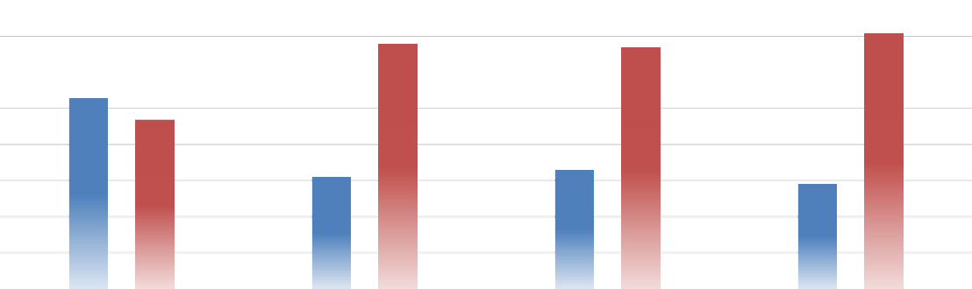


















Attachment 11
EMPLOYED LABOR FORCE BY GENDER: UNITED STATES OF AMERICA AND CPS HR
CONSULTING
80.0%
70.0%
60.0%
50.0%
40.0%
30.0%
20.0%
10.0%
0.0%
U.S.A. 2020
CPS 2022
CPS 2023
CPS 2024
Male Female
Employed Labor Force by Ethnicity: United States of America and CPS HR Consulting
70.0%
60.0%
50.0%
40.0%
30.0%
20.0%
10.0%
0.0%
U.S.A. 2020
CPS 2022 CPS 2023
White Black Asian Hispanic All Other*
CPS 2024
RECOMMENDATIONS: None, for information only.
FISCAL IMPACT: There is no fiscal impact associated with this informational item.

Slide 79
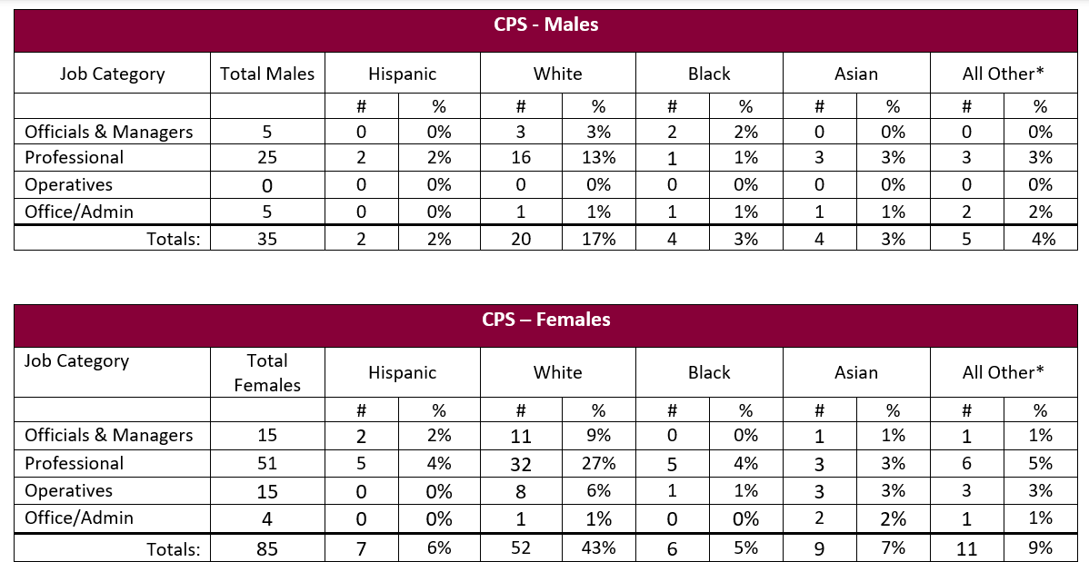
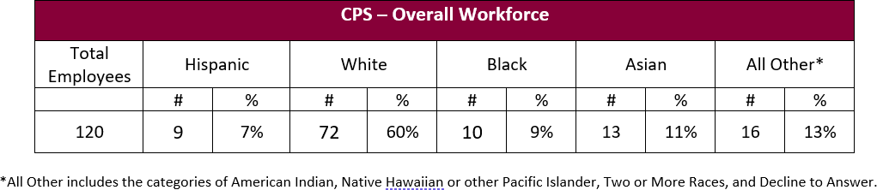
Attachment 11
CPS HR CONSULTING DEMOGRAPHICS AS OF April 30, 2024
Attachment 11– Page 3

Slide 80
Attachment 11
This page intentionally left blank.

Slide 81
Attachment 12
DATE:
June 7, 2024
TO:
CPS HR Consulting Board of Directors
FROM:
Jerry Greenwell, CEO
PREPARED BY:
Dana Henderson, Executive Assistant
SUBJECT: Client Satisfaction Update
ACTION REQUESTED:
X Information Item
Approval and/or Authorization
Policy Change or Adoption
Closed Session Item
RELATIONSHIP TO BUSINESS PLAN:
CPS HR Consulting strives to provide exceptional products and services that exceed client expectations. To measure success in the area of Care for Our Customers, one of our three Guiding Values, CPS HR Consulting conducts a client satisfaction survey following every client engagement. The surveys give customers a chance to voice their concerns or sing our praises. The information garnered from the surveys is used for corrective action and on-going continuous improvement.
DISCUSSION:
CPS HR Consulting set an aggressive goal of a 4.3 client satisfaction rating. At the request of the board, client satisfaction survey results are provided below.
State | 4.40
Local | 4.40
Emerging | 4.35
Test Rental | 4.50
Training | 5.00
Overall client satisfaction rating
4.45
RECOMMENDATIONS: None, for information only.
FISCAL IMPACT: There is no fiscal impact associated with this informational item.
Attachment 12- Page 1

Slide 82
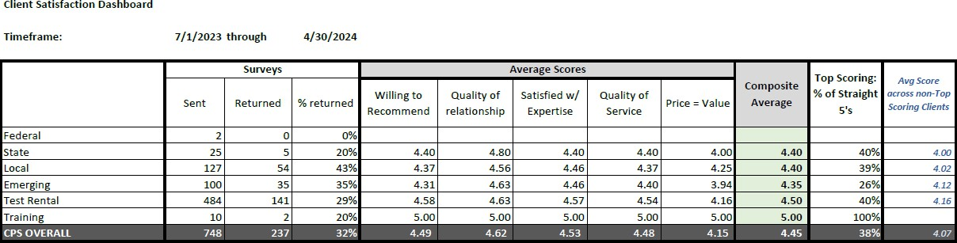
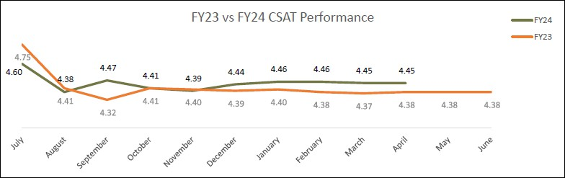
Attachment 12
Attachment 12- Page 2

Slide 83
Attachment 13
DATE: June 7, 2024
TO: CPS HR Consulting Board of Directors
FROM: Jerry Greenwell, CEO
PREPARED BY: Dana Henderson, Executive Assistant SUBJECT: FY24/25 Return to Board Funding Update ACTION REQUESTED:
x Information Item
Approval and/or Authorization
Policy Change or Adoption
Closed Session Item
RELATIONSHIP TO BUSINESS PLAN:
This fund is provided to promote Human Resources within Board member organizations. Funds go toward improvement of management, culture, or HR function of the organization. These funds are a part of the investment CPS HR makes in our Board member agencies from the Professional and Community Investment Fund segment of our operating budget.
DISCUSSION:
Board members have typically used Return to Board Funds for:
Training, HR Conferences (i.e., SHRM, PSHRA, NASPE), workshops, webinars (travel/lodging expenses for training or conferences)
Training materials
Employee Recognition (HR Dept. events or gifts for employee recognition)
Hardware or software for the HR department
CPS HR Consulting services
HR association membership dues
Leadership Development retreat
Data services (i.e., survey reports)
CPS HR Academy or Open Enrollment Classes
Meeting facilitation
Ideally, these funds support initiatives or training that might not otherwise be budgeted for. Each Board member agency has $5,000 to use in Return to Board Funds until March 1, 2025. RECOMMENDATIONS: None, for information only.
FISCAL IMPACT: Sufficient revenue exists to support this action (budgeted item)

Slide 84
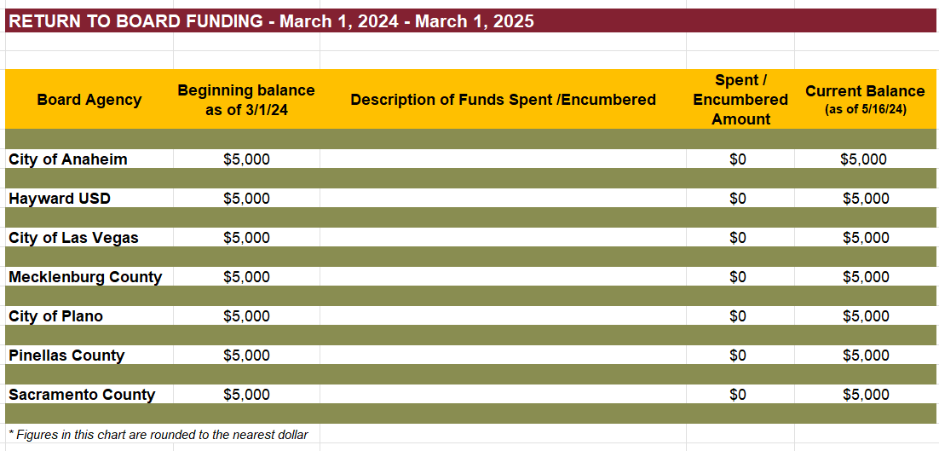
Attachment 13
Attachment 13– Page 2

Slide 85

Attachment 14
DATE:
June 7, 2024
TO:
CPS HR Consulting Board of Directors
FROM:
Jerry Greenwell, CEO
PREPARED BY:
Dana Henderson, Executive Assistant
SUBJECT: Employee Recognition
ACTION REQUESTED:
X Information Item
Approval and/or Authorization
Policy Change or Adoption
Closed Session Item
RELATIONSHIP TO BUSINESS PLAN:
The CPS HR “Make An Impact” Employee Recognition Program, which was implemented in July 2017, supports an organizational culture in which our CPS HR Guiding Values, and our strategic direction and goals are hallmarks of our individual and collective work practices. Our recognition programs reinforce these values.
The CPS HR Guiding Values are: Care For Our Customers, Care For the Organization, and Care For Each Other.
DISCUSSION:
The Team Impact Award is a team performance award focusing on the accomplishments, results, and achievements of a group of 2 or more.
The purpose of this award is to recognize stellar team performance that leads
to outstanding results, and especially noteworthy achievements in accomplishment of CPS HR’s strategic direction and goals.
Team Name: Equity Audit Team
Team Members: Jaclyn Padilla, Megan Misasi-Randles, Kale Brinley, Igor Shegolev and Vicki Quintero Brashear
Submitted by: Jaclyn Padilla
This Team Impact Award is in recognition of the Equity Audit Team’s exemplary dedication and success in conducting a comprehensive Pay Equity Audit across our
organization. This team meticulously analyzed and reviewed our employees’ experience and
education to ensure all are placed equitably in the pay ranges. Their efforts support a culture of transparency and fairness.

Slide 86
Attachment 14
The Pay Equity Audit was not only completed on schedule but also exceeded expectations by providing actionable insights that led to significant adjustments in our pay practices, benefiting our employees. The team's commitment to ensuring equity and their proactive approach to addressing discrepancies sets a benchmark in organizational integrity and teamwork. Their work has had a profound impact on improving employee morale and trust within CPS HR and making them truly deserving of the Team Impact Award.

