Slide 1
CPS HR Board of Directors
Board Meeting Agenda
Friday, November 8, 2024
9:00 AM PST
CPS HR Consulting
2450 Del Paso Road, Suite 220
Sacramento, CA 95834
t: 916.263.3600 f: 916.263.3613
www.cpshr.us

Slide 2
By request, alternate agenda and agenda document formats are available to persons with a
disability as required by Section 202 of the 1990 Americans with Disabilities Act.
To arrange an alternative agenda format or to arrange aid or services to accommodate
persons with a disability to participate in a public meeting, contact the Executive Office at (916) 263-3600 extension 3379.
Any person not on this Agenda who wishes to address the Board of Directors must sign in with the Board’s Executive Assistant. Any person requesting a disability-related modification or
accommodation, including auxiliary aids, or services who require these aids or services in order to participate in the public meeting should contact Dana Henderson, Executive
Assistant, CPS HR Consulting, 2450 Del Paso Road, Sacramento, CA, 95834, (916) 263-3600.
Requests must be made at least 3 business days before the scheduled meeting.
CPS HR Consulting Board Meeting Teleconference Locations November 8, 2024
Open Session - 9:00AM PST (12:00 PM EST)
Click on the “Join Microsoft Teams Meeting” link in your meeting invitation or phone in to the toll-free
number (866) 343-5340, Conference ID 555 927 560 #
Locations
CPS HR Consulting, 2450 Del Paso Road, Suite 220, Sacramento, CA 95834 City of Anaheim, 201 S. Anaheim Blvd., Suite 501, Anaheim, CA 92805
Hayward Unified School District, HR Dept., 24411 Amador Street, Hayward, CA 94544 City of Las Vegas, 495 S. Main Street, 1st Floor, Las Vegas, NV 89101
Mecklenburg County, 700 E. 4th Street, Suite 220, Charlotte, NC 28202 Pinellas County, HR Dept., 400 S. Fort Harrison, Clearwater, FL 33756
City of Plano, 1520 Avenue K, Suite 130, Plano, TX 75074 Sacramento County, 700 H Street, Suite 4667, Sacramento, CA 95814

Slide 3

The CPS Board Year
Revised October 2024
The following calendar outlines “routine” agenda items that are addressed throughout the year. Other items are added as required based on business/governance requirements.
Every Meeting
Minutes from previous meeting – for approval
Budget and Cash Flow Update – for information
Performance Dashboard – for information (variances only)
Investment Update – for information (as required by law)
Approve Class/Pay Plan (to meet CalPERS requirements)
Return to Board Funds Update – for information
Employee Recognition – for information (recognize the individual, and highlight the accomplishment)
Board Development/Emerging Trends (30-60 minutes)
  Organizational Showcase
  Current trends or client success stories
November
Review CPS HR cash minimum every two years. (Next review Nov. 2024) –for information
Annual Financial Audit Report – discussion/approval
Pay administration/class and pay plan review every other year (Next review Nov. 2025) – discussion/approval
Meeting dates/locations for following year’s Board Meetings – for approval
Disclosure of reimbursement for special districts – for information (no report out)
Board Member Meeting Attendance Cost Summary – annual report – for information (no report out)
Board Development Activity (new in 2011)
March
Board Offsite Meeting for Strategic Planning and Board Integration Activities
Review By-Laws & Ground Rules annually (eff. 3/2012)
Review Board Orientation (Eff. 2016)
Review Return to Board Funds availability and amount for next FY (Friday agenda)
Senior Leader/Board Dialogue
Board report out of CEO-level interviews on business trends (eff. 3/2014)
June
Next Fiscal Year Budget and Strategic Plan – for approval
Election of Board Officers (every 2 years) – upcoming in 2024, 2026, etc. or as needed – for approval
Annual appointment of Board Development Committee, Executive Committee and Financial Audit Committee members – for approval
Investment Policy for Next FY – for approval
Delegation of Authority/Authority to Contract (approval) if needed
FY Strategic Plan and Accomplishments – for info and discussion (variances only)
Annual Diversity Report – for information (year to year performance)
Client Satisfaction Survey Data (for information)
Emergency Succession Plan – Review and update for approval by the Board every two years starting in 2018.
Executive Performance Plan Accomplishments – discussion/closed session
Executive Performance Plan for Next FY – discussion/acceptance/closed session
As Needed
Information on policy changes, internal operations, investments, special projects and Board subcommittee reports.
CEO Report – info and discussion on an as-needed basis.
Insurance/Benefits-for information at the beginning of each calendar year; sent out as separate report

Slide 4

CPS HR Board Committee Appointments
Board Executive Subcommittee (standing committee) July 1, 2024 – June 30, 2026
LaShon Ross, Board Chair, City of Plano
Joseph Hsieh, Vice Chair/Secretary, Sacramento County
Vince Zamora, Member-At-Large, City of Las Vegas
Board Development Subcommittee (standing committee) July 1, 2024 – June 30, 2025
Vince Zamora, City of Las Vegas
Linda Andal, City of Anaheim
Joanette Freeman, Mecklenburg County
Board Financial Audit Subcommittee (ad-hoc committee) 2024 members:
Wade Childress, Pinellas County
Fernando Yañez, Hayward USD

Slide 5
CPS HR Consulting – Agenda
Board of Directors Meeting Friday, November 8, 2024
Open Session - 9:00 a.m. PST (12:00 p.m. EST)
CPS HR Consulting
2450 Del Paso Road, Suite 220
Sacramento, CA 95834
Action may be taken on any item on the Agenda
Board of Directors Business Meeting – Open Session – 9:00AM PST Board Meeting Attendee Introductions
Oath of Office – Victoria Huynh, City of Plano, Alternate
I.
Action Items
Approval of Annual Financial Audit Report (under separate cover)
Approval of Minutes from the June 7, 2024 Board Meeting
Approval of Class and Pay Plan
Approval of Board Meeting Dates and Locations for 2025
Attachment 1
Attachment 2
Attachment 3
Attachment 4
II.
Information Only
FY25 Budget/Cash Flow Update
CPS HR Performance Dashboard
FY25 Strategic Initiative Updates
CPS HR Investment Update
Disclosure of Reimbursement for Special Districts
Board Member Meeting Attendance Cost Summary
Return to Board Funds Update
Employee Recognition
Attachment 5
Attachment 6
Attachment 7
Attachment 8
Attachment 9
Attachment 10
Attachment 11
Attachment 12
Public Comment on Matters Not on the Agenda
End of Open Session

Slide 6
This page intentionally left blank.

Slide 7
Attachment 1
DATE:
November 8, 2024
TO:
CPS HR Consulting Board of Directors
FROM:
Ad-Hoc Finance Audit Subcommittee
PREPARED BY:
Sandy MacDonald-Hopp, CFO
SUBJECT: CPS HR Audited Financial Statements (under separate cover)
ACTION REQUESTED:
Information Item
X Approval and/or Authorization
Policy Change or Adoption
Closed Session Item
RELATIONSHIP TO BUSINESS PLAN:
The CPS JPA agreement requires that an audit be conducted annually. The audit ensures that the financial statements present fairly, in all material aspects, the financial position of CPS and the results of its operations and cash flows are in conformity with the accounting principles generally accepted in the United States of America.
DISCUSSION:
The CPS audited financial statements for the fiscal year ending June 30, 2024 are provided under separate cover along with the required communication from our independent auditor. On October 24, 2024, representatives Kevin Wong and Pam Sailor of Gilbert Associates Inc., CPS’ audit firm met by teleconference with the ad-hoc Finance Audit Subcommittee (Wade Childress, County of Pinellas board member and Vince Zamora, City of Las Vegas board member) to present and discuss the financial statements. A representative of Gilbert Associates will provide a live presentation at the board meeting which will include a summary of the audit and commentary. Once the fiscal 2023-2024 audited financial statements are accepted by the Board, the ad-hoc Finance Audit Subcommittee will have completed its responsibilities regarding the fiscal 2023-2024 audit.
RECOMMENDATIONS:
The Board accept the audited financial statements for fiscal 2023-2024.
The Board disbands the ad-hoc Finance Audit Subcommittee, to be reconstituted for the fiscal year 2023-2024 financial audit.
FISCAL IMPACT: None.
Attachment 1 Page 1

Slide 8
Attachment 1
This page intentionally left blank.
Attachment 1 Page 2

Slide 9

Attachment 2
Minutes of Board of Directors Meeting
June 7, 2024
The Board of Directors of CPS HR Consulting met on Friday, June 7, 2024, via teleconference.
Board members attending:
LaShon Ross, City of Plano, TX, Vice Chair Vince Zamora, City of Las Vegas, NV Linda Andal, City of Anaheim, CA
Joseph Hsieh, County of Sacramento, CA
Joanette Freeman, County of Mecklenburg, NC Wade Childress, County of Pinellas, FL
Carla Romine, City of Plano, TX (Alternate)
Board Members Not Attending:
Fernando Yañez, Hayward Unified School District, (Board Chair) Sue Brown, City of Las Vegas, NV (Alternate)
Maria Ciro, County of Pinellas, FL (Alternate)
Staff attending:
Jerry Greenwell, CEO | Dana Henderson | Sandy MacDonald-Hopp
Melissa Asher | Vicki Quintero Brashear | Megan Misasi-Randles
Greg Roberson | Paul Kang | Igor Shegolev
Edward Sission | Ellen Fishel | Karen Evans
Cerri Mansfield | Karina Mendez | Brisha Young
Dave Rechs | Dimple Patel | Jan Nishikawa
Alan Tomassetti | Lynne Harris | Chelle Ramon
Christina Peacock | Tiffany Bose | Manpreet Kaur
Roxana Durbin | David Prieto | Suzanne Ansari
Ana Costa | Kylie Wilson | Michelle Garbato
Layla Mansfield | Holly Hatada | Jose Gonzalez
Abby Ackers | Jhessyka Vergas | Veronica Lara-Lopez
Amy Bigone Kevin Nicholson | Deanna Heyn Eliza De La Cruz | Michelle Long
Others attending:
Jeff Mitchell, Legal Counsel from KMTG Victoria Huynh, City of Plano, TX

Slide 10
Attachment 2
Closed Session for CPS HR Consulting – Board Meeting
Closed Session was called to order at 9:34 a.m. PDT. The following Board Members, along with Jerry Greenwell were in attendance:
LaShon Ross, City of Plano, TX, Vice Chair Carla Romine, City of Plano, TX (Alternate) Vince Zamora, City of Las Vegas, NV Linda Andal, City of Anaheim, CA
Joseph Hsieh, County of Sacramento, CA Maria Ciro, County of Pinellas, FL (Alternate)
Joanette Freeman, County of Mecklenburg, NC (joined at 9:59 am)
The Board Members met with Jerry Greenwell to discuss the CEO’s performance evaluation. Closed Session adjourned at 10:35 a.m. PDT.
Open Session for CPS HR Consulting - Board Meeting
Open Session was called to order at 10:46 a.m. PDT by LaShon Ross, Vice Chair. All Board Members and senior staff attending the meeting introduced themselves.
Oath of Office
Wade Childress was sworn in as the County of Pinellas, FL representative.
Action Items
Attachment #1 – Approval of the March 8, 2024, Board Meeting Minutes
The minutes from the March 8, 2024, Board Meeting were presented for approval. There were no comments or changes to the minutes. The Board of Directors of CPS HR Consulting approved the Minutes from the March 8, 2024, Board Meeting.
Motion: Second: Vote:
Freeman, Mecklenburg County Hsieh, Sacramento County
City of Anaheim Aye City of Las Vegas Aye Mecklenburg County Aye Pinellas County Aye
City of Plano Aye Sacramento County Aye Hayward USD Absent
Attachment #2 – Election of Board Officers and Appointment of Board Committee Members

Slide 11
Attachment 2
Every two years, the Board makes decisions about who will serve as Board officers. The election of Board Officers is for a term serving from July 1, 2024, through June 30, 2026.
Another part of the annual Board Meeting in June is who will serve on board subcommittees for the next fiscal year.
Linda nominated LaShon for Board Chair and LaShon accepted the nomination.
Motion: Second: Vote:
Andal, City of Anaheim Hsieh, Sacramento County
City of Anaheim Aye City of Las Vegas Aye Mecklenburg County Aye
Pinellas County City of Plano
Aye Aye
Sacramento County Aye Hayward USD Absent
Resolution # 24-02
LaShon nominated Joseph for Vice Chair and Joseph accepted the nomination.
Motion: Second: Vote:
Ross, City Plano Andal, City of Anaheim
City of Anaheim Aye City of Las Vegas Aye Mecklenburg County Aye Pinellas County Aye
City of Plano Aye Sacramento County Aye Hayward USD Absent
Resolution # 24-03
Vince volunteered to be the Member-at-Large and serve on the Board Executive Committee.
Motion: Second: Vote:
Ross, City Plano
Hsieh, Sacramento County
City of Anaheim Aye City of Las Vegas Aye Mecklenburg County Aye Pinellas County Aye
City of Plano Aye
Sacramento County Aye Hayward USD Absent

Slide 12
Attachment 2
Resolution # 24-04
Joanette volunteered to be on the Board Development Committee along with Linda and Vince who agreed to continue on the committee. Wade and Fernando will be on the Finance Audit Committee.
Motion: Second: Vote:
Ross, City Plano
Hsieh, Sacramento County
City of Anaheim Aye City of Las Vegas Aye Mecklenburg County Aye Pinellas County Aye
City of Plano Aye
Sacramento County Aye Hayward USD Absent
Resolution # 24-05
Attachment #3 – Approval of the FY2025 Strategic Plan and FY2025 Budget (under separate cover)
The proposed FY2025 Strategic Plan and FY2025 Budget documents outline the direction for our organization.
Jerry reviewed the FY2025 Strategic Initiatives graphic and the annual goals we will use to measure progress throughout the year.
Sandy reviewed the FY2025 budget assumptions and the budget in detail. Some of the highlighted points were:
Revenue includes $1.7M for Test Rental for 5% year-over-year increase; $5.9M Training revenue for 0.5% increase; $7.6M State Market 19% year-over-year decrease, $13.2M Local Market 26.5% year-over-year increase, and $4.8M for Emerging Market 7% decrease.
The labor budget assumes potential 3% salary increases moving to anniversary date
cycle with new compensation plan. Some positions have been budgeted for promotions in line with development plans.
The Operating Expense includes $365.9k bonus accrual this fiscal period.
Fringe benefit expense is budgeted to increase by 12% considering rising health insurance.
Depreciation and amortization accrual amounts of $299k are included in expenses in monthly increments. The depreciation figure includes depreciation on existing assets plus capital budget.
Capital expenditures of $40,000 for replacing Veeam and VMWare Servers that have reached the end of their service life.

Slide 13
Attachment 2
The Board of Directors of CPS HR Consulting approved the FY2025 Strategic Plan Initiatives as presented in the FY25 Strategic Plan and Budget packet under separate cover with the June 7, 2024, Board Agenda.
Motion: Second: Vote:
Freeman, Mecklenburg County Andal, City of Anaheim
City of Anaheim Aye City of Las Vegas Aye Mecklenburg County Aye
Pinellas County City of Plano
Aye Aye
Sacramento County Aye Hayward USD Absent
Resolution # 24-06
Attachment #4 – Approval of the CPS HR Investment Policy for FY2025
Sandy presented the CPS Investment Policy and noted that the Board approves this policy annually often with no changes. For FY2025, there are no changes.
The Board of Directors of CPS HR Consulting approved the CPS HR Investment Policy for FY2025 as presented in the June 7, 2024, Board Agenda.
Motion: Second: Vote:
Andal, City of Anaheim Hsieh, Sacramento County
City of Anaheim Aye City of Las Vegas Aye Mecklenburg County Aye Pinellas County Aye
City of Plano Aye Sacramento County Aye Hayward USD Absent
Resolution # 24-07 Attachment #5 – Approval of Class/Pay Plan
Jerry presented the Class and Pay Plan to the Board. The current plan was approved last in March 2024. There were a few modifications to the plan.
The Program Coordinator salary range was changed to align with the HR Consultant position which is the appropriate benchmark.
Effective January 1, 2024, California legislation raised the minimum salary for exempt positions to $66,560 annually. In response to this change, CPS HR has adjusted the minimum salary range of five impacted classifications which include: Accounting Coordinator, Contracts Coordinator,

Slide 14
Attachment 2
Associate Training Coordinator, Associate HR Consultant and Associate Bid and Proposal Coordinator.
The Board of Directors of CPS HR Consulting approved the CPS HR Class & Pay Plan as presented in the June 7, 2024, Board Agenda.
Motion: Second: Vote:
Andal, City of Anaheim Hsieh, Sacramento County
City of Anaheim Aye City of Las Vegas Aye Mecklenburg County Aye Pinellas County Aye
City of Plano Aye
Sacramento County Aye Hayward USD Absent
Resolution # 24-08 Attachment 6: Adoption of DBA
Since 2011, Cooperative Personnel Services has been using “CPS HR Consulting” as a DBA and as part of its logo without any formal authorization by the Board of Directors. The staff has determined that there is no official process for Cooperative Personnel Services, a JPA, to apply for and register a DBA. The California Secretary of State does not accept DBA applications, and the counties in which Cooperative Personnel Services operate do not have a process for DBA applications by JPAs.
It is recommended that the Board of Directors adopt this resolution “authorizing the use of “CPS HR Consulting” as a DBA of Cooperative Personnel Services.”
The Board of Directors of CPS HR Consulting approved the Adoption of DBA as presented in the June 7, 2024, Board Agenda.
Motion: Second: Vote:
Freeman, Mecklenburg County Hsieh, Sacramento County
City of Anaheim Aye City of Las Vegas Aye Mecklenburg County Aye Pinellas County Aye
City of Plano Aye
Sacramento County Aye Hayward USD Absent
Resolution # 24-09
Action Item 7: Action to modify Chief Executive Officer compensation and benefits
LaShon stated the Board met in closed session and had a discussion regarding the CEO’s

Slide 15
Attachment 2
performance.
LaShon wanted to acknowledge that the Board understands and appreciates everything the entire organization has accomplished.
The CPS HR Board of Directors have agreed to a 7.5% performance bonus for the CEO.
Motion: Second: Vote:
Freeman, Mecklenburg County Andal, City of Anaheim
City of Anaheim City of Las Vegas
Mecklenburg County
Pinellas County City of Plano Sacramento County Hayward USD
Resolution # 24-10
Aye Aye Aye Abstain Aye Aye Absent
For Information Only
Attachment #7 – FY24 Budget/Cash Flow Update
Sandy MacDonald-Hopp gave an overview of the budget and cash flow as of April 30, 2024. The total CPS revenue of $26.1 million for the fiscal year-to-date as of April 30, 2024, is $103k or 0.4% better than budget. This revenue represents a 7% decrease from year-to-date April 2023 in which CPS HR had $1.8 million more in revenue. The year-over-year revenue change reflects mix of growth in class & comp, DEI, and talent marketing increased revenue offset by other service lines contracting. Year-to-date, Training, State, and Emerging Markets are all exceeding revenue budget.
Direct expenses are underrunning budget by $464k and the mix generated gross profit margin of 38.9% versus budgeted 36.9% as a percent of revenue. Operating expenses are $213k or 2% over budget due to the print shop and facilities allocation. OMS indirect expense, a component of total operating expense, is $214k under budget. The average monthly operating expense is running $1M per month versus FY23’s $815k monthly average.
Year-to-date CPS has net operating loss of $131k, which is $355k better than the budgeted operating loss thru April 2024. The positive net income figure of $541k equates to 2% of revenue and better than budgeted $62k net loss. The cash flow forecast for the next 12 months indicates some ups and downs in cash reserves with capital expenditures, ongoing disbursements, and timing of collections. Monthly variations in cashflow reflect changes in the timing of receipt of invoice payments and payments to vendors. Minimum cash reserve balance of $4M was established in November 2018 and as of April 30, 2024, the cash balance is $14.4M. Based on a ten-month Operating Expense average of $1M the $4M reserve would cover 117 days of operations.

Slide 16
Attachment 2
LaShon asked if DEI training is maintaining the momentum like it was two years ago. Melissa responded that DEI/Inclusion training is still in our top ten of training courses requested by our clients.
Attachment #8 – CPS HR Performance Dashboard
Jerry gave an overview of our Performance Dashboard. We have reached our goal of Qualified Leads and are currently at 701. Our Overall Win Rate by Market is slightly below our goal for the year at 66.8%. We have decreased our reliance on Full and Open proposals and are coming in at 29.3%. Our Limited Comp win rate is 57.9% and our Sole Source is 95.9%. Our win revenue for this fiscal year is $19.7 million. We have a total of 300 proposals currently in play.
Attachment #9 – Investment Update
Sandy reviewed the investment update. We have $7,418,963 which includes accrued interest of
$62.7k. We have 32% of our investment dollars in CDs that are FDIC insured.
Attachment #10 – FY24 Strategic Plan Progress Update and FY24 Accomplishments
Jerry reviewed the FY24 Strategic Plan Progress and Accomplishments with the Board during the Closed Session, so this was not reviewed during Open Session. Jerry spoke briefly about the FY24 strategic initiative graphic and how we track the progress throughout the year.
Vince said it has been a tremendous amount of work over the past year that the staff has been able to accomplish, and the revenue speaks for itself. LaShon wanted to reiterate what Vince said and told the other board members earlier that when she was with the board many years ago, she is continuing to see the consistency with the leadership and the performance of the organization, and it seems we have clear mission and approach to how we do the work.
LaShon also wanted to thank the board and the staff for the meeting in March and the discussion around fragility and felt this topic was purposeful. Jerry added that the Board Development Committee should think about having a follow up to that discussion in November and not wait until next March.
Attachment #11 – Annual Diversity Report
Jerry reviewed the annual diversity report. The CPS HR workforce is predominantly female and white. Year over year, targeted outreach efforts have translated into diversifying the workforce.
Attachment #12 – Client Satisfaction Update
Jerry presented the Client Satisfaction Update. We set an aggressive goal of a 4.3 client satisfaction rating. Our client satisfaction rating for this year is at 4.45. We sent out 748 surveys and have received 237 back – 32% returned.
Attachment #13 – Return to Board Funds Update
Each Board member agency has $5,000 to use in Return to Board Funds. Jerry reminded the Board Members they have until March 1, 2025, to use these funds.

Slide 17
Attachment 2
Attachment 14 – Employee Recognition
The Team Impact Award is a team performance award focusing on the accomplishments, results, and achievements of a group of 2 or more. The purpose of this award is to recognize stellar team performance that leads to outstanding results, and especially noteworthy achievements in accomplishment of CPS HR’s strategic direction and goals.
The Pay Equity Audit Team was nominated for the Team Impact Award for their exemplary dedication and success in conducting a comprehensive Pay Equity Audit across our organization. This team meticulously analyzed and reviewed our employees’ experience and education to ensure all are placed equitably in the pay ranges. Their efforts support a culture of transparency and fairness.
Having no other questions or business to discuss, the meeting was adjourned at 12:23 p.m. PDT. Minutes prepared by:
Dana Henderson
Minutes reviewed by:
Jerry Greenwell
Respectfully Submitted:
Dated: 6/24/24
Signed: LaShon Ross
LaShon Ross, CPS HR Vice Chair City of Plano

Slide 18
Attachment 2
This page intentionally left blank.

Slide 19
Attachment 3
DATE:
November 8, 2024
TO:
CPS HR Consulting Board of Directors
FROM:
Jerry Greenwell, CEO
PREPARED BY:
Kale Brinley, Senior HR Consultant
SUBJECT:
Approval of Classification and Pay Plans
ACTION REQUESTED:
Information Item
X_ Approval and/or Authorization
Policy Change or Adoption
Closed Session Item
RELATIONSHIP TO BUSINESS PLAN:
Maintenance of competitive pay is critical to attracting and retaining a workforce that can deliver our products and services to meet the wide variety of our clients’ needs.
DISCUSSION:
Prior to each Board meeting, HR staff updates the Classification and Pay Plan to incorporate any additions, deletions, or modifications to the plan that have occurred during the time since the previous approval. As part of our ongoing efforts to align the organization’s leadership structure with our strategic goals, we have adjusted the senior leadership titles and removed a couple of unused classifications. These changes are due to a recent reorganization following the retirement of the Senior Leader of Organizational Strategy Business Unit.
Reorganization of Leadership Titles:
  The retirement of the Senior Leader for Organizational Strategy created an opportunity to restructure our Products and Services responsibilities -across units, which has resulted in the following structural changes:
    Title change, Chief of Client Services classification: As part of this reorganization, we have merged responsibilities with the Senior Practice Leader and Products and Services Senior Leader to create the Chief of Client Services classification. This change is expected to enhance efficiency by streamlining strategic oversight and improving service integration across departments.
    Title change, Chief of Marketing and Business Development: to better align with comparable market titles, we recommend changing the title "Director of Marketing and Business Development" to "Chief of

Slide 20
Attachment 3
Marketing and Business Development," as it more accurately reflects the scope of responsibilities and leadership level associated with the role.
Abolish the Senior Practice Leader Classification: This role’s duties have been absorbed into the revised leadership structure. The responsibilities previously under the Senior Practice Leader role will now fall under existing and redefined senior leadership roles, which better reflect the current and future needs of the organization.
Abolish the Practice Leader Classification: The responsibilities of this role have now been consolidated into the Manager position.
Impact on Classifications and Pay Plan:
The title changes and restructuring of responsibilities have been reflected in updates to the classification system. The pay plan has been reviewed to ensure equity and alignment with market benchmarks, without significant financial impact from these adjustments.
Next Steps:
  As a result of the consolidation of the Chief of Client Services, we will be transferring all employees in the Senior Practice Leader classification, which is only one, Melissa Asher, from class code 109 into class code 110 and will continue to monitor the effectiveness of the revised structure and make further adjustments if necessary. Ongoing evaluation will be based on performance metrics and feedback from senior leaders and department heads.
  Any additional reclassifications or adjustments to the pay plan will be brought to the board for review in future meetings.
Conclusion: This reorganization marks a step forward in improving the organizational structure by creating clearer lines of responsibility and better aligning leadership roles with strategic objectives. We anticipate these changes will position the organization for continued success and operational efficiency.
RECOMMENDED ACTION:
Approve the Class and Pay Plan as shown in the CPS HR Board Agenda for November 8, 2024.
FISCAL IMPACT: Sufficient revenue exists to support this action.

Slide 21

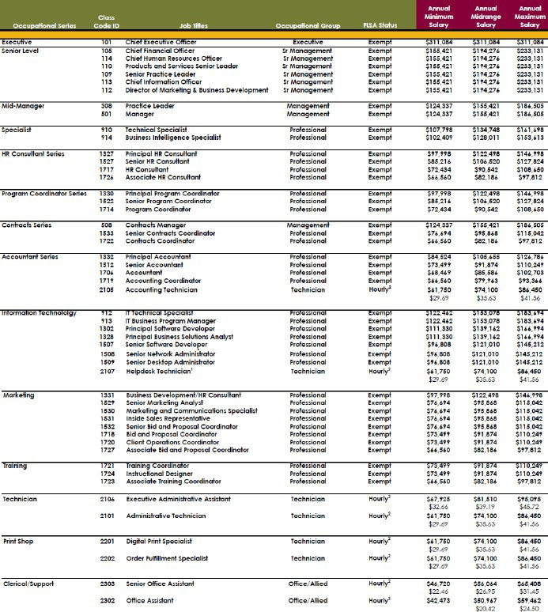
Attachment 3
ATTACHMENT A

Slide 22
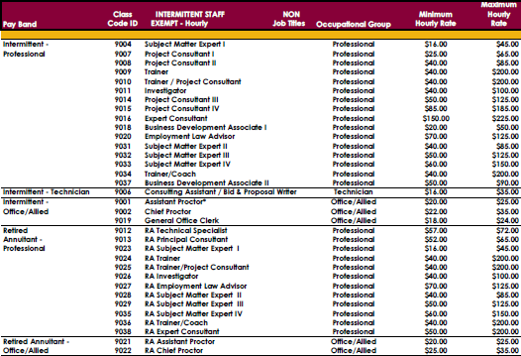
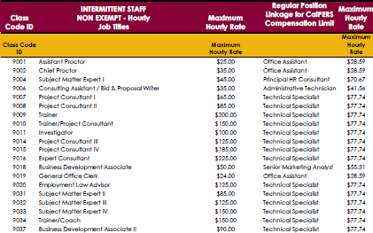
Attachment 3

Slide 23
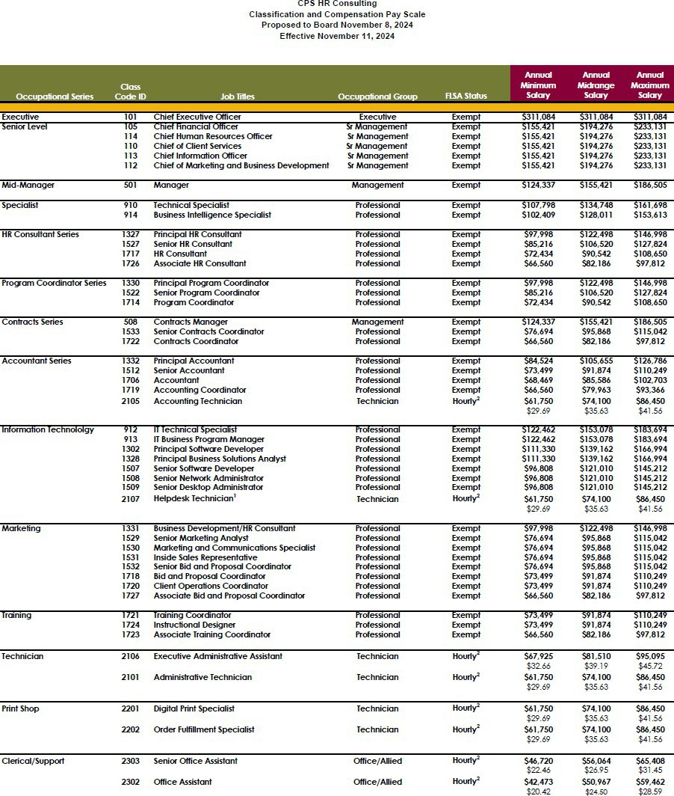
Attachment 3
ATTACHMENT B

Slide 24

Attachment 3

Slide 25
Attachment 4
DATE: November 8, 2024
TO: CPS HR Consulting Board of Directors
FROM: Jerry Greenwell, CEO
PREPARED BY:
SUBJECT:
Dana Henderson, Executive Assistant
Approval of 2025 Proposed Board Meeting Dates & Locations
ACTION REQUESTED:
Information Item
X Approval and/or Authorization
Policy Change or Adoption
Closed Session Item
RELATIONSHIP TO BUSINESS PLAN:
The Board governance role is essential to CPS HR’s ability to successfully carry out the goals and initiatives that are a part of the annual and long-term business plan.
DISCUSSION:
Board Meetings are generally held on the first or second Friday in the months of March, June, and November. The proposed March 2025 meeting date will be on the first or second Thursday and Friday of the month per the dates indicated below. Board meeting locations will be held either at the CPS HR Sacramento office, remote teleconference, or an identified location within one of our Board Member agency’s jurisdictions.
Proposed Board Meeting Schedule for 2025
March 5 - 7, 2025
TBD
June 6, 2025
Sacramento/Remote teleconference
November 7, 2025
Sacramento/Remote teleconference
RECOMMENDED ACTION:
Approve proposed Board meeting dates above and choose a location to hold the March 2025 Board Meeting.
FISCAL IMPACT:
Costs are built into the budget annually. Board meeting costs in Sacramento are approximately
$7,000 - $8,000 per meeting (based on 7 - 8 Board Members attending) considering airfare/transportation, hotels, and food. Board meetings in alternate cities are likely to triple that amount depending on the location.

Slide 26
Attachment 4
Historical CPS March Board Meetings List of Locations
Date | Facility | City | State
March 2024 | CPS HR Headquarters | Sacramento | CA
March 2023 | CPS HR Headquarters | Sacramento | CA
March 2022 | Remote Meeting | - | -
March 2021 | Remote Meeting | - | -
March 2020 | Board Meeting Cancelled (COVID19) | - | -
March 2019 | Hotel Maya | Long Beach | CA
March 2018 | Waterfront Inn | Oakland | CA
March 2017 | JW Marriott Resort & Spa | Las Vegas | NV
March 2016 | Hilton Charlotte City Center | Charlotte | NC
March 2015 | Emgcy Ops Ctr & Hilton Dallas Granite Park | Plano | TX
March 2014 | Sheraton Sand Key Resort | Clearwater | FL
March 2013 | City Hall | Las Vegas | NV
March 2012 | Disney’s Grand Californian Hotel & Spa | Anaheim | CA
March 2011 | JW Marriott Resort & Spa | Las Vegas | NV
March 2010 | Harvest Inn, Vineyard View Rm | St. Helena | CA
March 2009 | Disneyland Hotel, Sleeping Beauty Pavilion | Anaheim | CA
March 2008 | Handlery Union Square Hotel/Moscone Ctr | San Francisco | CA
March 2007 | Wine & Roses | Lodi | CA
March 2006 | The Beach House Inn & Conf Ctr | Half Moon Bay | CA
Sept 2005 | Madison Concourse Hotel | Madison | WI
March 2005 | Hyatt Regency Islandia | San Diego | CA
Sept 2004 | Marriott Oakland City Center | Oakland | CA
March 2004 | City University of NY | New York | NY
Sept 2003 | S.F. Public Library | San Francisco | CA
March 2003 | Venetian Hotel | Las Vegas | NV
Sept 2002 | East Bay MUD | Oakland | CA
March 2002 | Disney’s Grand Californian Hotel | Anaheim | CA
Sept 2001 | S.F. City Hall-Mayor’s Conf Rm | San Francisco | CA
March 2001 | Tiburon Lodge | Tiburon | CA
March 2000 | Calistoga Spa Hot Springs | Calistoga | CA

Slide 27
Attachment 5
DATE:
November 8, 2024
TO:
CPS HR Consulting Board of Directors
FROM:
Jerry Greenwell, CEO
PREPARED BY:
Sandy MacDonald-Hopp, CFO
SUBJECT: FY2024 Budget and Cash Flow Update
ACTION REQUESTED:
Information Item
X Approval and/or Authorization
Policy Change or Adoption
Closed Session Item
RELATIONSHIP TO BUSINESS PLAN:
The attached schedules depict unaudited financial performance for the month-ending September 30, 2024 in comparison to the budget. These schedules depict the organization in its’ component groups of State, Local, Emerging Markets, Client Services, and Operation Management Services.
DISCUSSION:
Revenue
The total CPS revenue of $7.3 million for the fiscal year-to-date as of September 30, 2024 is $425k or 5.5% less than budget. This revenue represents 14% decrease from year-to-date September 2023 in which CPS HR had $1.2 million more in revenue. The year-over-year revenue change reflects mix of growth in assessment centers, exec search, and talent marketing increased revenue offset by other service lines contracting. Year-to-date, Training and State Markets are exceeding revenue budget.
Expense
Fiscal year-to-date through September 2024, direct expenses are underrunning budget by $561k and the mix generated gross profit margin of 38.5% versus budgeted 34.6% as a percent of revenue. Operating expenses are $21k or 0.7% over budget due to facilities and print shop allocations. OMS indirect expense, a component of total operating expense, is $110k over budget. Average monthly operating expense is running $1.08M per month versus FY24’s $1.05M monthly average. We anticipate spending full $12.7 million FY25 operating expense.
Net Operating Income/Loss and Cash Flow
Year-to-date CPS has net operating loss of $441k, which is $114k better than the budgeted operating loss thru September 2024. The net loss of $102k equates to 1.4% of revenue and better than budgeted
$372k net loss. The cash flow forecast for the next 12 months indicates some ups and downs in cash
reserves with capital expenditures, ongoing disbursements, and timing of collections. Monthly variations in cashflow reflect changes in the timing of receipt of invoice payments and payments to vendors.
Minimum cash reserve balance of $4M was established in November 2018 and as of September 30, 2024
cash balance is $13.9M. Based on three-month Operating Expense average of $1.08M, the $4M reserve would cover 111 days of operations.
RECOMMENDATIONS: None, information only
FISCAL IMPACT: None, information only

Slide 28
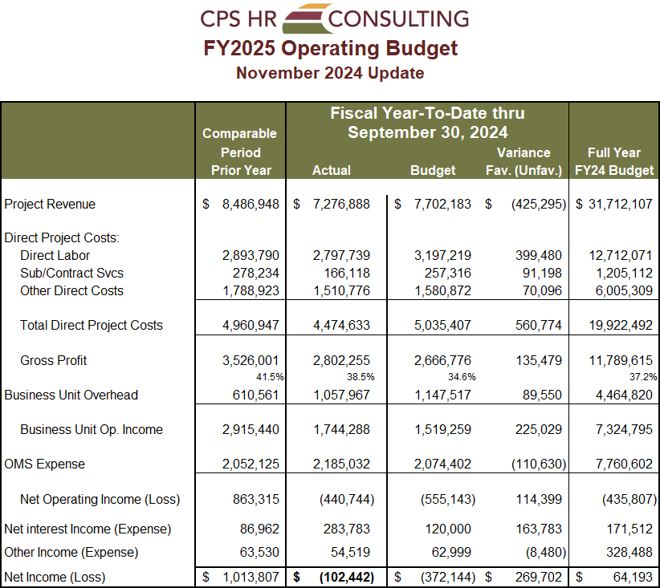
Attachment 5

Slide 29
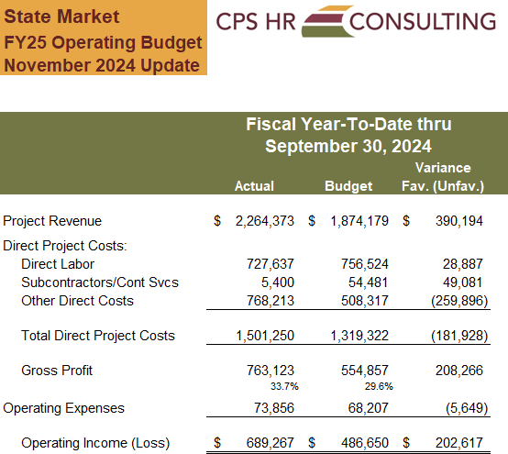
Attachment 5

Slide 30
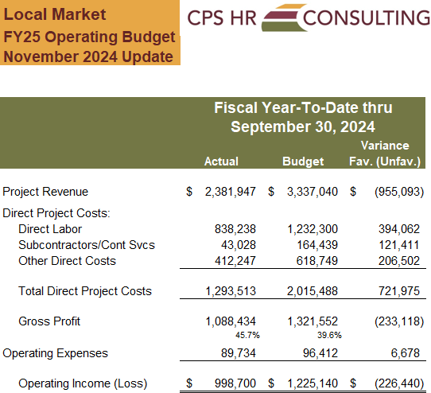
Attachment 5

Slide 31
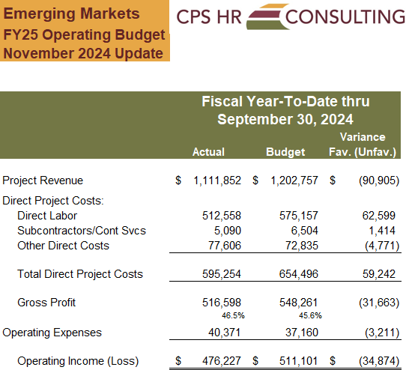
Attachment 5

Slide 32
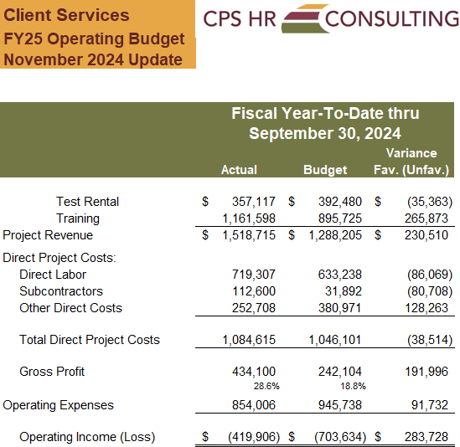
Attachment 5

Slide 33
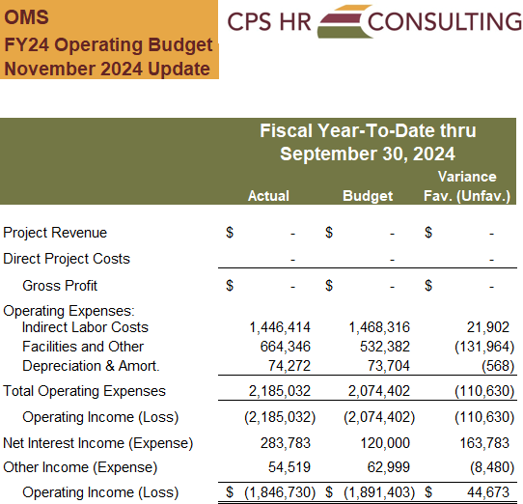
Attachment 5

Slide 34
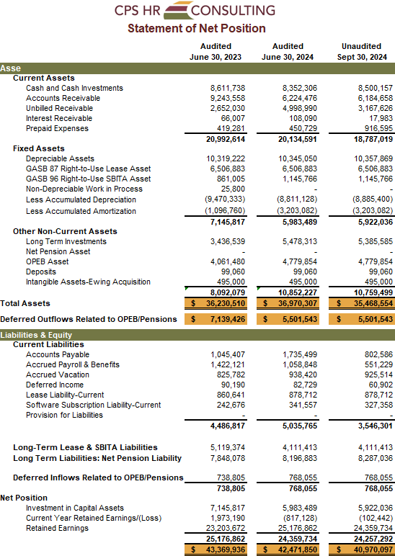
Attachment 5

Slide 35
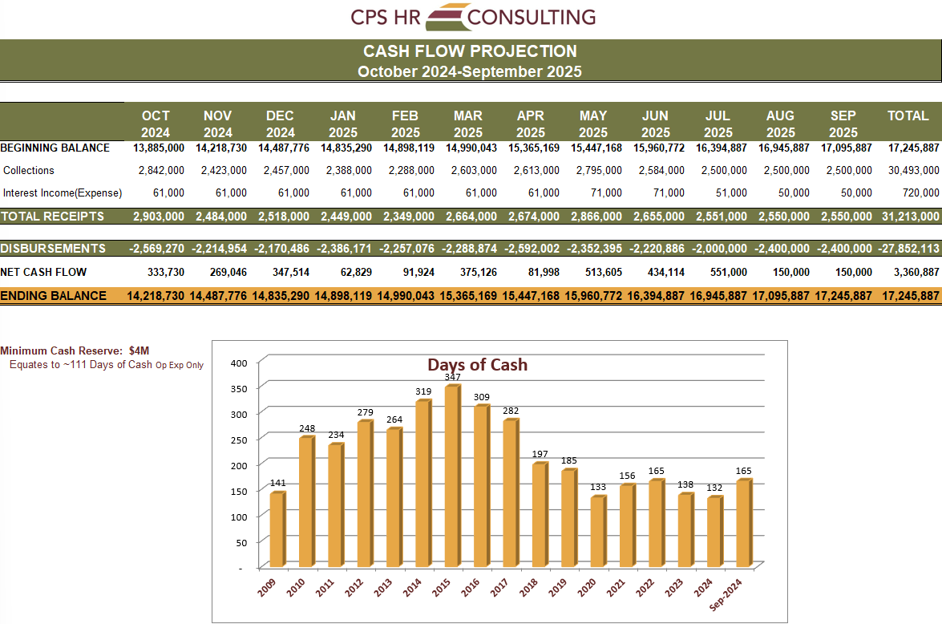
Attachment 5
Attachment 5 Page 9

Slide 36
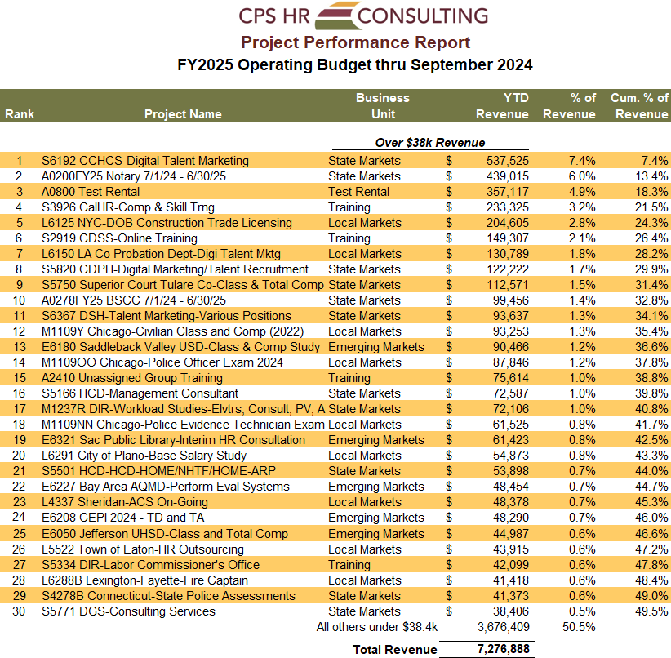
Attachment 5

Slide 37
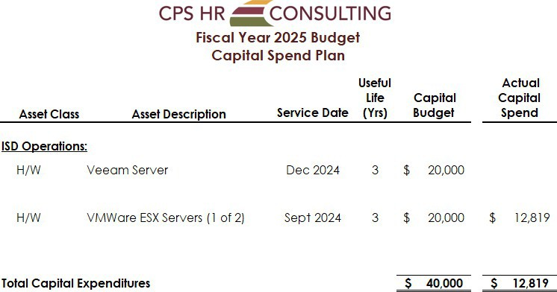
Attachment 5

Slide 38
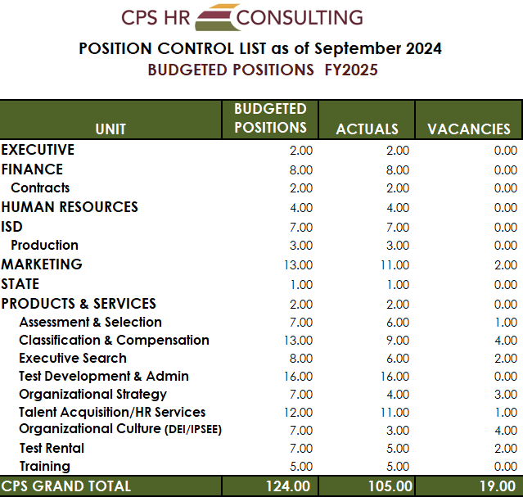
Attachment 5

Slide 39
Attachment 6
DATE: November 8, 2024
TO: CPS HR Consulting Board of Directors
FROM:
PREPARED BY:
Jerry Greenwell, CEO
Dana Henderson, Executive Assistant
SUBJECT: CPS HR Performance Dashboard
ACTION REQUESTED:
X Information Item
Approval and/or Authorization
Policy Change or Adoption
Closed Session Item
RELATIONSHIP TO BUSINESS PLAN:
At the request of the Board, the purpose of the Performance Dashboard is to provide the Board with a high-level overview of the performance of the organization at a glance. The Senior team and staff monitor these indicators in order to assess organizational performance as tracked to goals.
DISCUSSION:
The performance indicators on the Performance Dashboard reflect the key elements that are monitored to assess organizational success at a high level.
RECOMMENDATIONS: None, for information only.
FISCAL IMPACT: None, for information only.

Slide 40
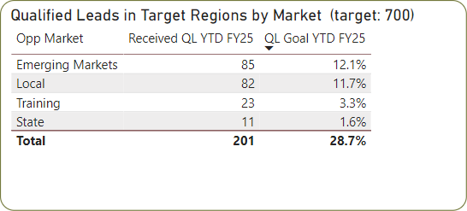
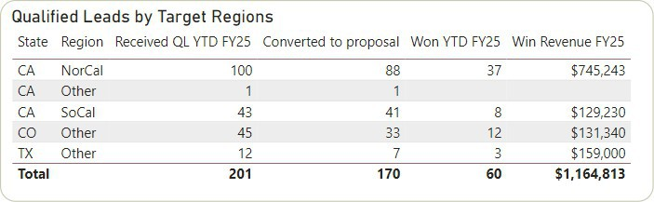
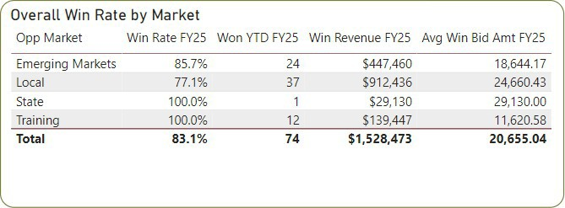




Attachment 6

Slide 41
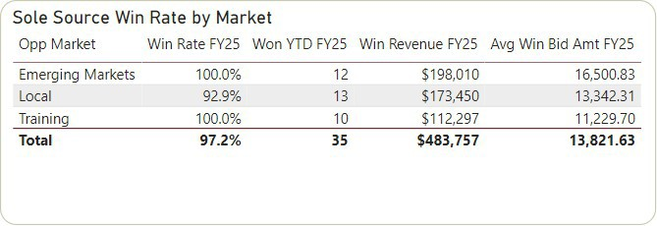
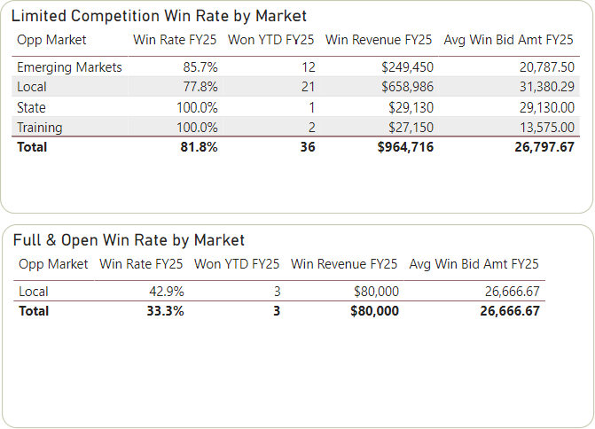


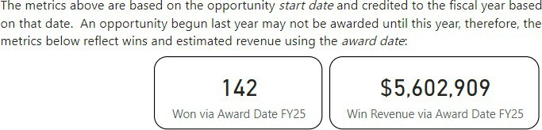
Attachment 6
*Information current as of 10/21/24

Slide 42
Attachment 6
This page intentionally left blank.

Slide 43
Attachment 7
DATE:
November 8, 2024
TO:
CPS HR Consulting Board of Directors
FROM:
Jerry Greenwell, CEO
PREPARED BY:
Jerry Greenwell, CEO and Dana Henderson, Executive Assistant
SUBJECT: FY25 Strategic Initiatives – Progress Update
ACTION REQUESTED:
X Information Item
Approval and/or Authorization
Policy Change or Adoption
Closed Session Item
RELATIONSHIP TO BUSINESS PLAN:
Our FY25 strategic goals are aligned with the FY 2025 Strategic Direction as approved by the board in June 2024. The goals were designed to move us toward re-establishing our market presence and improving our sustainability as an organization post-pandemic. The plan has been built to ensure we achieve our mission and vision while adhering to our core organizational principles.
DISCUSSION:
After one quarter we are short of revenue by $425K on $7.3M but ahead on gross margin by 4%. With interest income creating a positive variance, our net loss of $102K is less than the budgeted loss of $270K as we anticipated a slow start to the new fiscal year. We are confident that our projections will begin to match actuals as we go forward.
In the 1st quarter we progressed in a number of areas related to the plan. Our first Quarterly Update with all staff occurred in October and was well received as our efforts to be inclusive and intentional about sharing information and progress is in full effect.
We launched the Employee Engagement survey and obtained an 83% participation rate for FTEs, and a modest 15% for intermittent staff. The 83% met goal. In addition, we conducted a Pulse survey. We held 3 Values Unplugged forums with staff to personalize and make actionable the core values for the organization.
With the onset of AI and its implications on both business and personal life we established a set of guidelines and parameters for the organization to adhere to. This is consistent with industry best practice and to stay vigilant in our efforts to monitor this new capability.
The partnership with GovInvest in the compensation service area was ratified and has already begun to pay dividends. We anticipate increased outreach and effort in the second quarter.

Slide 44
Attachment 7
We are making sustained progress on all our strategic goals and the updates that follow will detail our efforts.
RECOMMENDATIONS: None, for information only.
FISCAL IMPACT: None, for information only.

Slide 45
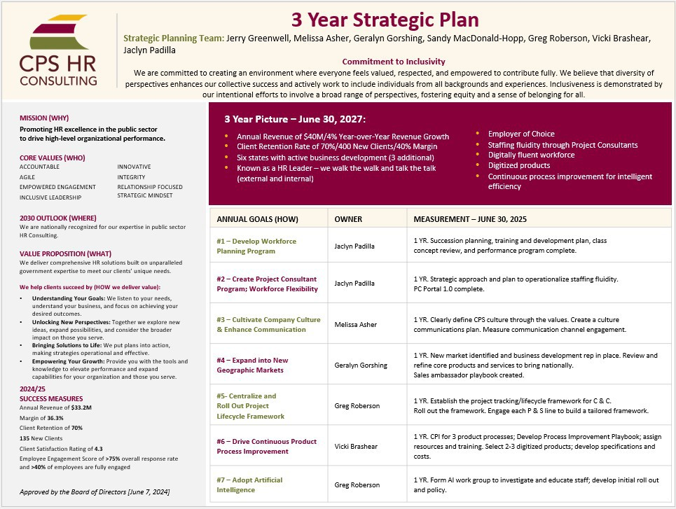
Attachment 7
Attachment 7 Page 3

Slide 46
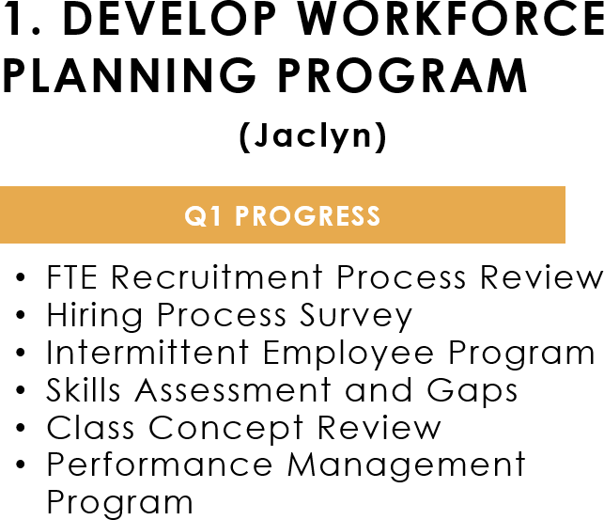
Attachment 7
Attachment 7 Page 4

Slide 47
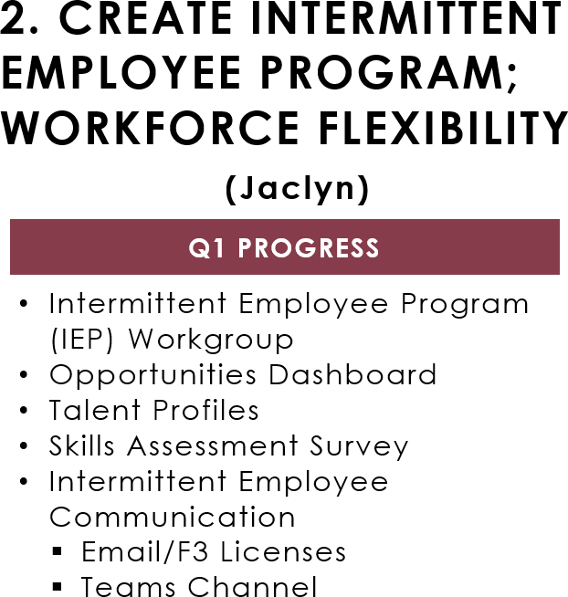
Attachment 7
Attachment 7 Page 5

Slide 48
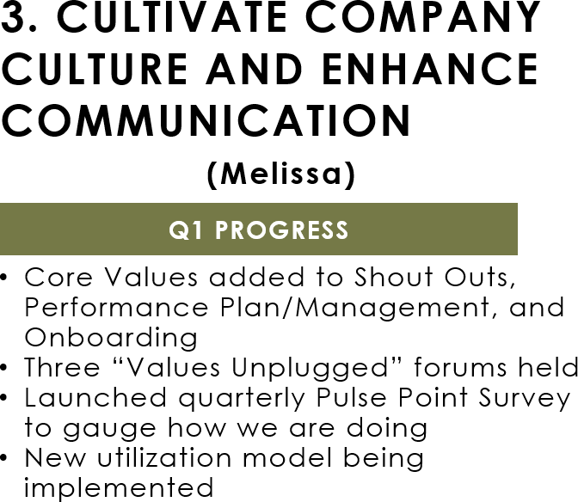
Attachment 7
Attachment 7 Page 6

Slide 49
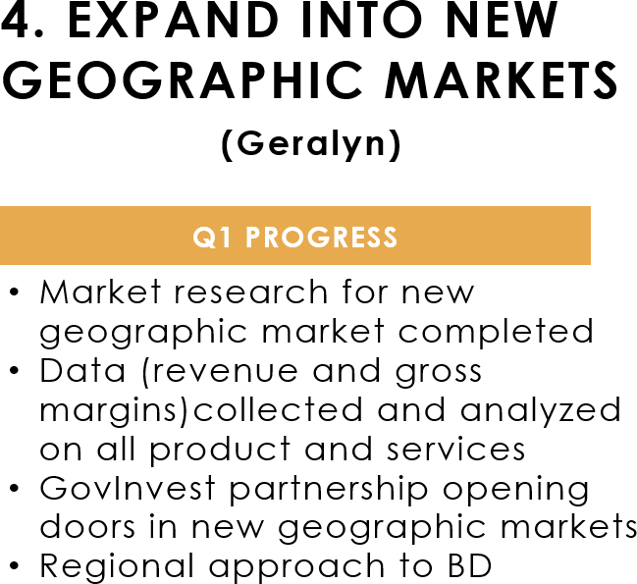
Attachment 7
Attachment 7 Page 7

Slide 50
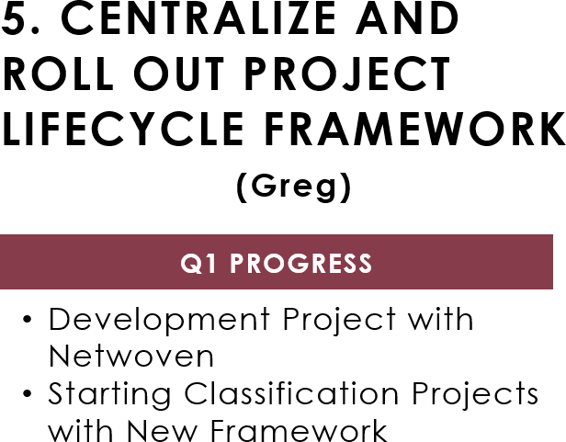
Attachment 7
Attachment 7 Page 8

Slide 51
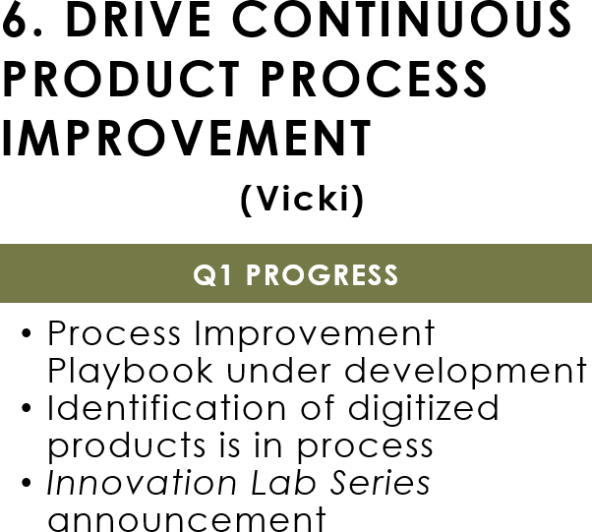
Attachment 7
Attachment 7 Page 9

Slide 52
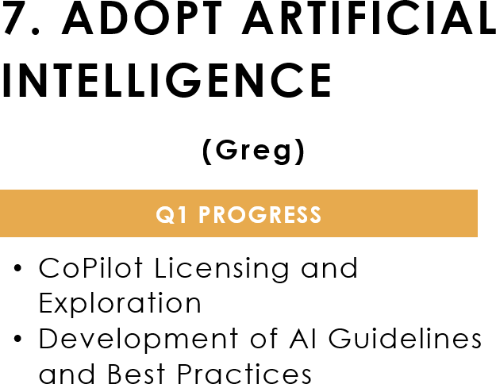
Attachment 7
Attachment 7 Page 10

Slide 53
Attachment 8
DATE:
November 8, 2024
TO:
CPS HR Consulting Board of Directors
FROM:
Jerry Greenwell, CEO
PREPARED BY:
Sandy MacDonald-Hopp, CFO
SUBJECT: Investment Update
ACTION REQUESTED:
X Information Item
Approval and/or Authorization
Policy Change or Adoption
Closed Session Item
RELATIONSHIP TO BUSINESS PLAN:
The CPS schedule of investments is presented for Board information and to comply with the reporting section of CPS’s Investment Policy. It is the intent of CPS to maximize investment earnings through longer-term investments while maintaining a balance of short-term investments to meet current obligations. All investments must conform to CPS’s investment policy. Current reserves are sufficient to meet the next 30 days’ obligations.
DISCUSSION:
As part of the Board’s role in providing financial oversight each meeting, an updated investment portfolio is provided for informational purposes. At the request of the board, portfolio summary statistics are provided below, including the annualized investment total return on the long-term portfolio.
Portfolio Value as of September 30, 2024: $7,399,063 (includes accrued interest of $45.7k)
Average Maturity | 2.6 years
Average S&P Rating | AA-; 20% investment dollars are CDs that are FDIC insured
Performance | 1 month | YTD | Since Inception
Period Total Return | 0.67% | 2.66% | 0.24%
Annualized Total Return | 8.37% | 2.71% | 0.24%
RECOMMENDATIONS: None, for information only.
FISCAL IMPACT: None, no expense will be incurred.

Slide 54
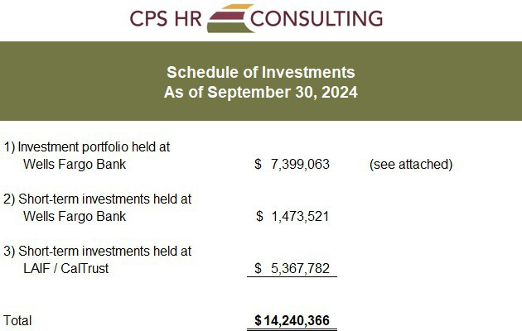
Attachment 8

Slide 55
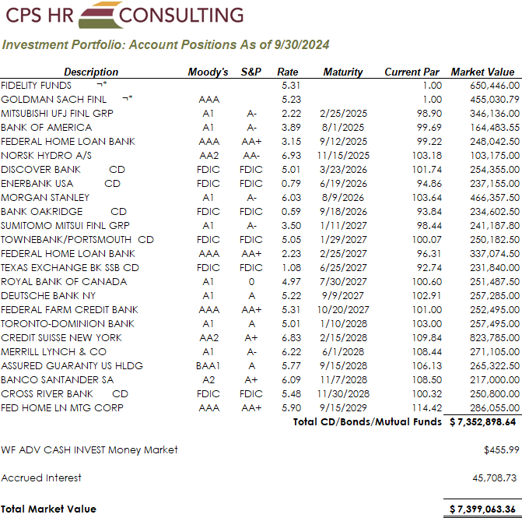
Attachment 8

Slide 56
Attachment 8
This page intentionally left blank.

Slide 57
Attachment 9
DATE:
November 8, 2024
TO:
CPS HR Consulting Board of Directors
FROM:
Jerry Greenwell, CEO
PREPARED BY:
Sandy MacDonald-Hopp, CFO
SUBJECT: Disclosure of Reimbursement for Special Districts
ACTION REQUESTED:
X Information Item
Approval and/or Authorization
Policy Change or Adoption
Closed Session Item
RELATIONSHIP TO BUSINESS PLAN:
This fulfills our requirement as a governmental agency to disclose information related to reimbursements of employee travel and expenses.
DISCUSSION:
In 1994, legislation was passed requiring special districts to disclose employee travel and expense related reimbursements (under Government Code sec. 53065.5). Accordingly, we are required to print and make available our warrant (check) list at least annually. CPS HR prints a list of all checks as part of the check run process and all lists are electronically saved to SharePoint library by fiscal year. Employee travel and expense-related reimbursements are included in each check run. The documents are public information and available for viewing by interested parties.
RECOMMENDATIONS: None, for information only.
FISCAL IMPACT: None, no expense will be incurred.

Slide 58
Attachment 9
This page intentionally left blank.

Slide 59
Attachment 10
DATE:
November 8, 2024
TO:
CPS HR Consulting Board of Directors
FROM:
Jerry Greenwell, CEO
PREPARED BY:
Dana Henderson, Executive Assistant
SUBJECT: Board Member Meeting Attendance Cost Summary – Annual Report
ACTION REQUESTED:
X Information Item
Approval and/or Authorization
Policy Change or Adoption
Closed Session Item
RELATIONSHIP TO BUSINESS PLAN:
This item is related to Board Operations rather than the Business Plan.
DISCUSSION:
As a special district, CPS HR is required to disclose expense reimbursements of at least $100 on an annual basis. This will occur as a standard annual agenda item, providing the expense reimbursement disclosure for the Board meetings for the previous year.
RECOMMENDATIONS: None, for information only.
FISCAL IMPACT: None, for information only.
Attachment 10 Page 1

Slide 60
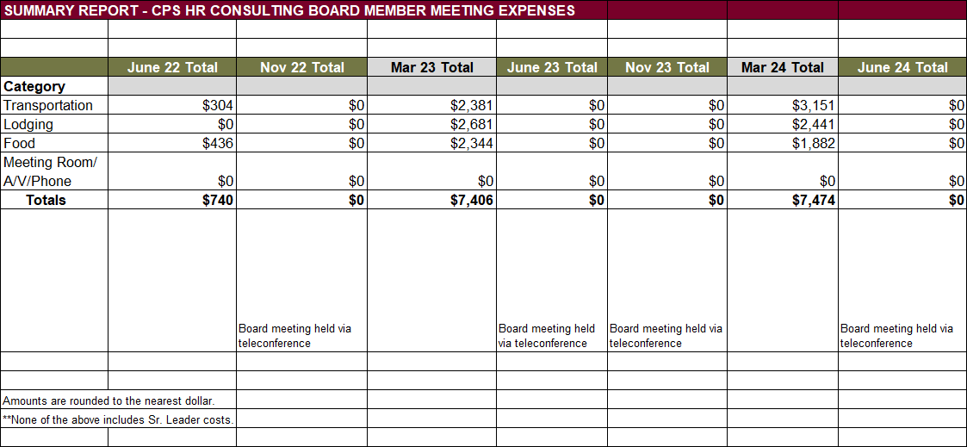
Attachment 10
Attachment 10 Page 2

Slide 61
Attachment 11
DATE: November 8, 2024
TO: CPS HR Consulting Board of Directors
FROM:
PREPARED BY:
Jerry Greenwell, CEO
Dana Henderson, Executive Assistant
SUBJECT: Return to Board Funds Update
ACTION REQUESTED:
X Information Item
Approval and/or Authorization
Policy Change or Adoption
Closed Session Item
RELATIONSHIP TO BUSINESS PLAN:
This fund is provided to promote Human Resources within board member organizations. Funds go toward improvement of management, culture, or HR function of the organization. These funds are a part of the investment CPS HR makes in our board member agencies from the Professional and Community Investment Fund segment of our operating budget.
DISCUSSION:
Board Members have typically used Return to Board Funds for:
Training, HR Conferences (i.e., SHRM, PSHRA, NASPE), workshops, webinars (travel/lodging expenses for training or conferences)
Training materials (books, DVD’s, etc.)
Employee Recognition (HR Dept. events or gifts for employee recognition)
Hardware or software for HR department
CPS HR Consulting services
HR association membership dues
Leadership Development retreat
Data services (i.e., survey reports)
CPS HR Academy or Open Enrollment Classes
Meeting facilitation
Ideally, these funds support initiatives or training that might not otherwise be budgeted for. The attached table details the remaining fund balances for each Board agency as of October 23, 2024.
RECOMMENDATIONS: None, for information only.
FISCAL IMPACT: Sufficient revenue exists to support these funds.
Attachment 11– Page 1

Slide 62
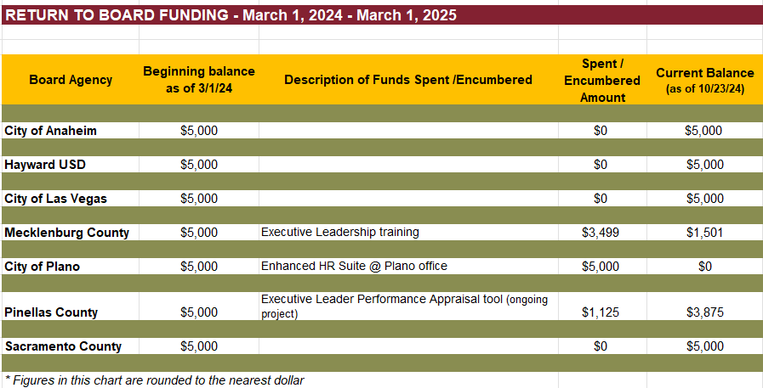
Attachment 11
Attachment 11 Page 2

Slide 63

Attachment 12
DATE:
November 8, 2024
TO:
CPS HR Consulting Board of Directors
FROM:
Jerry Greenwell, CEO
PREPARED BY:
Dana Henderson, Executive Assistant
SUBJECT: Employee Recognition
ACTION REQUESTED:
X Information Item
Approval and/or Authorization
Policy Change or Adoption
Closed Session Item
RELATIONSHIP TO BUSINESS PLAN:
The CPS HR “Make An Impact” Employee Recognition Program, which was implemented in July 2017, supports an organizational culture in which our CPS HR Guiding Values, and our strategic direction and goals are hallmarks of our individual and collective work practices. Our recognition programs reinforce these values.
The CPS HR Guiding Values are: Care For Our Customers, Care For the Organization, and Care For Each Other.
DISCUSSION:
The Team Impact Award is a team performance award focusing on the accomplishments, results, and achievements of a group of 2 or more.
The purpose of this award is to recognize stellar team performance that leads
to outstanding results, and especially noteworthy achievements in accomplishment of CPS HR strategic direction and goals.
Team Impact Award Winners since June 2024
Team Name: Hurricane Heroes!
Team Members: Cerri Mansfield, Gloria Timmons, Rachael Danke, Deanna Heyn and Pam Derby
Submitted by: Kylie Wilson
I was unfortunately impacted by Hurricane Beryl starting on the morning of Monday, July 15th and did not have power and internet, or even fully functioning cell service until it was all restored the

Slide 64

Attachment 12
evening of Friday, July 19th. Throughout this week, I would only have short snippets of cell service to try and access my files to download offline while also trying to use the wi-fi in my car and keep the battery level up for my laptop with a car charger. These wonderful people assisted me with finalizing a candidate report; conducting a screening interview; scheduling candidates for semi- finalist interviews; finalizing two recruitment brochures to get live on a Job Board; approving the advertising and eblasts for three recruitments; and reaching out to my clients to let them know what was going on with me (all these clients were in 3 different states!). Not only did these "heroes" assist me with all these needs (in addition to their own work), but they also continued to provide me that calming reassurance and support that the work was being taken care of. I was beyond stressed and trying to navigate that whole week at home with my 13-year-old son and our pets, while also being one of 2.5 million others in the same boat with no power and service. I am beyond grateful and appreciative for them, not only as colleagues, but just being wonderful human beings.
Team Name: HR Roundtable (BD/Marketing, ISD and Leadership)
Team Members: Kevin Nicholson, Marisa Diaz, Alan Winscott, Gilles Laborde Lagrave, Greg Roberson, Geralyn Gorshing, Vicki Quintero Brashear, Jaclyn Padilla, Melissa Asher, and Allen Myers
Submitted by: Tiffany Bose
The first HR Roundtable was held in Sacramento on August 21st, and we wish to thank everyone that participated. In attendance we had 19 agencies and 33+ participants and your involvement directly contributed to the success of the HR Roundtable Meeting. Your contribution and support helped showcase CPS HR's abilities as a trusted advisor with our HR clients! Our thoughtful planning and execution showed how CPS HR is an innovative forward-thinking leader in public service with an interest in nurturing our relationships with our clients.
The Instant Impact Award is a recognition program that allows a supervisor to appreciate an employee's extra efforts and initiative. It requires the employee to have acted with initiative in volunteering and completing a project or assignment that is outside of their normal job duties and responsibilities.
Instant Impact Award Winners for 2024
Name: Kale Brinley
Submitted by: Jaclyn Del Carlo
I am pleased to nominate Kale Brinley for the Instant Impact Award in recognition of their exceptional work in designing, implementing, and training our team on the new Talent Assessment and Development program, as well as the new Onboarding and Development program within NEOGOV. Kale took on the challenge of transforming our talent management

Slide 65
Attachment 12
processes by creating a comprehensive Talent Assessment and Development program that is not only aligned with our strategic goals but also tailored to meet the diverse needs of our workforce. This program has already shown a positive impact on employee engagement, skill development, and overall performance. In addition to this, Kale led the design and implementation of our new Onboarding and Development program within NEOGOV. They meticulously developed the program to ensure new hires have a seamless and engaging onboarding experience, which is crucial for their long-term success and integration into our company culture. This new onboarding program is now a cornerstone of our employee development strategy, helping to foster a more connected and well-prepared workforce from day one.
What truly sets Kale apart is their commitment to knowledge sharing and employee development. They didn't just stop at creating these programs; they also took the initiative to personally train all employees on how to utilize and benefit from these new tools and processes. Through a series of hands-on training sessions and one-on-one coaching, Kale ensured that every employee, regardless of their role or technical proficiency, could confidently navigate the new systems and maximize their potential.
The immediate and significant impact of Kale's work is evident in the improved onboarding experience for new hires, the enhanced development opportunities for existing staff, and the overall boost in organizational efficiency and morale. Their dedication, innovative thinking, and ability to deliver high-quality results in a short period make them a standout candidate for the Instant Impact Award.
In summary, Kale has not only demonstrated exceptional leadership and technical skills but has also shown a profound commitment to the success of our employees and the future growth of our company. Their work has already made a lasting impact, and I wholeheartedly support their nomination for this well-deserved recognition.
Name: Sheila McAuliff
Submitted by: Vicki Quintero Brashear
Your dedication to ensuring our clients and team always have what they need is exemplary.
C & C functions seamlessly to the client because of you! While taking care of all of the balls in the air is not part of your normal responsibilities, you are always the first to step up with leadership and assistance. Thank you, Sheila!
Name: Kale Brinley
Submitted by: Jaclyn Del Carlo
It is with great enthusiasm that I nominate Kale Brinley for the Instant Impact Award, in recognition of her exceptional leadership in the implementation of the NEOGOV Core and Perform modules. Kale Brinley has not only spearheaded the design and implementation of the two modules but has been the project manager leading all data collections, communication, meetings, and

Slide 66
Attachment 12
partnerships, etc. She has also been instrumental in designing and delivering an effective training program that has streamlined our processes and enhanced our operational efficiency. Her dedication to creating a robust communication strategy and implementation timeline ensured that all stakeholders were informed and engaged throughout the transition period. The content she designed for the training modules was not only informative but also intuitive, facilitating a smooth adoption curve for all employees. Her tireless efforts have resulted in a seamless integration of NEOGOV, which has significantly improved our HR capabilities from HR data to performance evaluations and beyond. Kale's forward-thinking approach and commitment to excellence is setting HR up for future automation success. Please join me in celebrating Kale's outstanding contributions, which have not only benefited our team but have also positively impacted the entire organization.
Name: Matt Hicks
Submitted by: Greg Roberson
Matt created a macro so a complete PDF version of the candidate Official Invitation Letter (OIL) could be emailed to each candidate. For the upcoming written exam in June, delays from the City of Chicago prevented us from sending the letters via USPS, which was the standard practice for all previous exams. Candidates can receive via email and either print their letter at home or we can print a copy of their email at the exam. Comments from Lynette Conn - Thanks to your macro, we’re able to avoid a huge issue with candidates not getting their letters in time due to the City’s delay and can accept these email letters at the exam. THANK YOU!!!
Name: Megan Misasi-Randles
Submitted by: Jaclyn Del Carlo
I am delighted to nominate Megan for the Instant Impact Award in recognition of her outstanding contribution to the "Mental Health in the Workplace" presentation from an HR perspective.
Megan's dedication and expertise were instrumental in the success of this important initiative.
Megan's presentation attracted significant interest, with over 450 people registering and 220 participants attending. This high level of engagement underscores the importance and relevance of the topic she addressed.
The feedback from attendees highlights the impact of Megan's presentation:
"I was astounded by the statistical information presented! That alone can help leadership take notice of supporting employees and make it a positive experience for them when they seek services/support for their mental health needs. Thank you!!!"
"This was very useful information that I plan on implementing in my organization. Thank you!!" "I would like to say every HR person should be required to attend."
Megan's ability to convey critical information and her commitment to improving mental health awareness in the workplace were evident throughout the session. Her efforts not only educated but also inspired attendees to take actionable steps within their own organizations.

Slide 67

Attachment 12
For these reasons, I wholeheartedly recommend Megan for the Instant Impact Award. Her work has made a significant and lasting contribution to the well-being of employees and the effectiveness of HR practices.
The Impact! Award is a “Thank You” for a substantive amount of effort put forth by an eligible employee. This is a semi-formal recognition award allowing a co-worker or supervisor to appreciate an employee’s extra efforts and initiatives beyond that of a Shout Out Award. It requires the employee to have achieved something noteworthy that stands out within the otherwise understood scope of their job duties and responsibilities.
Name: Nancy Yang
Submitted by: Alan Tomassetti
On 9/19, myself, Ana Costa, and Andrea Rumbaua all had plans to be out of the office. The three of us constitute the entire project team for one particular client. Prior to logging off, I checked with the client and then attempted to perform one final action for them. Unfortunately, there was an error in a file transfer process. I either had to find and trust someone to resolve the error/resend the files or return home (and forfeit money spent, disappoint my loved ones, be sad, etc.). After asking Nancy if she had the bandwidth and detailing the situation, she gave me the assurances I needed to (begin to) de-stress and know that she would not rest until the issue was solved. She began by repeating my action steps with the addition of a (then unknown to me) potential workaround and followed-up by contacted technical support for assistance when that failed. She quickly and accurately followed the advice from technical support, verified accuracy, and kept me posted all along the way (and even forgave me for checking in a little too frequently :) ).
As mentioned previously, I had initiated the (failed) file transfer in the morning, and the client was waiting on verification of process completion before taking actions of their own to notify exam candidates of critically important information. They needed to send the notification update by EOD, with zero wiggle room. Shortly before Nancy implemented the ultimate fix, I was minutes from needing to return home (i.e., leave from the reason I took off work), address the issue myself, and be prepared to manage the client's disappointment (if that became necessary).
In all, she spent well over half her day on an issue and a project that was both unexpected and well outside her normal scope. She performed admirably, above expectations, and deserves to know the incredible Impact! she made on the project, on myself, and for the client. I cannot thank her enough!

Slide 68
Attachment 12
This page intentionally left blank.

